Slide 1
Local Veteran Employment Representative:
Job Club (Job Search Groups)
State Veterans’ Program Office
(Date of presentation) Month Day, Year

Slide 2
OBJECTIVES
Job Club Definition
Benefits
Types of Job Clubs
Joining a Job Club
Questions and Answers
Creating A Job Club

Slide 3
WHAT IS A JOB CLUB?
A Job Club is a group that helps members find meaningful employment.
Members of Job Clubs support each other.
Members have the opportunity to network.

Slide 4
WHY ARE JOB CLUBS IMPORTANT?
Job Clubs can help experienced members find positions that match their career goals and interests.
2
Job Clubs provide all members with the opportunity to learn valuable skills from other members.
3
Job Clubs can help members with minimal professional work experience find organizations that are looking for entry-level candidates.
1

Slide 5
WHAT ARE THE BENEFITS OF JOB CLUBS?
The most obvious benefit of a Job Club is that it provides you a space to get advice on your job search.

Slide 6
WHAT ARE THE BENEFITS OF JOB CLUB?
Members can give feedback on resumes and cover letters.
Help prepare for interviews.
Get insight into newer technology.
Provide an informal place for networking.
Help encounter new people.
Participants can be directed to current job openings.

Slide 7
WHAT ARE THE BENEFITS OF JOB CLUBS?
Job searching can be overwhelming!
Job club:
Provides support during stressful time.
Encourages interaction.
You are not alone.

Slide 8
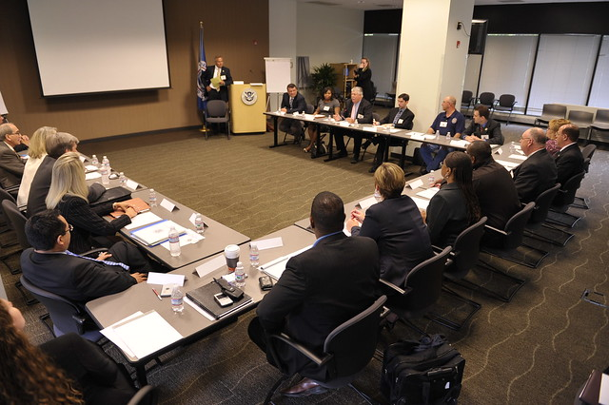
Formal
WHAT ARE THE TYPES OF JOB CLUBS?
A Formal Job Club:
Have executive boards, monthly dues, required meetings, etc.
A more formal Job Club may be moderated by a career counselor or other career expert.
Job Clubs vary in many ways.

Slide 9
Informal
WHAT ARE THE TYPES OF JOB CLUBS?
An Informal Job Club:
Offer a space for people to talk about their job search experiences.
Many Job Clubs fall somewhere in the middle.

Slide 10
Specific
WHAT ARE THE TYPES OF JOB CLUBS?
Some Job Clubs cater to specific types of job seekers, such as people looking for jobs in one industry.
Other Job Clubs are for specific groups of people, such as Job Clubs for women.
Job Clubs are often based around a geographic location.

Slide 11
Enhanced
WHAT ARE THE TYPES OF JOB CLUBS?
Enhanced Job Clubs aim to match members with careers that interest them.
An enhanced Job Club may help members apply to several positions that interest them.

Slide 12
Traditional
Traditional Job Clubs attempt to match members with many types of suitable positions.
A traditional Job Club may help members apply for many jobs.
WHAT ARE THE TYPES OF JOB CLUBS?

Slide 13
Continuous
WHAT ARE THE TYPES OF JOB CLUBS?
While other Job Clubs may only operate for a certain period, continuous Job Clubs operate until all members find employment.
Continuous Job Clubs may also continue to operate indefinitely, so long as there are members attending meetings.

Slide 14
Remote
WHAT ARE THE TYPES OF JOB CLUBS?
Remote Job Clubs meet via teleconferencing software instead of in person.
This is a good option for Transitioning Service Members or Veterans interested in relocating.
Notes:
These clubs allow members from around the world to meet, providing unique opportunities for development.

Slide 15
Perspective Members
HOW DO WE CREATE A SUCCESSFUL JOB CLUB?
Clubs should have 8-12 members
Not everyone must be unemployed
Job club can serve members in different industries
Mix up the ages

Slide 16
The Process
HOW DO WE CREATE A SUCCESSFUL JOB CLUB?
Invite
Invite individuals to join
Choose
Choose a good time and location
Guest
Invite guests to speak at meetings
Keep
Keep it light/ Keep it focused/ Keep it professional
Track
Track progress

Slide 17
Purpose of a Job Club
CREATING THE JOB CLUB
Be encouraged, inspired, energized, educated, evaluated, and accountable.
Notes:
It is NOT a place to complain about the job search or to wallow in self-pity.
There is always a time and place to share disappointments

Slide 18
Consider the Goals
WHAT TO CONSIDER WHEN CREATING A JOB CLUB?
Consider how closely the job seeker’s goals align with the goals of specific Job Clubs.
Determine the job seeker’s personal goals before joining a Job Club.

Slide 19
WHAT TO CONSIDER WHEN CREATING A JOB CLUB?
Determine the Connection
Do some research on?
Job seekers with similar career goals and interests may provide valuable networking opportunities.

Slide 20
Consider the Duration
WHAT TO CONSIDER WHEN CREATING A JOB CLUB?
Some Job Clubs last for a certain number of weeks or days while other clubs exist until all members find employment.

Slide 22
STATE VETERANS’ TEAM
Exit Smith, State Veterans’ Program Coordinator
Email: Exit.Smith@DEO.MyFlorida.com
Mark Brennan, Regional Veterans’ Program Coordinator
(LWDBs 1-8) | Email: Mark.Brennan@DEO.MyFlorida.com
Greg Tudor, Regional Veterans’ Program Coordinator
(LWDBs 9-16) | Email: Gregoy.Tudor@DEO.MyFlorida.com
Awilda Carozza, Regional Veterans’ Program Coordinator
(LWDBs 17-24) | Email: Awilda.Carozza@DEO.MyFlorida.com
Eric Ocasio, Regional Veterans’ Program Coordinator (IPA)
Email: Eric.OcasioNieves@DEO.MyFlorida.com

