Slide 1
JVSG
Connecting with Employers through External Job Postings in Employ Florida
State Veterans’ Program Team

Slide 2
What is OFCCP?
OFCCP: Office of Federal Contract Compliance Programs
OFCCP protects workers, promotes diversity and enforces the law.
OFCCP holds those who do business with the federal government (contractors and subcontractors) responsible for complying with the legal requirement to take affirmative action.
Notes:
In addition, contractors and subcontractors are prohibited from discharging or otherwise discriminating against applicants or employees who inquire about, discuss or disclose their compensation or that of others, subject to certain limitations.

Slide 3
Affirmative Action
Must not discriminate based on:
Race
Color
Sex
Sexual Orientation
Gender Identity
National Origin
Disability
Status as a Protected Veteran
Notes:
41 CFR § 60-1.4 and 60-4.3 Equal opportunity clause.

Slide 4
Connecting with Contractors
VEVRAA: Federal contractors are required to list “all employment openings” with the appropriate Employment Service Delivery Systems (ESDS) where the job opening occurs.
All job openings with three exceptions:
Executive and Senior Management
Positions filled internally
Positions lasting 3 days or less
Notes:
ESDS: EF, AJC,Unemployment office

Slide 5
External Jobs in Employ Florida
External postings in Employ Florida are a hidden asset
These jobs can lead to placements for Veteran job seekers
The postings can be connected to existing Employ Florida Accounts
Notes:
ESDS: ef, ajc< Unemployment office

Slide 6
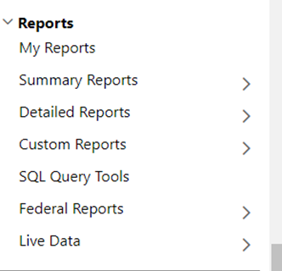
Locating External Daily Jobs in Employ Florida
Sign in to Employ Florida with employee credentials
Go to the reports tab on the left side
Click on Custom Reports
Click on State Performance

Slide 7
Locating External Daily Jobs in Employ Florida
Scroll down to the State Performance tab
Click on Florida
Click on Daily Job Openings

Slide 8
Locating External Daily Jobs in Employ Florida
Locate The
Search Area
Locate the search area Click run report
Run Report

Slide 9
Locating External Daily Jobs in Employ Florida
This report shows all the external jobs that are currently in this region in Employ Florida
Click on the highlighted numbers and the full report will display
These jobs are not directly associated with any EF employer account.
External Jobs in EF

Slide 10
Getting the Most From the Report
99% Of these are Federal Contractors Posting under VEVRAA Rules
NLX: National Labor Exchange. 99% of the employers that use the NLX are federal contractors and are obligated under OFCCP Requirements to post jobs in EF.
This is an effective way to locate federal contractors in EF and establish a relationship with them.

Slide 11
Questions & Answers

