Slide 1
Reporting Fraud – Case Managers
Welfare Transition (WT) and Supplemental Nutrition Assistance Program (SNAP)
Notes:
We’d like to welcome you to the Welfare Transition, or WT, and Supplemental Nutrition Assistance Program’s, or SNAP’s, Reporting Fraud for Case Managers Webinar. This training is being brought to you by the Florida Department of Economic Opportunity or DEO, and in this training, we will focus on the new procedures for reporting and submitting vital information for cases suspected of fraud.

Slide 2
Commonly Used Terms
Fraud
Public Assistance Fraud (PAF)
FLORIDA
CLRC screen
OSST
Alternative Plan
Case Notes
Notes:
Here are a list of some commonly used terms and acronyms that will be addressed throughout this presentation. You should be familiar with these terms and acronyms by the end of this presentation.

Slide 3
What is Fraud?
Fraud is best defined as: A false representation of a matter of fact—whether by words or by conduct, by false or misleading allegations, or by concealment of what should have been disclosed—that deceives and is intended to deceive another.
Notes:
Let’s define what we mean when we say “fraud” for the purposes of this presentation. Fraud is best defined as the act of deceiving or misleading something or someone to achieve an outcome of an undeserved gain.

Slide 4
What is Public Assistance Fraud?
Notes:
The part that particularly relates to the WT and SNAP work programs and the services we provide are located in section 414.39 (1) (a), (b), and (c), Florida Statutes.

Slide 5
Florida Statute 414.39 1(a)
Notes:
Altered documents can be considered misrepresentation and impersonation. Altering a document or forging a document to receive public assistance, including services, under any state or federally funded program, is considered fraud.

Slide 6
Florida Statute 414.39 1(b) (c)
Notes:
Section 414.39 (1)(b) of the Florida Statutes states:
Failure to disclose a change in circumstances in order to obtain or continue to receive any such public assistance (this includes services) to which he or she is not entitled or in an amount larger than that to which he or she is entitled or
(C) – Aids and abets another person in the commission of any such act is guilty of a crime and shall be punished as provided in subsection (5)

Slide 7
Public Assistance Fraud Warning
Notes:
DEO and the Department of Children and Families, or DCF, are both serious about discouraging fraud and fraud attempts. Customers applying and recertifying for public benefits are made aware that fraud and attempted fraud are prosecutable and could lead to disqualification for public assistance benefits.

Slide 8
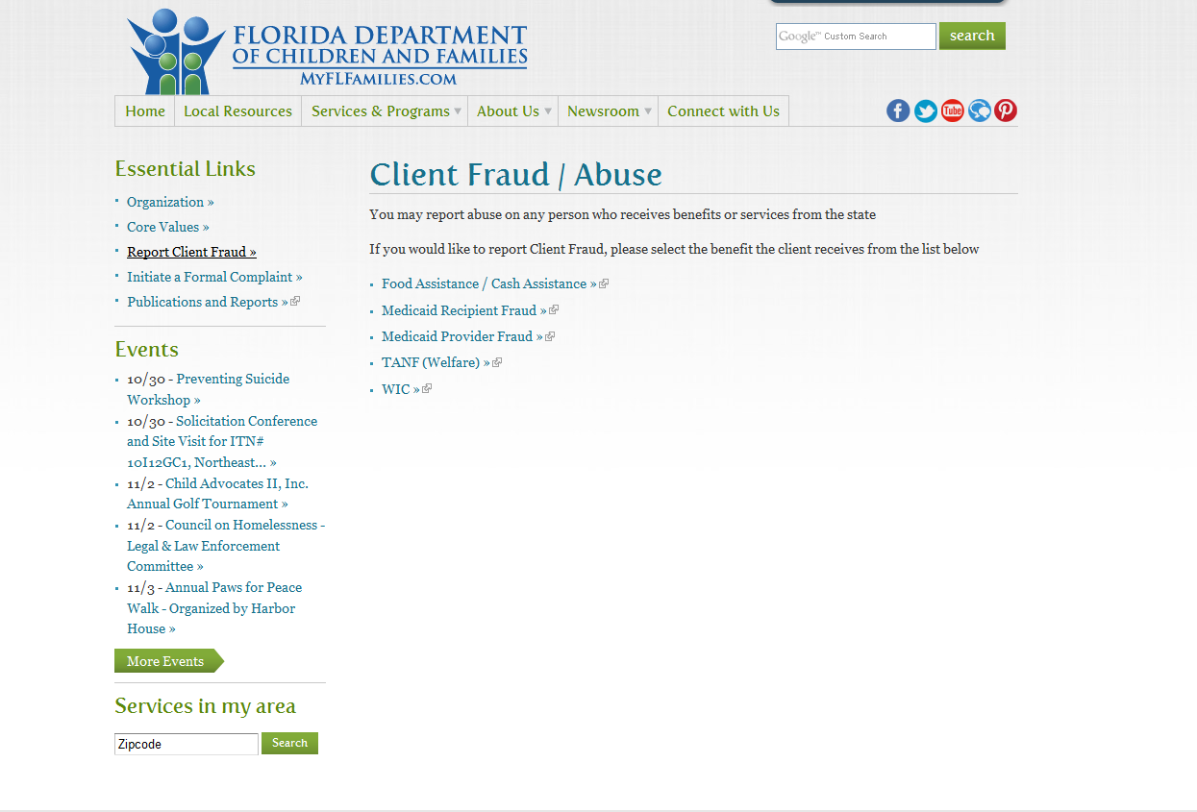
Public Assistance Fraud
Notes:
In addition to the Public Assistance Fraud Warning on DCF’s website, DCF has provided the ability for citizens to report instances of fraud or suspected fraud. These options are available to anyone wishing to report fraudulent activity. The site offers two types of fraud reporting: formal and general. There is a formal complaint form (found on the left hand side of the screen under Report Client Fraud). This process is not anonymous and requires detail.
There is also the hyperlinked options to report “Food Assistance/Cash Assistance” and “TANF (Welfare)” fraud – which are anonymous.

Slide 9
Formal Complaint – Employees
http://www.myflfamilies.com/about-us/office-inspector-general/formal-complaints
Notes:
The link “Initiate a Formal Complaint” on DCF’s Website is for reporting suspected fraud by DCF employees, including Department contracted providers. To initiate a formal complaint, the complainant will click on the “Inspector General Complaint Form.” It also provides general information about the Whistle-blower’s Act, which can be found in Florida Statutes sections 112.3187-112.31895. To learn more about reporting formal complaints, please visit DCF’s website.

Slide 10
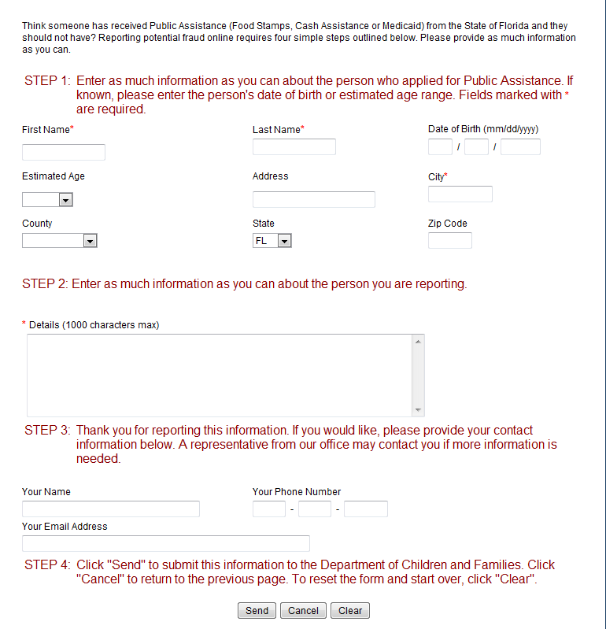
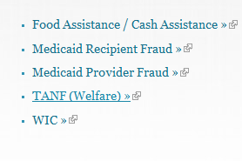
DCF Fraud Reporting - General
Notes:
DCF’s General Fraud Reporting can be accessed by clicking on the applicable hyperlink. After selecting one of these options, the user will see a screen that has four steps. Elements such as name and city are required. Information such as name and phone number can be provided; however, this information is not required. Since it is an online form, a person can submit the report and no further action is required from the person making the report.

Slide 11
DEO’s Fraud Reporting Process
Notes:
DEO and DCF have teamed up to provide a formal way to report suspected incidents of fraud by customers participating in the SNAP and WT programs. The process involves reporting suspected fraud directly into DCF’s FLORIDA system.

Slide 12
Identifying Potential Fraud
Case managers are generally made aware of potential fraudulent activity by conducting follow-ups with
Work site supervisors
Employers
Schools
Doctor Offices
Notes:
Case managers are generally alerted to potential fraud when they are conducting progress follow-ups and employer satisfaction on customers who are assigned to various activities. They may also be alerted to potential fraud while verifying other documentation submitted by a participant.

Slide 13
Example
Carol has been assigned to complete 25 hours a week of work experience since 6/4
She has turned in signed timesheets every week since 6/4 showing 25 hours per week
Case manager contacts the worksite supervisor on 7/2 to follow-up on Carol’s progress
The supervisor tells the case manager that Carol has not been to the site since 6/8
Carol hasn’t been to the site since 6/8, but she has turned in a signed time sheets through 6/29 showing 25 hours of participation each week
What should the case manager do next?
Notes:
Let’s use Carol as an example. Carol has been assigned to complete 25 hours a week of work experience since June 4. She has turned in signed timesheets every week since June 4 showing that she has completed 25 hours per week. On July 2, Carol’s case manager contacts the worksite supervisor to follow up on Carol’s progress. During the follow up, the supervisor informs the case manager that Carol has not been to the site since June 8. What should the case manager do next based on the information she has received?

Slide 14
Case Manager’s Steps
Review documentation
Activity start date
Discovery date
Find out who has been signing the time sheets
Mail a notice of failure and make an oral attempt to inform customer of failure
Determine if Carol has good cause for missing the activity
Notes:
In this example, the case manager would review the participant’s case file. A review of the information would include looking at when the participant started the activity. The case manager would take into consideration the discovery date, which could be best described as the date the case manager found the discrepancy. The case manager might also try to find out who has been signing the time sheets. Since the case manager learned that the customer had not been attending the activity, he/she would need to determine a failure date and mail the Notice of Failure to Comply (form 2290) to the participant. The failure reason cannot be “suspected fraud”. The case manager would enter a failure reason such as “failed to attend worksite” and indicate a specific date, not a date range. The failure and the failure date must be specific. The case manager would also make an oral attempt to contact the customer if good cause exists for the failure.

Slide 15
When fraud is suspected
If a case manager suspects fraud he/she will need to determine the following:
The time frame of the suspected fraudulent activity
The monetary value associated with services received during the investigation period
This includes
Transportation assistance for the time period
Childcare assistance for the time period
Cash assistance and food assistance amounts received for the time period
Notes:
Once the research of the participant’s case has been completed and the case manager suspects fraud, he/she should ensure that the following factors have been thoroughly identified. The time frame of the suspected fraudulent activity must be addressed. Additionally, the case manager will evaluate the monetary value associated with this investigation to be inclusive of the total of all monies for services rendered to the participant during this period.

Slide 16
When fraud is suspected
Once all information is gathered, program staff will
Case note the events
Work site
Doctor’s office
School
Gather supporting documentation
Statements, as needed
Provide the report to the Local Fraud Designee
Notes:
The case manager will prepare available documentation to support the suspected fraud and case note the event(s) in the One-Stop Service Tracking, or OSST, system in detail. Copies should be submitted to the Local Fraud Designee in your region, and you should also retain copies of the documentation in the participant’s case file.

Slide 17
Fraud Referral Template
Notes:
We have created a template for regions to use to make fraud referrals. Program staff will use this template to make a referral for fraud. The form will be provided to the regional designee along with copies of all supporting documentation as stated previously in this presentation.

Slide 18
Fraud Referral Template
Notes:
The second page of the fraud referral template allows the individual reporting fraud to select from common support services provided by the WT and SNAP work programs. The user also can choose a date range using the calendar feature to calculate the amounts associated with each service for the suspected fraud date range. The form will calculate the total amount of services received by the participant during the suspected fraudulent period.

Slide 19
Commonly Asked Questions
What happens once we refer a case for Public Assistance Fraud?
Notes:
What happens after we refer a case for the Public Assistance Fraud unit? Let’s take a closer look at this process.

Slide 20
Fraud Referrals – Benefit Recovery
DCF Benefit Recovery Review
Public Assistance Unit Fraud Review
Disqualification Hearing
State Attorney Prosecution
Notes:
After we refer a case in FLORIDA, the case goes to its first stop which is the DCF Benefit Recovery Unit. Although all fraud referrals move on to the next step, this unit is responsible for reviewing the case to see if an evident overpayment has been made. If there is an evident overpayment (not due to fraud), they will start a benefit recovery record, notify the customer that an overpayment has been made, and notify them that the department will start recovering the overpayment amount. This is often accomplished by withholding a little of their monthly cash or food assistance benefit until the overpayment is recovered.

Slide 21
Fraud Referrals
DCF Benefit Recovery Review
Public Assistance Unit Fraud Review
Disqualification Hearing
State Attorney Prosecution
Notes:
After the recovery unit conducts its review, it goes to the Public Assistance Fraud or PAF unit. This group reviews the case to determine whether or not the case will be referred for a disqualification hearing or to the State Attorney’s Office to prosecute for PAF. We will discuss more about how that determination is made.

Slide 22
Fraud Referrals – Disqualification Hearing
DCF Benefit Recovery Review
Public Assistance Unit Fraud Review
Disqualification Hearing
State Attorney Prosecution
Notes:
Disqualification hearings occur when the PAF unit determines that intentional fraud took place, but the amount the recipient fraudulently received wasn’t enough to send to the state attorney for prosecution. To determine if the fraud was intentional or not, the PAF unit will conduct a thorough review, including
Reviewing documentation collected by the RWB
Interviewing the case manager that made the discovery
Interviewing workforce staff that may have had contact with the customer regarding the suspected fraudulent activity
If forgery is involved, they will interview the injured party (work site supervisor, employer, instructor or physician)
Asking the RWB to provide documentation for events leading up to discovery and events that occurred after discovery

Slide 23
IPV Levels
Notes:
Intentional Program Violation, or IPV, consists of 3 levels. Individuals found to have committed an IPV will lose their eligibility of receiving benefits for a specific amount of time, based on the number of violations they have committed.

Slide 24
IPV Levels
Level 1
Level 2
Level 3
Permanent disqualification
24 month disqualification
12 months disqualification
Notes:
If it is the customer’s first violation, they may be disqualified from the program for 12 months. A second violation carries a disqualification period of 24 months. A third violation may result in a permanent disqualification from receiving public benefits.

Slide 25
Fraud Referrals – State Attorney
DCF Benefit Recovery Review
Public Assistance Unit Fraud Review
Disqualification Hearing
State Attorney Prosecution
Notes:
A case may be referred to the State Attorney for prosecution depending on the amount of benefits and services the customer received as a result of the fraudulent activity. The customer may be prosecuted for public assistance fraud.

Slide 26
Fraud Reporting Responsibilities – Case Manager
Case note events in OSST
Start the Pre-penalty process if appropriate
Complete fraud report - keep a copy for participant’s file
Submit a copy of the fraud report to Regional Designee
Enter general note in FLORIDA (CLRC)
Notes:
If the case manager suspects fraudulent activity has occurred, they should first make a case note explaining the situation and why the participant is suspected of fraud. Once the case note is complete, the case manager should initiate a pre-penalty if the participant failed complete a requirement. Next, you will be to complete the fraud report, gather all documentation that pertains to the suspected fraudulent activity, and make a copy of all the materials so you can submit it to your Regional Designee and retain a copy to remain in the participant’s case file. Lastly, you will enter a general note in the FLORIDA CLRC screen explaining the events surrounding the suspected fraud.

Slide 27
Fraud Reporting Responsibilities - Designee
Complete BVBR Screen in FLORIDA
Print a copy of the BVBR screen for RWB records
Provide a copy to Case Manager
Keep a copy of the Case Manager’s referral form and BVBR screen for your records
Notes:
Once the case manager has submitted a copy of the fraud report to the regional fraud designee, the fraud designee will complete the BVBR screen in the FLORIDA system. The designee will print copies of the BVBR screen, one to keep and another copy for the case manager so the information can be stored in the participant’s case file.

Slide 28
What will you need???
You will need the following information
Suspected fraud date range
Estimated monetary value for the suspected date range for everything the participant received during the time period, including the value of
Transportation
Childcare
Other support services or local incentives awarded to customers for participation
Cash assistance amount for the time period
Food assistance amount for the time period
Notes:
Remember, to make a fraud report, you will need some crucial information. You will need
The suspected fraud date range
An estimated monetary value for the suspected date range for every service that the participant received during the time period. These services include transportation assistance, the dollar amount for childcare , cash assistance received during the fraudulent time period, food assistance during the fraudulent time period, and any other supportive services or local incentives awarded to customers for participation.

Slide 29
Case Note Events in OSST
Once you have assessed the suspected fraud time frame, you will create a case note in OSST:
Date range of suspected fraud
Date the notice of failure was mailed
Notice should include the exact failure and failure date
Oral attempt was made to notify participant of the failure and to see if they have good cause for the failure
Notes:
After you gathered all of your information and suspect fraudulent activity has occurred, you would enter a case note in OSST. The case note in OSST will allow the case manager to record vital information concerning the referral. It is important that you attempt to communicate with the customer to address the failure and counsel them to see if good cause exists.

Slide 30
Initiating the pre penalty process
Notes:
Upon completion of the case note, you would then start the pre-penalty process and complete the Fraud Referral Template. To start the pre-penalty process, you would log on to OSST, search for the participant’s case, and select the “Add” button under the Sanction section in the Alternative Plan screen. It is important to note that we do NOT start the pre-penalty process because we suspect the participant has committed fraud. Pre-penalties are put in place because a participant has failed to complete an assignment or activity. You must set a specific failure date for the participant when beginning the pre-penalty process, which would be the most recent date the participant has failed to participate in the program.

Slide 31
Fraud Referral Template
http://www.floridajobs.org/PDG/Memos/CompletingtheFraudReferralForm.pdf
Notes:
You can refer to the DEO website for a step guide for completing the Fraud Referral Form. The address can be found at the bottom of this screen.

Slide 32
Give Designee the fraud report
Make a copy of all documentation of the fraud report
Place a copy in the case file
Give a copy of the fraud report to the Regional Designee who enters the information in the FLORIDA system
Notes:
It is important to make a copy of all the documentation you will be presenting to refer the case for fraud. Place one copy in the participant’s case file and provide an additional copy to the Regional Designee.

Slide 33
Enter Event Notes in FLORIDA
Enter the events in FLORIDA’s CLRC screen:
Date range of suspected fraud
Date the notice of failure was mailed. Notice should include the exact cause of failure
Notes:
The final step would be to enter the event notes on the FLORIDA CLRC screen. The case manager is responsible for entering the same information located in the OSST case note.

Slide 34
Enter Event Notes in FLORIDA
Notes:
Here is an example of event note included on the CLRC screen.

Slide 35
Questions?
Please Contact us at
1-866-352-2345
An equal opportunity employer/program. Auxiliary aids and services are available upon request to individuals with disabilities. All voice telephone numbers on this document may be reached by persons using TTY/TDD equipment via Florida Relay Service at 711.
Notes:
For any additional questions, please contact us at 1-866-352-2345.

