Slide 1
Effective Case Management
Welfare Transition (WT) Program,
Division of Workforce Services
Bureau of One-Stop and Program Support
February 2024
Notes:
Good morning/afternoon:
Welcome to the Florida Department of Commerce or Florida Commerce’s Welfare Transition (WT) program presentation Effective Case Management. At the end of this presentation, you will be provided with an opportunity to ask questions.

Slide 2
OBJECTIVES
Define Case Management
Skills and Requirements
Case Management
Strategies
Notes:
We will define case management, discuss some vital skills and requirements needed, and ask for your assistance in sharing your case management strategies to help manage our WT participants.

Slide 3
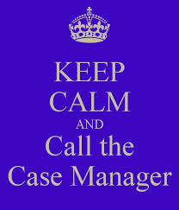
Calling All Case Managers
Notes:
By show of hands, how many of you are case managers/consultants, etc..? How many of you have been in this capacity for five or more years? You are now looking at the experts and make sure you speak with them before leaving!
Your role as a case manager is very important because you are the first impression to the program; you are change agents because you help to influence change. Each day, WT participants come to you for help and hope, and you strive to help people in need to help themselves to become self-sufficient. This is by NO means always an easy task.
Case managers are an essential part of the service delivery and success of this program, and the skills and values that you devote daily are the driving force for the WT program.

Slide 4
Life of a WT Case Manager
You will never be bored.
You may sometimes be frustrated.
You will be surrounded by challenges with so much to do and so little time.
You will carry immense responsibility and very little authority.
You will step into people’s lives, and you will make a difference. Some will bless and some will curse you.
You will see people at their worst and their best.
You will never cease to be amazed at people’s capacity for love, courage, and endurance.
You will experience resounding triumphs and devastating failures.
You may laugh and even cry sometimes.
Yet, you will know what it is to be human and what it means to be humane.
Notes:
These words capture the many experiences of a dedicated case manager. This situation is what you may truly experience. It takes a special kind of professional to work with our WT population. There is an old expression that states, “People don’t care how MUCH you know, until they know how MUCH you care.”
Case management functions as a partnership and case management is a participant-centered process. It begins with the participant and then it uses certain tools to move the WT participant to becoming self sufficient.

Slide 5
WHAT IS CASE MANAGEMENT?
Notes:
Case management is the coordination of services on an individual’s behalf with an anticipated outcome. It functions as a partnership between you and the WT participants.

Slide 6
CASE MANAGEMENT
Notes:
When you think about case management, you should think in terms of process. There are several common components that should be included in the management of participants. Every participant must be assessed, per the Code of Federal Regulations (CFR) at 45 CFR 260. Following an assessment is the planning phase where you being to develop goals with the participant. Once goals have been set, case managers should align available resources or requirements of the program to meet established goals and result in positive outcomes to include employment. Overall, we want participants to walk away with a different sense of self and well-being. To that end, self-determination is key. Once this has been achieved, the participant has been empowered to do and achieve more.
Although WT participants are required to participate in work activities to receive their benefits, their buy-in is an essential contributor to the success of case management and its outcomes. Participant reimbursements help increase overall participation which typically lead to better outcomes.

Slide 7
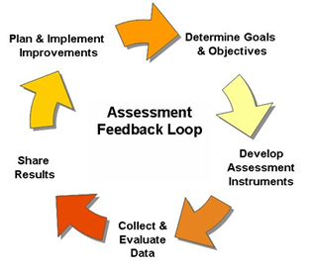
Assessments
Skills and Requirements
Notes:
Assessments are probably the single most important step in the process of case management. It includes the process of current conditions and needs of the participant. After all, how do you know where you’re going if you don’t have any direction or guide? Assessments allow case managers to uncover current needs of participants. It gives you an opportunity to begin building rapport with your participant to see how to best place them in activities that will benefit them in the long run. It is during an assessment that you get a bird’s eye view of the participant’s education, employment history, and other circumstances that may help or hinder their progress through the program. All assessments must be reviewed with the participant to gain a clear understanding of the information provided. Simply noting completion of this activity is not acceptable for on-going case management.

Slide 8
PLANNING – GOAL DEVELOPMENT
Notes:
When participants are referred to the WT program, they are required to meet certain requirements to continue receiving TCA benefits. However, the end goal for our participants is to go beyond assisting them with simply receiving benefits and help them gain skills that are marketable and transferable, to lead them into gainful employment. For these reasons, goal development is pertinent to the process. Participants should be allowed an opportunity to express desires of skills and activities they want to achieve and, with the assistance of the case manager, turn those into workable goals to maneuver through the program. The SMART methodology provides an effective framework to help develop goals that will be user friendly and usable. (Discuss in greater detail with audience).

Slide 9
Customer - Case Manager Rapport
Notes:
Case management is no easy task. There are several rules, policies, and time constraints that sometimes make completing tasks seem nearly impossible. We encourage you to remain flexible in your approach without straying too far from your guiding principles. If you have a participant whose timesheet must be submitted every other Friday and they miss one Friday because something came up, have some flexibility and leniency, within the guidelines. For instance, you might reach out with a phone call or a reminder of the task earlier in the day. Of course, we want participants to be accountable, but not so much that we create tense working relationships or create additional hardships for participants. Always take time to put the shoe on the other foot. If there are circumstances where you can help, choose that route.
Be flexible. Work with your participants because it is a partnership!

Slide 10
Tools for Case Management
Notes:
There are some essential tools that will help you keep track of the WT participants and their progress in the program.

Slide 11
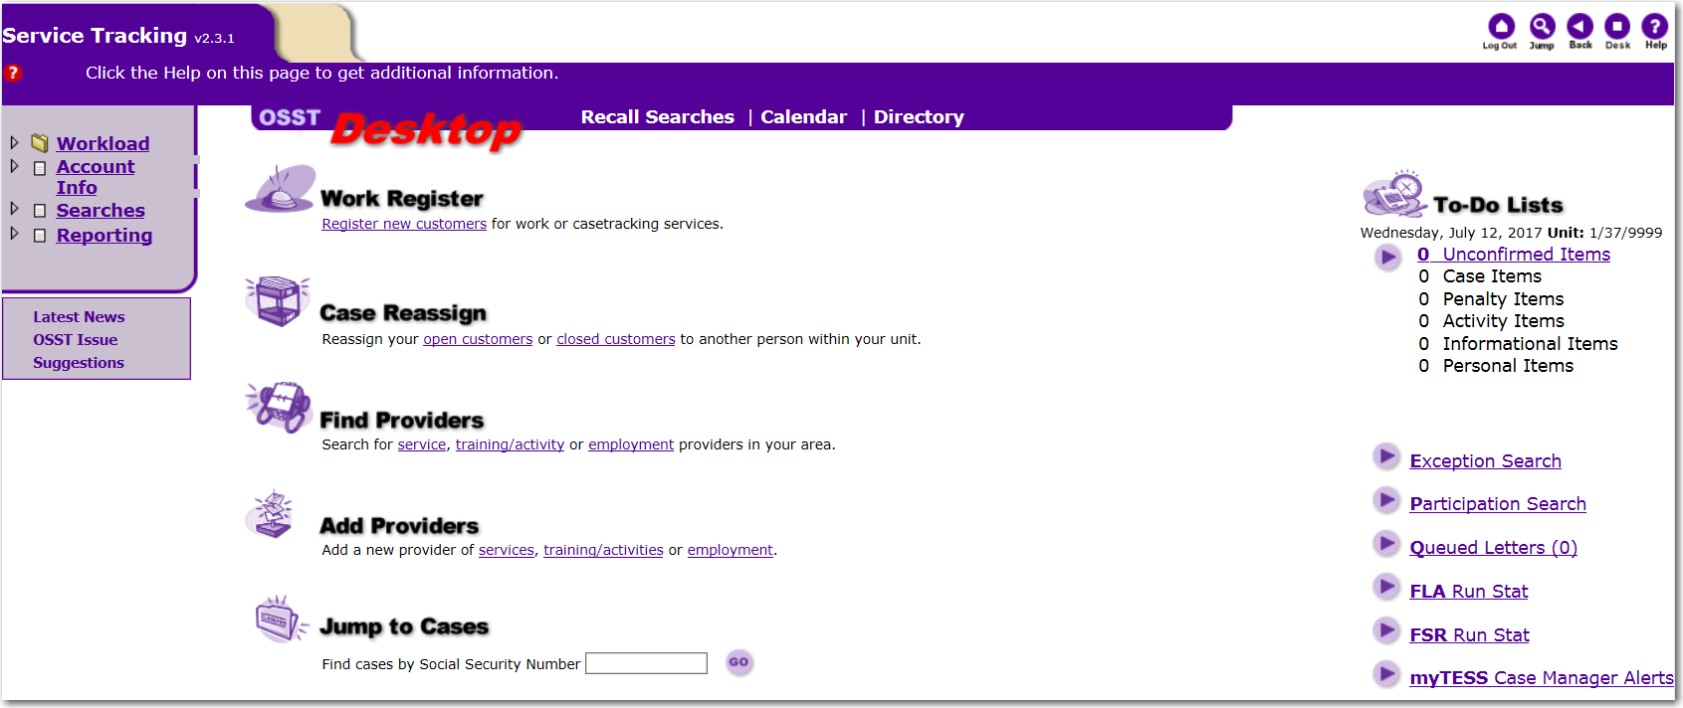
Tools of Case Management
Notes:
The One-Stop Service Tracking system, OSST, is your great friend, because you depend on it to assist in working with the WT participant. It is a comprehensive system that tracks all the many components for customers, from A to Z.

Slide 12
Writing Effective Case Notes
Notes:
Have you ever heard this statement, “If it’s not written, it did not happen”? Case notes are an essential task that all case managers must do to better serve participants. Case notes help fill in the gaps that are not captured by other fields in OSST, such as activity codes. Case notes provide a free space to explain incidents that have occurred with the participant, requests that have been made, or other means of communicating issues that may need to be shared beyond the local area. Specificity is key when writing case notes. Vague or general statements that provide no detail to the events that have occurred aren’t efficient or helpful. It is vital to ensure your case notes are well written, grammatically correct, and acronyms are spelled out the first time they are used.

Slide 13
WRITING EFFECTIVE CASE NOTES
Exercise discretion in the content
Withhold specific medical or mental illness diagnosis
Content should be summarized, not exhaustive
Refrain from subjective statements
Notes:
Case notes also require case managers to exercise caution when entering information in the system. Information related to medical conditions, personal opinions, or judgements are not permissible uses of case notes. If participants indicate they have a medical condition that prevents them from participation, your case note should never specify a specific condition, but refer the reader to see their physical file. After all, a medical condition that may prevent participation must be handled by DCF, so a case note specifically describing a participant’s condition would not benefit our system of service. Case notes must be detailed without being exhaustive. It is better to have too much rather than not enough, but there is a fine line between concise and wordy. Aim for comprehensive summaries while leaving out extraneous information. Additionally, case notes should never include opinions or subjectivity. They should be written objectively, focusing on a participant’s progress with the employment and training program, and never address feelings about a participant.

Slide 14
Best Practices Strategies
Notes:
Although we have not exhausted everything in reference to the role and responsibilities of case managers, we have touched on many important areas. Can someone share any best practice strategy or strategies that is incorporated in your LWDB? How has it helped to improve delivery to your participants? Do you share these practices with others? Don’t forget about the importance of networking and sharing.

Slide 15
Questions & Answers
Notes:
Are there any questions?

Slide 16
Contact Us
Thank You.
If you have questions or comments about this presentation, please contact us
DEO Division of Workforce Services
One-Stop & Program Support
Main Line: 850-245-7240
Email: WTProgram@commerce.fl.gov
Notes:
This concludes the presentation on Effective Case Management. If you have questions about this presentation or questions about the WT program, in general, please contact us at WTProgram@commerce.fl.gov.

