Slide 1
SOUTH FLORIDA WORKFORCE
Region 23
Welfare Transition
Review Tool

Slide 2
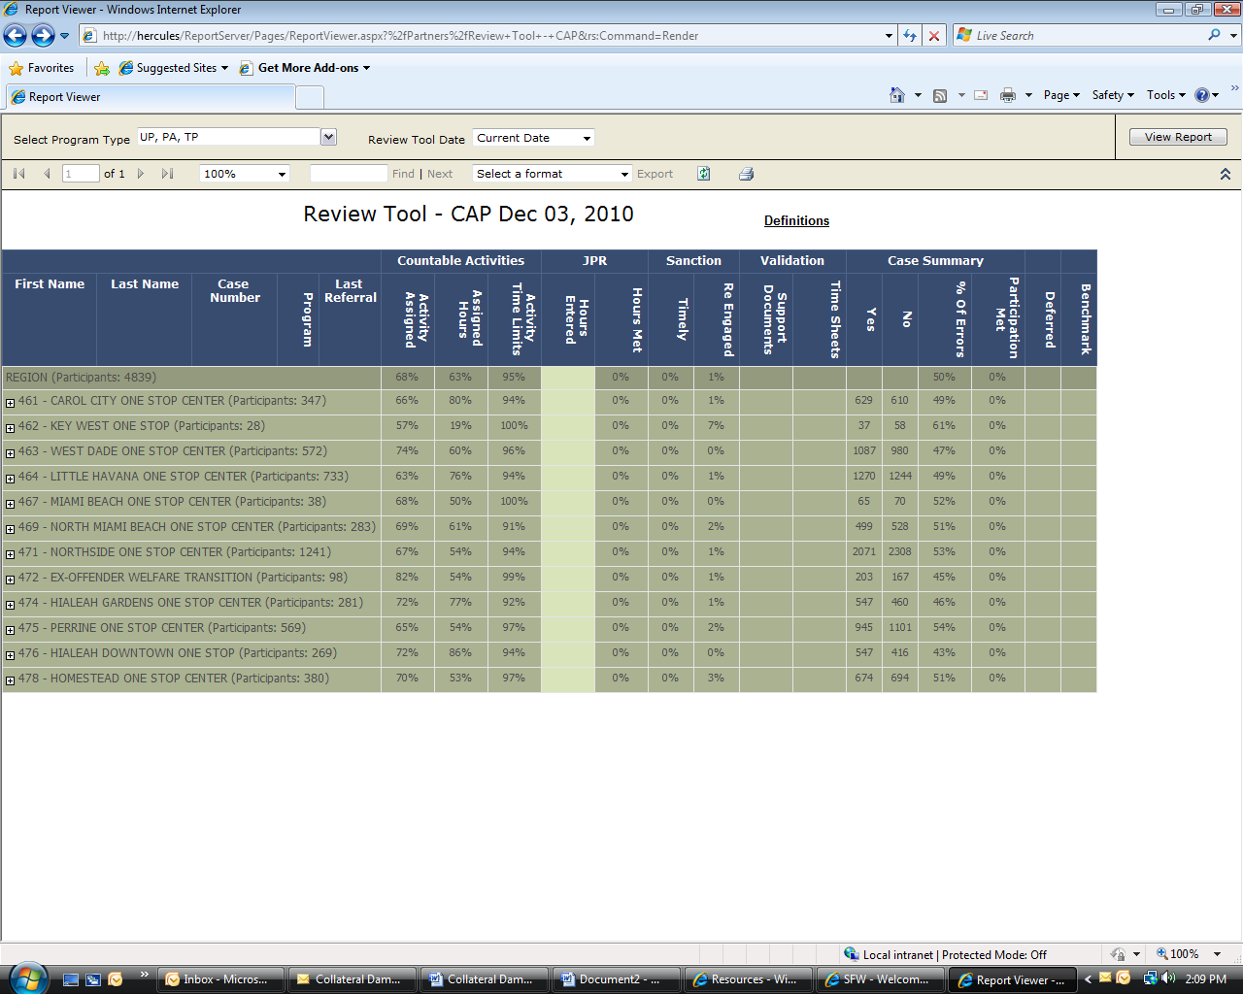
FEATURES
Select the program TYPE
See Definitions
Select the Month to Review
Choose To Export
Program Topics
Program Strengths & Weaknesses
Select to View the Report
See the Region’s Total Mandatory Caseload
Select by Career Center
Drill Down to Career Advisor’s Caseload
See the # of Mandatory Participants per Career Center

Slide 3
PROGRAM TYPE
Select the program TYPE
Enter View Report
UP = Two Parent
PA = Single Parent
TP = Teen Parent

Slide 4
MONTHLY DATA
Select the Month to Review
View data that is stored from previous months

Slide 5
EXPORT DATA
Choose To Export

Slide 6
DEFINITIONS
See Definitions

Slide 7
TOPICS DEFINED

Slide 8
STRENGTHS & WEAKNESSES
Percentages Indicate how Program is performing AT A GLANCE

Slide 9
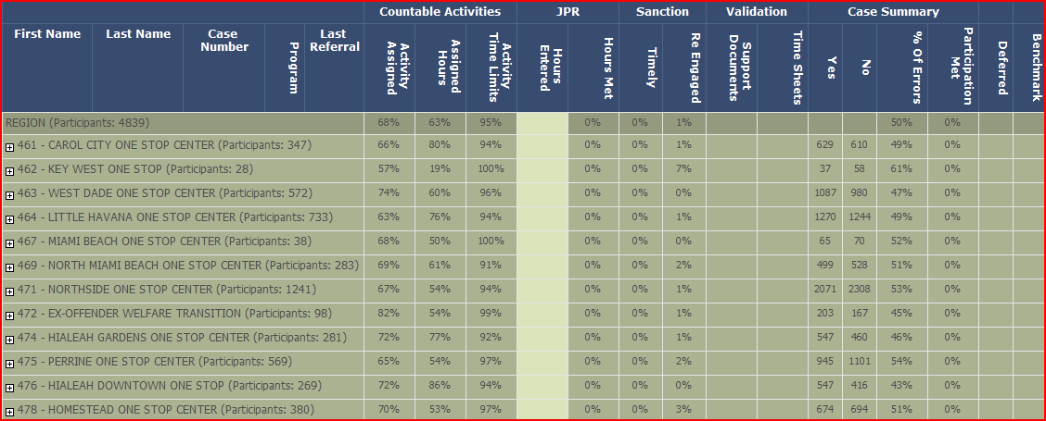
VIEW THE DATA
View the Region
View by the Career Center

Slide 10
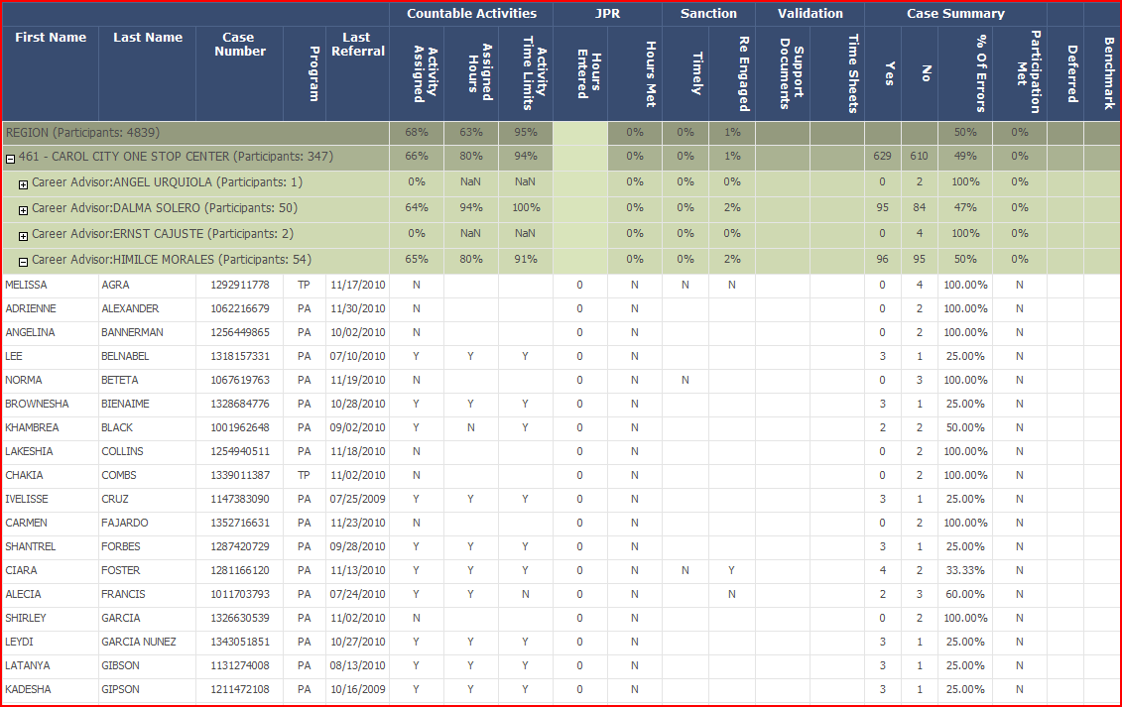
VIEW THE DATA
View
by
Career Advisor
View Career Advisor’s Caseload
View OSST Case Details

Slide 11
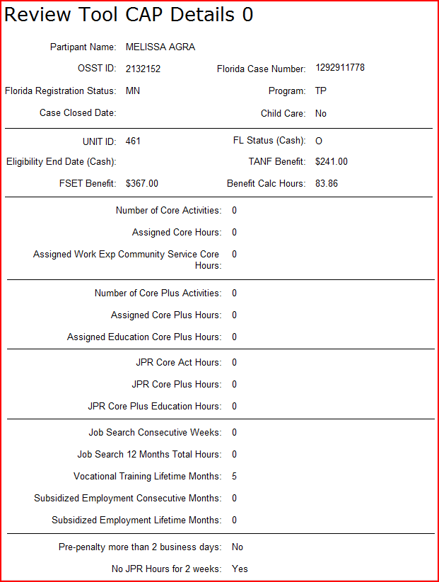
OSST CASE DETAILS

Slide 12
EARLY BIRD SPECIAL
$999.99

Slide 13
For Questions Contact: Theresa Chester
tchester@southfloridaworkforce.com
To Request a Demonstration
Contact: Juan Hernandez
jhernandez02@southfloridaworkforce.com

