Slide 1
Case Notes for Wagner Peyser
Case notes made simple
By: Christina Diamond
Labor Exchange Officer
Suncoast Workforce

Slide 2
Case Notes in Wagner Peyser
Why are case notes important?
Some common service codes that require case notes
How to write case notes
What is a good/bad case note
Placements and obtains must have explicit case notes.
Example of a Job Development case note
If it is not documented; it didn’t happen!

Slide 3
Why are case notes important?
Assessment Summary
Case Management Guide
Accountability
Professional and Ethical Responsibility
Information Sharing
Assessment summary
a. Capture relevant data elements
b. Present accurate customer “snap shot”
c. Deficiencies and barriers should link directly to services and activities!
Case management Guide
a. Sequential tracking and reporting of customer contact and progress!
b. Capture newly emerging barriers!
c. Revise action plan!
Accountability
a. WIA axiom = “If it isn’t in writing, it never happened!”
b. Internal oversight!
c. Monitoring and auditing!
Professional and ethical responsibility
Professionals need to know that record keeping is an important ethical requirement!
Information Sharing
a. “In-house” sharing of important data and action plans critical to successful customer service!
b. “External” sharing is critical to optimizing referral relationships with outside partner agencies!

Slide 4
Service Codes
Please refer to handout
http://www.floridajobs.org/workforce/WP_trngInfo.html

Slide 5
How to Write Case Notes
Write Case Notes that are:
• Clear and brief
• Concise, precise
• Accurate and complete
• Timely
• Readable – acceptable grammar

Slide 6
How to Write Case Notes
What you should avoid:
• Avoid “diagnoses”
• Avoid “Clichés”
• Avoid “street talk”
• Avoid Jargon
• Avoid Stereotypes and prejudices

Slide 7
How to Write Case Notes
Case Notes should:
• Describe behaviors reported by customer and
collateral contact!
• Record statements made by customer!
• Record your observations!
• Substantiate conclusions and judgments!
• Link services to documented deficiencies!

Slide 8
Professional and Ethical
Strong Verbs to use:
Words to Avoid:
• Advised Focused
• Assessed Identified
•Assisted Recommend
• Clarified Referred
• Confronted Reflected
• Counseled Structure
• Discussed Summarize
• Directed Supported
• Encouraged Urged
• Abnormal Impulsive
• Abusive Irrational
• Overwhelmed
• Dangerous Resistant
• Delusional Suicidal
• Demanding Threatened
• Disturbed Troubled
• Hysterical
Uncooperative Anxious
• Immature Unfit

Slide 9
Case Notes for every service
When providing services to job seekers in Wagner Peyser, one must first take the service, second, give a concise and factual account of the service provided.
It is easy to elaborate when writing about what happen when you met with someone. DON”T!
Keep to the facts.
Example of a good case note:
“Gave orientation to customer explaining our One-Stop services: adult training, Resource Room, EFM, workshops, office machines, and other job seeking websites. Performed initial assessment of customer’s educations, work history, and any barriers. Discussed their skill sets. Provided counseling in job search and networking techniques.”
Example of a bad case note:
“Spoke to the customer on the phone letting them know of our services and told them to come into the Center if they needed any help.”

Slide 10
Example of Job Development Case Notes:
Don’t Forget!
Placements and obtains must have explicit case notes both on the Job Seeker screen AND the Job Order Screen.
“Arranged interview for Bryan with Brandi Tompkins of Southern Comfort One Hour as an A/C Technician, located at 410 22nd Street East, Bradenton, FL 34208. Phone number: 941-747-3096.”

Slide 11
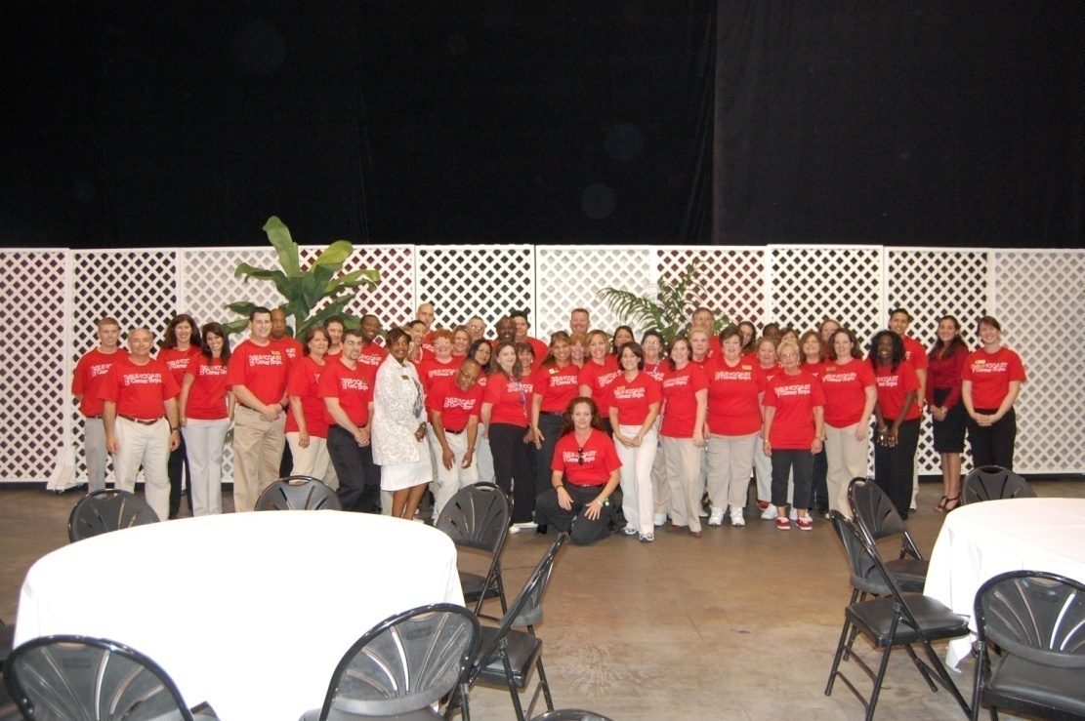
Always be Factual and to the point
Always remember:
If it is not documented it didn’t happen!
By: Christina Diamond
Suncoast Workforce

