Slide 1
Bridging the Gaps through collaboration
STEM Initiatives

Slide 2
What is S.T.E.M. ?
Part of a plant
Science, Technology, Engineering, and Math
Space, Time, Energy, and Mass
Statistics, Trigonometry, Exponentials, and Metrics

Slide 3
NSF Definition
The National Science Foundation defines S.T.E.M. as: Science, Technology, Engineering, and Math; this includes some healthcare components

Slide 4
Job Titles in STEM
Science
Biological Scientist
Biophysicists
Biochemists
Microbiologists
Agricultural Scientist

Slide 5
Job Titles in STEM
Technology
Database Administrator
Computer Programmers
Network/Data Systems Analyst
Computer Software Engineer

Slide 6
Job Titles in STEM
Engineering
Aerospace Engineers
Civil Engineers
Environmental Engineers
Electrical Engineers
Industrial Engineers
Biomedical Engineers

Slide 7
Job Titles in STEM
Math
Actuaries
Statisticians
Mathematicians

Slide 8
Why should a WDB care about STEM
STEM careers represent 12 of the 20 highest growth occupations
Projected Through 2012: 70% growth in Science and Engineering occupations; by 2014, employers expect to hire 2.5M new STEM workers
Bureau of Labor Statistics: Occupational Employment Statistics 2008-2018 Projections

Slide 9
Why should a WDB care about STEM
The U.S. S&E workforce continues to rely heavily on attracting foreign-born scientists and engineers, who are most highly represented in engineering, mathematics, and computer sciences, especially at advanced degree levels;
National Science Board. (2010, January). Key Science and Engineering Indicators: 2010 Digest. Arlington, VA

Slide 10
Current unfilled positions state-wide
Science
Biological Scientists = 70
Microbiologists = 19
Agricultural Scientists = 17
As of December 9, 2010; Florida Conference Board’s Hiring Demand Dashboard; Based on a query of SOC codes

Slide 11
Current unfilled positions state-wide
Technology
Database Administrator = 965
Computer Programmer = 1,444
Computer Software Engineer = 2,315
As of December 9, 2010; Florida Conference Board’s Hiring Demand Dashboard; Based on a query of SOC codes

Slide 12
Current unfilled positions state-wide
Engineering
Industrial Engineers = 1,024
Electrical Engineers = 710
Civil Engineers = 358
Aerospace Engineers = 278
As of December 9, 2010; Florida Conference Board’s Hiring Demand Dashboard; Based on a query of SOC codes

Slide 13
Current unfilled positions state-wide
Math
Actuaries = 27
Statisticians = 23
As of December 9, 2010; Florida Conference Board’s Hiring Demand Dashboard; Based on a query of SOC codes

Slide 14
STEM Salaries

Slide 15
Role of K-12 STEM
Expose students to STEM related activities
Enhance and customize subject delivery methods to increase awareness and interest in STEM

Slide 16
What is DOL’s role in STEM
Building the gateway to STEM careers
Enhancing the capacity of talent development institutions to produce more and better skilled STEM workers
Contribute and collaborate to develop an overall national strategy around the STEM workforce pipeline
The STEM Workforce Challenge: the role of the Public Workforce System in a National Solution for a Competitive Science, Technology, Engineering, and Mathematics Workforce; April 2007; Department of Labor, Employment and Training Administration

Slide 17
WCF STEM TI Background
In 2004 the WCF Board launched the Targeted Industry initiative with the following mandate:
“WCF shall develop and implement plans to meet the employers’ workforce needs in each industry, targeting one per year beginning with the most critical in need. A unique mix of brainstorming with HR professionals, customized usage of current tools and some National best practices shall be combined to create a solution that we will build upon for each targeted industry.”

Slide 18
WCF STEM TI Background
During the June 2009 the WCF Board of Directors voted to institute a New and Emerging Industry Plan which will support the following industries for one year in recruitment, retention and training needs: Cyber Security, Biotechnology, Renewable and Sustainable Energy and Digital Media.

Slide 19
WCF STEM TI Background
Industry support includes training and recruitment activities geared to dislocated workers and youth. Recruitment of youth is accomplished through awareness and immersion initiatives specific to each industry.

Slide 20
WCF STEM TI Initiatives
WCF Industry Days
STEM Summer Camps
STEM Undergraduate Research
UCF EXCEL
G.E.M.S.

Slide 21
Maintaining the STEM Pipeline
Foundation has been set…
How is the STEM pipeline maintained through youth and Healthcare Initiatives across Florida?
WorkNet Pinellas
SunCoast Workforce

Slide 22
For more information on WCF STEM or New and Emerging programming please contact…
Nirmala Ramlakhan
nramlakhan@wcfla.com
407-531-1222 ext 2006

Slide 24
Evolution
Originally known as the Summer Career Institute, the program has evolved into STEM TEC: Summer Career Institute which now concentrates on career exploration in STEM occupations
Served over 1,800 youth ages 14-16 since 2002
What began as a 4 week full-time career exploration program that also focused on workplace readiness and leadership has developed into a year round program that offers internship and job shadowing opportunities for new and past graduates
Started as a full-contract; now managed by WorkNet and facilitated by contractor

Slide 25
Program Basics
WHO
14-16 year olds
At-risk youth; economically disadvantaged (eligibility depends on funder)
GPA 2.5 or higher
WHAT
Career exploration training in STEM occupations; Microsoft Office; work readiness; entrepreneurial planning; leadership skills
Hands on STEM projects
Field based learning experiences – business and environmental sites
Career blueprints & assessments
Performance incentives based
WHEN
4 weeks-5 days a week: June-July after school year
Year round for internships/job shadowing/select Saturday events
WHERE
St. Petersburg College campuses around the county
Various business & environmental site locations
HOW MUCH
Average cost per participant: $1,666

Slide 26
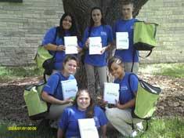
Best Practices
Established relationships:
Public school system
Youth provider
Post-secondary school(s)
Education foundation
Business
Community organizations/government
Top instructors:
Recruitment of STEM teachers through the school system
Teachers propose curriculum & hands on projects in STEM
Engaged students:
Recruitment of students through school counselors; intensive enrollment process; communicated expectations
Recruitment of college students as mentors
Incentives for positive performance & attendance

Slide 27
Best Practices
Employer “buy in”:
Menu of options for involvement – sponsorship, site visit, internship/job shadow offering, in-kind
STEM interest continuum:
Connecting middle school students to high school
Connecting high school students to post-secondary
Year round activities
Sponsorship fundraising campaign:
Establishing independent funding stream
Spin off programs:
IT Summer Camp
Pinellas Hope

Slide 28
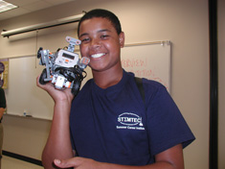
Proven Results
More than 1,800 served since 2002
In 2010:
Trained 180 WIA youth in STEM (120% of goal set at 150)
Of the 180 students trained:
228 credentials were earned (1 GED, 39 occupational certificates & 188 work readiness certificates)
47 students achieved grade level gains in reading & math
27 students gained employment
Raised scholarships for 6 students who didn’t meet WIA eligibility
Established new partnerships with 40 high school and middle schools in Pinellas County
Established new business partnerships for the future

Slide 29
Success Stories
“Through STEM TEC I have been able to learn very important skills. From building solar powered cars, learning how to design websites, understanding the American banking system, to learning the importance of business ethics, I have gained invaluable knowledge and skills…I plan on studying engineering and technology when I go to college and having this hands-on experience has really opened my eyes to the possibilities in my future.”
– Allijah G.
“All of the students who participated (in STEM TEC) impressed me greatly with their preparation, focus and good ideas. They demonstrated a real entrepreneurial spirit. It’s always fun to watch young people meet and exceed our expectations.”
– Dr. Bill Law, President
St. Petersburg College

Slide 30
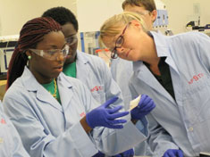
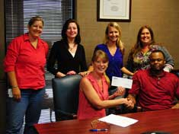
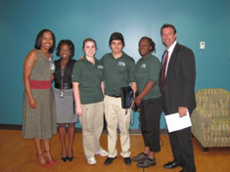
Replication
Partnerships
Partnerships
Partnerships
Partnerships

Slide 31
Questions?
Contact :
Jacqueline Skryd
Project Director
WorkNet Pinellas, Inc.
jskryd@worknetpinellas.org
(727) 608-2451

Slide 32
Our Mission:
To recruit, train
and retain talent
for the Suncoast.
An equal opportunity program. Auxiliary aids and services are available upon request by individuals with disabilities via the Florida Relay System at 711.

Slide 33
Building the Platform

Slide 34
Suncoast Workforce Received a $300,000
Employ Florida Healthcare Workforce Initiative Grant
The Bi-County Healthcare Committee was established to be the advising body of the initiative
Dr. Jennifer Bencie, Administrator Manatee County Health Dept., Chair
Suncoast Workforce hired Runa Badal as the dedicated Project Manager

Slide 35
Healthcare Workforce Initiative Objective
Develop an innovative model for recruitment, assessment and training in four healthcare subsectors:
Nursing
Allied Health
Long-term Care
Health Information Technology

Slide 36
Performance Design Group (PDG) was engaged to:
Analyze and map healthcare education and employment linkages
Identify gaps between training needs and available training programs
Develop, certify and implement curriculum for necessary training programs
These initiatives ensure that individuals are provided and receive optimal training opportunities in healthcare

Slide 37
Suncoast Workforce staff immediately began work to establish recruitment, screening and enrollment processes for adult/dislocated and employed workers
A database was designed to track performance of:
Pre-assessments
Healthcare Occupations Enrollees
Skill Upgrades for Employed Workers
Tracking of Matching and Leveraged Funds

Slide 38
Planning the Mission

Slide 39
The Bi-County Healthcare Committee working with PDG conducted a needs assessment among healthcare employers in Manatee and Sarasota counties
Real time data was collected on projected in-demand occupations and training requirements for 2011 through 2015

Slide 40
Phase I of the Healthcare research and analysis was completed by PDG and reviewed by the Bi-County Healthcare Committee
Key Findings
Need for local educational programs for:
Physical Therapist
Nurse Practitioner
Physician’s Assistant
Physical Therapy Doctorate

Slide 41
Key Findings
Employers identified a need for employee training in the areas of:
Leadership – necessary for career advancement
Communication and Professionalism
Nurse Specialty Education: Perioperative Nursing

Slide 42
Key Findings
Career Laddering programs are critical to meeting employer and employee needs
Licensed Practical Nurse (LPN) --- Registered Nurse (RN)
RN --- Bachelor’s of Science, Nursing (BSN)
BSN --- Master’s of Science in Nursing (MSN)
MSN ---- ARNP/Doctorate
Physical Therapist (BS or MS) ---- Doctorate
CNA ---- CMA/Medical Technology
Most immediate need is to elevate more RNs to BSN

Slide 43
Key Findings
Many factors are driving the need for upgrading of skills among current healthcare workers
New technology
Efficiency improvements
Certification requirements
Increased regulation

Slide 44
Key Findings
Employers want to quickly move RNs into specialty areas which require advanced training and often certification
Employers citied priority needs:
Specialty Certification
Perioperative Nursing CNOR
Medical Surgical Nursing RN-BC, CMSRN
Sexual Assault Nurse Examiner SANE
Critical Care CCRN
Progressive Care/Telemetry PCCN
Oncology OCN
Certified Hospice and Palliative Care CHPN
Emergency/Trauma TNCC, CEN
Infusion nursing CRNI
Wound, Ostomy and Continence CWOC, CWON, CWCN
Lee SilvermanVoice Treatment LSVT
Diabetes Educator CDE
Rehabilitation Nursing CRRN

Slide 45
Firing the Rockets

Slide 46
Based on these findings the Bi-County Healthcare Committee has directed PDG in Phase II to develop curriculum for:
Perioperative Nursing
Professionalism/Communications
Leadership/Supervision

Slide 47
Suncoast Workforce has worked with State College of Florida to launch the first class bridging RN to BSN in an 18-month curriculum
Manatee Memorial Hospital is piloting a leadership training program with funding from Suncoast Workforce

Slide 48
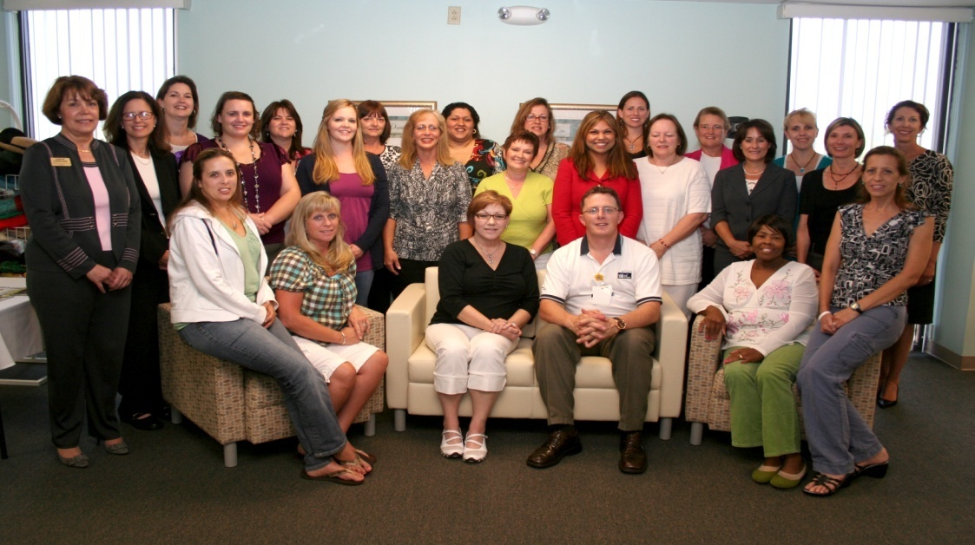
The Bi-County Healthcare Committee has collaborated to solve problems, improve matching of job seekers with jobs, and barriers to industry growth
The collaboration has yielded valuable results:
Identified need for Certified Sexual Assault Nurse Examiners
Found Registered Nurses eager for the advanced training
Three hospitals worked together to provide resources
Twelve certified nurses now staff the Sexual Assault Response Team

Slide 49
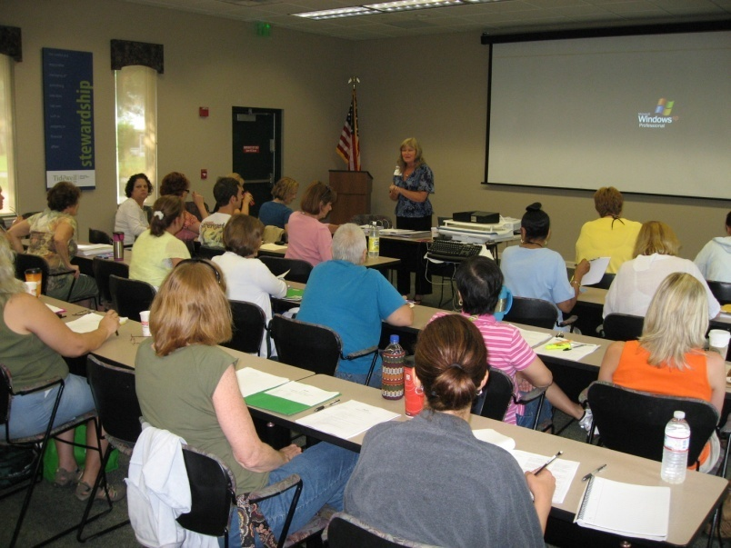
Bi-County Healthcare Committee Collaborative Success
Identified need for Certified Hospice and Palliative Care Nurses
Suncoast Workforce recruited and screened nurses
Training was implemented
Tidewell now employs 58 CHPN Nurses

Slide 50
Suncoast Workforce has already surpassed the initial goals of the Healthcare Workforce Initiative
Action | Goal | Current Status
Assess Suitability for Training | 150 | 165
Enroll Adult Dislocated Workers in Training | 30 | 30
Employed Worker Training | 100 | 90

Slide 51
Six major healthcare employers in Manatee and Sarasota Counties have requested skills upgrades for employees
Career Edge has partnered to help fund the employed worker training

Slide 52
Healthcare Takes Off!

Slide 53
The Suncoast Workforce Bi-County Healthcare Committee has developed a vision for the Healthcare Industry as an economic engine that creates jobs across the entire spectrum of skill levels
Just as Manatee-Sarasota is known for training world-class athletes, the region can train world-class healthcare providers

Slide 54
A Shared Commitment to Excellence
Employers – continued collaboration to achieve the potential to become a world-class healthcare industry
Educators – best practices in the full range of healthcare training
Elected Officials – maintain legislative and funding mechanisms to support growth in the healthcare industry

Slide 55
The Sky is the Limit

Slide 56
This special project,
Employ Florida Healthcare Workforce Initiative - Round II, is made possible by Workforce Florida, Inc.
An equal opportunity program. Auxiliary aids and services are available upon request by individuals with disabilities via the Florida Relay System at 711.

Slide 57
Members of the Bi-County Healthcare Committee
Sheree Threewits / Beth Murphy
Manatee Memorial Hospital
Veronica Lequeux
Blake Medical Center
LaTousha Daniels
Manatee County Rural Health Services
Deborah Kostroun
Manatee Glens
Jodi Egger
Freedom Village
JoAnn Westbrook / Dawn Crable
Pines of Sarasota
Kari Kushto
Sarasota Memorial Hospital
Dana Wheeler / Serena Huggins Venice Regional Medical Center
Bill Little / Barbara Laidlaw
Sarasota County Health Department
Philomena D’Sa / Debra French
Tidewell Hospice and Palliative Care
Elaine Boyer
Village On The Isle
Theresa Levering
Doctors’ Hospital of Sarasota
Mary Murphy
Pinnacle Medical Group
Linda De Mello
University of South Florida
Mireya Eavey / Lisa Carter
Career Edge Funders Collaborative
Bonnie Hesselberg
State College of Florida
Priscilla Haflich
Manatee Technical Institute
Kathy Drotar
Keiser University
Trent Terry / Mike Kennedy
Sarasota County Technical Institute
James Schreiber
TechHouse I.T. Staffing Solutions
Lou Galterio Suncoast RHIO & Health Information Exchange
Mary Chilton
Manatee Economic Development Council
Liz Gatlin
Manatee Medical Society
Edna Apostol
Gulfcoast South AHEC
Larry Face
Next Level Achievement
Suncoast Workforce
Mary Helen Kress
President and CEO
Bob Beck,
Board Chair
Dr. Jennifer Bencie
Chair, Bi-County Healthcare Committee

Slide 58
Members of the
Bi-County Healthcare
Support Staff & Consultants
Support Staff:
Leslie Loveless
Chief Operating Officer
Suncoast Workforce
Runa Badal
Special Projects Manager
Suncoast Workforce
Consultants:
Performance Design Group
Dr. George Reid
Sanders Bell
Teresa Carafelli

Slide 59
For More Information:
Please contact:
Leslie Loveless, LLoveless@suncoastworkforce.org
or
Runa Badal, RBadal@suncoastworkforce.org
Link for Video
http://www.yousendit.com/download/cEd0ZFhtSytFc0x2Wmc9PQ
941-358-4200

Slide 60
Q & A

