Slide 1
Disaster Recovery & Mitigation Funding for
Hurricane Sally
Florida Department of Economic Opportunity (DEO)
Office of Long-Term Resiliency (OLTR)
February 2, 2023

Slide 2
Agenda
Introductions
Overview of Hurricane Sally Community Development Block Grant – Disaster Recovery & Mitigation (CDBG-DR & MIT) Timeline
Most Impacted and Distressed (MID) Areas
Subrecipient Overview
Project Eligibility Overview
Infrastructure Repair Program (IRP)
Voluntary Home Buyout Program (VHB)
Workforce Recovery Training Program (WRTP)
Hometown Revitalization Program (HRP)
Subrecipient Housing Repair and Replacement Program (HRRP)
Workforce Affordable Housing Construction Program (WFAH)
Federal Cross-Cutting Requirements
Subrecipient Expectations Overview
Environmental Review Process
Application Process & Requirements
Resources
Questions

Slide 3
Disaster Recovery Team for Hurricane Sally
Justin Domer – Director, OLTR
Lecia Behenna – Bureau Chief, OLTR
Garnet Nevels – Deputy Bureau Chief, OLTR
Amanda Iscrupe – Infrastructure Program Manager, OLTR
Taylor Doolin – Disaster Recovery Program Manager, OLTR
Anastasia Smith – Subrecipient Housing Program Manager, OLTR
Jody McCormick – Grants Coordinator, OLTR

Slide 4
CDBG – Disaster Recovery & Mitigation
DEO, through OLTR, supports disaster recovery and mitigation projects related to housing, infrastructure, and economic development in Florida communities impacted by disasters.
DEO is the governor-designated State authority responsible for administering all U.S. Department of Housing and Urban Development (HUD) Community Development Block Grant-Disaster Recovery (CDBG-DR) and Mitigation (CDBG-MIT) funds awarded to the State of Florida.
DEO is currently administering long-term recovery and mitigation programs for Hurricanes Hermine, Matthew, Irma, and Michael. Sally programs have begun this year.
"Rebuild Florida” was created to brand the State’s long-term disaster recovery and mitigation efforts.

Slide 5
Hurricane Sally CDBG Timeline
September 2020: Hurricane Sally made landfall in the Florida Panhandle.
October 29, 2021: $113,191,000 allocated from HUD.
March 22, 2022: Additional $74,192,000 allocation from HUD.
February 3, 2022: Federal Register published: FR Vol. 87 No. 23.
Total Florida Allocation: $187,383,000
August 5, 2022: HUD approved State of Florida’s Action Plan for Hurricane Sally Disaster Recovery Programs.
January 18, 2023: Launch of Infrastructure Repair Program (IRP) Application Cycle.
January 24, 2023: Launch of Voluntary Home Buyout (VHB) Application Cycle.
February 14, 2023: Launch of Workforce Recovery Training Program (WRTP) and Hometown Revitalization Program (HRP) Application Cycles.
February 28, 2023: Launch of Subrecipient Housing Repair & Replacement Program (HRRP) Application Cycle.

Slide 6
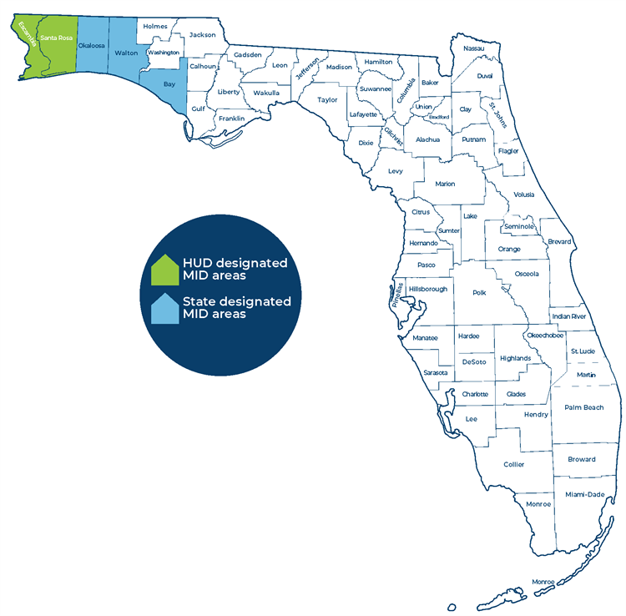
Most Impacted and Distressed (MID) Areas
HUD-Designated MID areas:
Escambia County
Santa Rosa County
State-Designated MID areas:
Bay County
Okaloosa County
Walton County

Slide 7
CDBG – DR/CDBG – MIT Subrecipients
Subrecipients are non-federal entities that receive a subaward in order to carry out part of a federal program. Subrecipients have:
Autonomy to make eligibility determinations.
Responsibility to ensure performance outcomes and goals are met.
Responsibility for making programmatic decisions.
U.S. Department of Housing and Urban Development
Florida Department of Economic Opportunity
Community Development Block Grant - DR and/or MIT Program
Subrecipient

Slide 8
Subrecipient Process
Application Cycle
Award
Federal Regulations & Compliance
Project and Grant Closeout
Authority to Use Grant Funds
Project Implementation
Subrecipient Agreement Process
Communication with DEO
Ongoing Monitoring
Reporting

Slide 9
Rebuild Florida Hurricane Sally Programs

Slide 10
Project Eligibility Overview
Applicants must propose projects that meet the Hurricane Sally State Action Plan and Federal Register requirements, including, but not limited to:
Projects located in HUD and State-identified MID areas.
Projects that primarily serve Low to Moderate Income (LMI) populations.
Projects that do not duplicate benefits.
Municipalities, counties, and water management districts are eligible to apply.
Activities funded by the CDBG-DR mitigation set-aside do not require a ‘‘tie-back’’ to the specific qualified disaster that has served as the basis for the grantee’s allocation. Grantees must demonstrate that mitigation activities funded:
Meet the HUD definition of mitigation activities;
Address the current and future risks as identified in the grantee’s mitigation needs; and
Meet a National Objective.

Slide 11
Project Eligibility Overview, Continued
Once fundamental requirements are met, eligible project activities include:
Restoration – Infrastructure damaged by Hurricane Sally.
Creation – Public facilities such as emergency community shelters.
Demolition – Rehabilitation of publicly or privately owned commercial or industrial buildings.
Economic Revitalization – Eligible activity that directly restores and improves an aspect of the local economy.

Slide 12
Rebuild Florida Infrastructure Repair Program (IRP)
Total Allocation: $67,000,000 – Designed to fund infrastructure restoration and improvement projects in communities impacted by Hurricane Sally. 15 percent of the allocation must be spent on projects that provide mitigation benefits.
Minimum Award Amount: $750,000
Maximum Award Amount: $67,000,000
Application cycle is January 18 – April 4, 2023

Slide 13
IRP Eligible Infrastructure Activities
Restoration of infrastructure damaged by Hurricane Sally (such as water and sewer facilities, streets, removal of debris, drainage, bridges, etc.)
Demolition and rehabilitation of publicly or privately-owned commercial or industrial buildings.
Renourishment of protective coastal dunes systems and state beaches.
Repairs to damaged buildings that are essential to the health, safety, and welfare of a community when repairs to these buildings constitutes an urgent need (this can include police stations, fire stations, parks and recreational centers, community and senior centers, hospitals, clinics, homeless shelters, schools and educational facilities, and other public properties, including properties serving as emergency shelters).
Repairs to water lines and systems, sewer lines and systems, drainage, and flood mitigation systems.

Slide 14
IRP Eligible Mitigation Activities
Development of mitigation standards, regulations, policies, and programs.
Land use/zoning policies.
Strong building code and floodplain management regulations.
Dam safety programs, seawalls, and levee systems.
Acquisition of flood prone and environmentally-sensitive lands.
Retrofitting/hardening/elevating structures and critical facilities.
Relocation of structures, infrastructure, and facilities out of vulnerable areas.
Public awareness/education campaigns.
Improvement of warning and evacuation systems.

Slide 15
Rebuild Florida Voluntary Home Buyout (VHB) Program
Total Allocation: $22,000,000 – Designed to encourage risk reduction by acquiring properties in high-risk flood areas. Properties acquired through buyouts will benefit areas in which at least 51 percent of the residents are LMI. Buyouts will only be available to qualifying LMI households.
Minimum Award Amount: $750,000
Maximum Award Amount: $5,000,000
Application cycle is January 24 – April 14, 2023

Slide 16
VHB Eligibility Requirements
Applicants must meet eligibility requirements as outlined in section 105(a)(1) of the Housing and Community Development Act of 1974 (HCDA).
Buyout projects, except those which qualify as meeting an urgent need, must benefit LMI persons through either LMA benefit or LMHI. To be considered eligible for the LMA or LMHI national objective criteria, applicants must meet the eligibility requirements outlined in Federal Register Vol. 87, No. 23 (p. 6373).
The program is only for non-commercial properties, which may include owner-occupied structures, residential rental properties, or vacant lots. To be considered an eligible property for the buyout, the property must satisfy at least one of the following requirements:
The property is located within a designated MID area;
The property is located within a floodway; or
The full fee title of properties must be from a willing, voluntary seller.

Slide 17
Rebuild Florida Subrecipient Housing Repair & Replacement Program (HRRP)
Total Allocation: $45,000,000 – Designed to repair, replace, and/or reconstruct homes damaged by Hurricane Sally with a focus on LMI communities. Fair housing requirements must be met.
Minimum Award Amount: $750,000
Maximum Award Amount: $9,000,000
Application cycle is February 28 – May 15, 2023

Slide 18
Subrecipient HRRP Eligible Activities
Temporary Relocation Demolition/Clearance
Single-Family Housing Rehabilitation/Repair
Multi-Family Housing Rehabilitation/Repair
Housing Construction
Public Housing
Emergency Community Shelters (public facilities)
Homeless Shelter
Repair and Replacement of Manufactured Housing Units
Hazard Mitigation
Elevation
Planning Activities Related to Housing
DEO will require construction methods and standards that emphasize quality, durability, energy efficiency, sustainability, and mold resistance.

Slide 19
Rebuild Florida Hometown Revitalization Program (HRP)
Total Allocation: $13,513,850 – Designed to support the recovery of economic activity in commercial areas of storm-impacted towns and cities to facilitate the recovery and return of businesses and jobs and the provision of goods and services to the community.
Minimum Award Amount: $500,000
Maximum Award Amount: $5,000,000
Application cycle is February 14 to May 1, 2023.

Slide 20
HRP Eligible Activities
Public facility improvements, including streetscapes, lighting, sidewalks, and other physical improvements to commercial areas.
Acquisition, demolition, site preparation, or rehabilitation of commercial structures carried out by a unit of local government.
Assistance to small businesses for rehabilitation and physical improvements to their places of business.
Façade improvements to private or public structures in commercial areas.

Slide 21
Rebuild Florida Workforce Recovery Training Program (WRTP)
Total Allocation: $5,000,000 – Designed to provide funding opportunities for local workforce development boards, educational institutions and technical centers located in the communities most impacted by Hurricane Sally to train new workers in construction trades to help meet the increased demand for skilled workers.
Minimum Award Amount: $1,000,000
Maximum Award Amount: $2,000,000
Application cycle is February 14 – May 1, 2023

Slide 22
WRTP Eligible Activities
Roofing
Masonry
Carpentry
Concrete finishing
Plumbing
HVAC (heating, ventilation, and air conditioning)
Electricity
Heavy equipment operations
Flooring installation / Carpet laying
Glass / Window installation
Plastering
Welding
Customized training tailored to the specific economic revitalization needs of the region

Slide 23
Federal Cross-Cutting Requirements

Slide 24
Federal Subrecipient Requirements Overview
Subrecipients carrying out federally-funded activities under the Sally CDBG programs are expected to understand and comply with federal regulations outlined in the subrecipient agreements, including those related to:
Procurements
Environmental Reviews
Labor Standards
Relocations
Fair Housing
Audits
Monitoring subcontractors for compliance
Maintaining comprehensive program records
Monitoring and reporting on activity progress
Meeting performance goals

Slide 25
Federal Subrecipient Procurements & URA Requirements
Procurements
Subrecipients are required to carry out all procurements in compliance with the federal requirements under 2 CFR 200.318-326 and 200.330.
Fair and open competition for all federally-funded procurements is essential.
Uniform Relocation Assistance and Real Property Acquisition Policies Act (URA)
Any property acquisition, rehabilitation, or demolition to be reimbursed with HUD funds are subject to URA rules. Subrecipients must submit all documentation required including a notice to property owners of their URA rights, an invitation to accompany the appraiser, all appraisals, offer to the owner, acceptance, contract for sale, statement of settlement costs, copy of deed, and waiver of rights (for donations), as applicable.
No acquisition of a property should be done prior to the completion of an Environmental Review on the property.

Slide 26
Federal Cross-Cutting Requirements
Section 3
Subrecipients will encourage their contractors to hire qualified low and very low-income persons for any job openings that exist on CDBG-DR-funded projects and to maintain records to document the number of hours these LMI persons worked on CDBG-DR-funded projects.
A Section 3 Contract Clause must be included in all CDBG-DR funded contracts.
Labor Standards
Davis Bacon – all laborers and mechanics employed by contractors or subcontractors for performing construction work financed in whole or in part with CDBG-DR funds must be paid wages at rates not less than those prevailing on similar construction in the locality.
Copeland Anti-Kickback Act – Subrecipient will maintain documentation that demonstrates compliance with applicable hour and wage requirements. The documentation must be made available to DEO for review upon request. We recommend using Form WH-347 for certified weekly payroll & interviews.

Slide 27
Federal Civil Rights Compliance
Fair Housing
Subrecipients must certify that they will "affirmatively further fair housing" in its community and undertake an activity each quarter to affirmatively further fair housing.
Equal Employment Opportunity (EEO)
A family of laws that prohibit discrimination of various kinds against protected classes of people.
Section 504 of the Rehabilitation Act of 1973
Protects persons with disabilities from discrimination and the Americans with Disabilities Act.
Americans with Disabilities Act (ADA)
Protects persons with disabilities in many areas of public life including parking and access to commercial and public state and local facilities.

Slide 28
Environmental Review Requirements
All CDBG-DR projects require some level of environmental review
Many projects require a two-step review process:
Exempt Activities Certification: Planning, administrative and operating costs
Full environmental review: Remaining project activities
IMPORTANT:
Once an application is submitted, the appropriate level of environmental review must be completed before entering into new contracts or conducting project-related activities.
Project funds ARE NOT reimbursable until a Subrecipient Agreement is executed, and an Exempt Activities Certification is approved.

Slide 29
Hurricane Sally CDBG-DR/CDBG-MIT Application Process

Slide 30
How to Submit an Application
Applicants must submit an online Application Request Form to begin the application process. The links to the forms are available on each Rebuild Florida Hurricane Sally Program Page (i.e., the unique pages for IRP, VHB, WRTP, HRP, HRRP, and WFAH).
After DEO receives a Request Form, we will provide a link to the application portal. A separate Request Form and link is needed for every proposed project application.
Applications must be submitted through the online application portal. However, DEO recommends that applicants draft a Word or PDF version, both for ease of editing during application preparation, and so as to have a backup version of the application for your files.

Slide 31
Application Submission Tips
Tips:
Make sure your Wi-Fi connection is strong and reliable.
Don’t delete “cookies.”
To navigate through the application, click the green arrow buttons on the bottom pane of the application. Do not click the “back” button in the top left-hand corner of your browser.
The application system saves as you work. There is no save button.
Do click past the signature page until you are finished, or your application will automatically submit.

Slide 32
Required Information & Documentation
Basic Applicant Information
FEIN and UEI Numbers
Flood Insurance Status
Qualifying MID Location
Contact & Co-Applicant Information
Citizen Participation
Public Notice
Public Hearing Agenda & Minutes
Public Comments
Maps
Project Service Area
Most Recent Floodplain
LMI Service Area
Photographs
Organizational Chart Template
Work Plan Template
National Objective
LMI Census Data or Survey Data

Slide 33
Required Information & Documentation, Continued
Narratives
Project Description
Damage Summary & Tieback to Hurricane Sally
Unmet Needs
Management Capacity
Procurement Process
Readiness to Proceed
Budget including any quotes and leveraged funds

Slide 34
Helpful Links & Questions
To learn more about the DEO Long-Term Resiliency and programs available to disaster-impacted communities, visit our Hurricane Sally webpage.
Program-specific emails are:
HRP/WRTP: OLTR-ER@DEO.MyFlorida.com
IRP: CDBG-DRInfrastructureApp@DEO.MyFlorida.com
VHB/HRRP: HousingSubrecipient@DEO.MyFlorida.com

