Slide 1
Jobs for Veterans State Grant
Employment and Advocacy Services
State Veterans’ Program Office

Slide 2
Objectives
Purpose and Scope
Policies and Procedures
Service Codes
Job Referrals
Staff-Assisted Job Search Activities
Job Development
State and Local Monitoring
Questions & Answers
Case Management Framework

Slide 3
Purpose and Scope
Provide Local Workforce Development Boards (LWDBs) the minimum requirements for providing employment and advocacy services under the Jobs for Veterans’ State Grant (JVSG) program.

Slide 4
Individualized Career Services
Upon determination of eligibility, DVOP specialists and LVER staff must facilitate individualized employment services to eligible persons.

Slide 5
Case Management Framework
Objective Assessment
Individual Employment Plan (IEP)
Consistent Contact

Slide 6
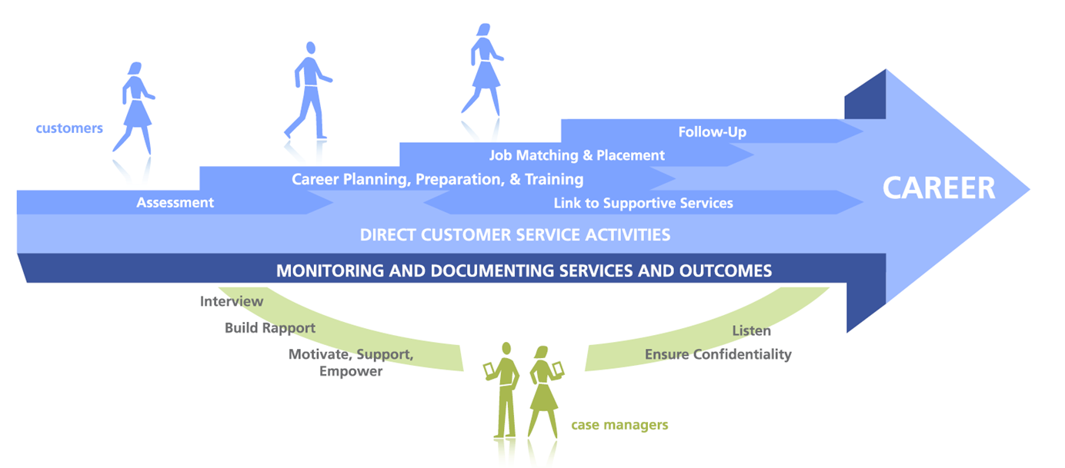
Case Management Process

Slide 7
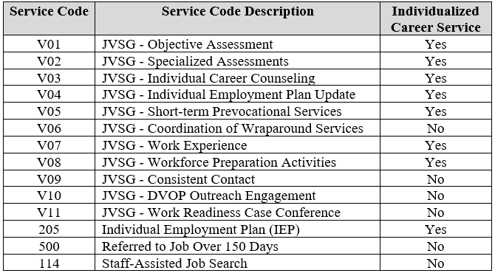
Jobs for Veterans State Grant Service Codes

Slide 8
V01 – Objective Assessment
Evaluation of:
Work history
Work readiness
Barriers
Expectations
Education
Certificates

Slide 9
V02 – Specialized Assessments
Specialized assessments examine one or more of the following:
Basic literacy in math, reading or writing
English language proficiency
Interests and aptitude
Occupational skill levels
Transferable skills
Staff may refer eligible persons to WIOA for the assessment process and must receive detailed results.
Note: If a WIOA referral is made, service code 211 (Referral to WIOA) must be recorded in Employ Florida.

Slide 10
V03 – Individual Career Counseling
Educational/occupational opportunities
Assessments
Labor market information
Specifics on occupational requirements
Training opportunities

Slide 11
205 – Individual Employment Plan
S.M.A.R.T. guidelines
Specific
Measurable
Attainable
Relevant
Time-bound

Slide 12
Individual Employment Plan Benefits
Improves accountability
Organizes goals into a concrete framework
Allows for guidance and feedback
Provides recognition of progression towards goal
Notes:
There are many benefits to developing a quality IEP with the TAA participant, including, but not limited to:
Improves accountability between the TAA participants and Local TAA Coordinators;
Provides concrete goals with a plan of achieving them;
Provides a visual road map for the TAA participant to achieve his/her employment goal;
Allows Local TAA Coordinators to provide specific guidance and feedback pertaining to the TAA participants’ progress;
Provides achievement and recognition of short-term goals which may improve the TAA participant’s confidence in his/her abilities; and
Increases engagement in achieving long-term goals.

Slide 13
Developing the Plan
Employ Florida IEP/ISS wizard
Auto-generated service code 205
One IEP per participant

Slide 14
Sample Goal

Slide 15
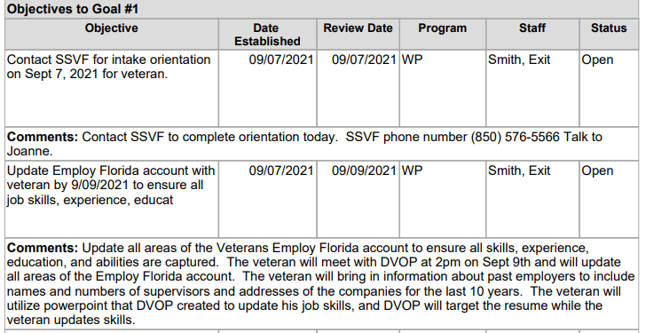
Sample Objectives

Slide 16
Reviewing and Updating the Plan
Plan developed collaboratively
Goal/objectives updated in Employ Florida
Signature

Slide 17
V04 – IEP Update
Objectives
Living document
30 days

Slide 18
V05 – Short-Term Prevocational Services
Study skills
Professional conduct
Computer literacy
Punctuality

Slide 19
V06 – Coordination of Wraparound Services

Slide 20
V07 – Work Experience
Apprenticeships
Department of Defense SkillBridge program
Internships
Job shadowing
Pre-apprenticeship programs
Transitional jobs
Veterans Affairs Work Study program

Slide 21
V08 – Workforce Preparation Activity
Adjusting to civilian work environment
Critical thinking
Digital skills
Utilizing resources
Working with others

Slide 22
V09 – Consistent Contact
Direct contact (successful)
Unsuccessful attempts
90-days post-employment
First month (biweekly)

Slide 23
V09 – Consistent Contact (cont’d)
Biweekly or monthly
Set reminders through Employ Florida alerts
Connect with the participant
Based upon Individual Employment Plan
Update the plan as changes occur
Notes:
The IEP is not meant to be a document this is completed and filed away. It is a living, working plan for how each individual participant will get the most out of the TAA program.
The Local TAA Coordinator must keep track of all important dates in the IEP, and check prior to deadlines to make sure the participant is doing what he/she has committed to doing. An effective IEP requires extensive follow-up to make sure things are happening as they need to be happening. The IEP is not about playing “gotch ya” after the participant has failed to accomplish or attempt an agreed upon goal or objective; it is about making sure they do it to begin with. IEP follow-up should be part of every visit and discussion the Local TAA Coordinator has with the participant. At a minimum, the IEP should be reviewed every 60 days.
The Local TAA Coordinator must not only stay on top of the participant to make sure they are doing what they need to do, but also so that they can intervene to help TAA participants be successful when it becomes necessary to do so. If it becomes apparent that the goals and action steps are not attainable by the participant, it is important to reevaluate those goals and objectives, and rewrite the IEP with goals and objectives which are attainable.

Slide 24
V10 – DVOP Outreach Engagement
In-person outreach
Enrollment
Provision of services
Center visit

Slide 25
V11 – Work Readiness Conference
Acceptable resumé
Suitable interview attire
Reliable transportation
Work Ready Veteran

Slide 26
V12 – Veteran Advocacy Contact
Post-case conference
Deemed work ready
Advocacy contact
Job interview
V12/E53

Slide 27
Job Referrals
Administrative Policy 96
Position match
Qualified participant
Advocacy efforts

Slide 28
Staff-Assisted Job Search
Participant knowledge
Job-search strategy
Workshops
Resume revision
Significant staff involvement

Slide 29
Job Development
Work readiness conference
No suitable opening
Direct employer contact
Job interview process

Slide 30
Questions & Answers

