Slide 1
Trade Adjustment Assistance
Funding Overview
Yolanda Triplett, State Trade Program Coordinator

Slide 2
Objectives
Trade Adjustment Assistance (TAA) Overview
Cost Categories
Funding Requests
TAA Expenditure Reporting
Questions
Notes:
During this presentation we will cover:
A brief overview of the Trade Adjustment Assistance (TAA) program;
Information regarding cost categories specific to the TAA program and why they are important;
Guidance on how to submit a request for TAA funding;
Instructions for reporting TAA expenditures in Employ Florida; and
Any questions you have about the information presented in today’s training presentation.

Slide 3
TAA Overview
TAA is federal program that assists workers who have lost their jobs due to foreign trade.
Offers training, income support, employment and case management services
Participants are covered by United States Department of Labor (USDOL) certified trade petitions
Notes:
For those unfamiliar with the TAA program, we will begin with a brief overview of the program to include a summary of some of the benefits and services which are available to participants.
TAA is a federally funded program established by the Trade Act of 1974 (Trade Act) to assist workers adversely affected by foreign trade who have lost their jobs because of a decline in production, sales, or outsourcing of jobs to foreign countries. The program was most recently reauthorized by the Trade Adjustment Assistance Reauthorization Act (TAARA) of 2015.
The TAA program offers extended income support, training, employment and case management services, and other benefits to displaced workers who are certified as eligible to receive TAA benefits and services. To be eligible for TAA, a group of two or more trade-affected workers, or an agent on their behalf, must petition the U.S. Department of Labor (USDOL) and become certified. Eligible trade-affected workers covered by the certification can apply for benefits and services at a local career center.

Slide 4
TAA Benefits
Employment Services
Employment and Case Management Services
Training
Job Search Allowance
Relocation Allowance
Benefits
Trade Readjustment Allowance (TRA)
Reemployment Trade Adjustment Assistance (RTAA)/ Alternative Trade Adjustment Allowance (ATAA)
*Health Coverage Tax Credit (HCTC)
*Administered by the Internal Revenue Service (IRS)
Notes:
The Florida Department of Commerce shares in the delivery of services with Florida’s 24 Local Workforce Development Boards (LWDBs) through the CareerSource Florida network. Services and benefits available to trade-affected workers include the following:
Employment services, such as giving labor market information and resume assistance, are provided to assist workers in preparing for and obtaining new employment. Workers may also receive case management services from a Local TAA Coordinator to eliminate any barriers to obtaining suitable employment. Suitable employment means work of a substantially equal or higher skill level than the trade-affected worker’s past trade-affected employment, with wages no less than 80 percent of the trade-affected worker’s average weekly wage from the trade-affected employment.
When suitable employment is unavailable, training funds are offered to support trade-affected workers in obtaining credentials to enhance their marketability. In some cases, workers who pursue employment outside their local commuting area may be eligible for job search or relocation allowances.
Trade Readjustment Allowance (TRA) is a weekly income support payment for TAA-certified workers who have exhausted their reemployment assistance (RA) benefits and who are enrolled in an eligible training program, or have received a waiver of the training requirement. Weekly TRA payments are equal to the worker’s final weekly RA benefit amount. Workers may collect RA and TRA for a combined maximum of 130 weeks, the final 13 of which are only available if necessary for the worker to complete a qualified training program.
Reemployment Trade Adjustment Assistance (RTAA), formerly known as Alternative Trade Adjustment Allowance (ATAA), is a wage insurance program available to certified workers age 50 and over who obtain reemployment at a wage lower than their trade-affected employment. The wage insurance program provides a cash payment equal to 50% of the difference between the worker’s new wage and previous wage, up to a two-year maximum of $10,000.
The Health Coverage Tax Credit (HCTC) is a tax credit equal to 72.5% of the trade-affected worker’s qualified health insurance premiums. Unlike other TAA benefits, HCTC is administered through the Internal Revenue Service (IRS).

Slide 5
Cost Categories
USDOL
Cost Categories
FloridaCommerce/LWDB
Cost Objects
Training
TAT
(TAA Training)
Case Management
TAC
(TAA Case Management & Admin)
Job Search and Relocation
TAT
Separate Funding
(STATE LEVEL ONLY)
Administrative
TAA (TAA Admin)
TRA
RTAA / ATAA
Notes:
Cost categories are federally established categories used to identify how program funds were spent. The Administrative Policy on TAA Funding outlines the cost categories within the TAA Program; these categories include: Training, Case Management, Job Search and Relocation, and Administrative.
Training, Case Management, and Job Search and Relocation funds are issued to the LWDBs on an as-needed basis. Fund allocations to LWDBs are made available through a Notice of Grant Award/Funding Availability (NFA) that specifies which cost object the issued funds support. This slide shows each federal cost category and the corresponding NFA cost object used at the state and local level.
The Administrative cost category is used exclusively to support the state-level administration of the TAA program. Funds for the TRA and RTAA benefit programs are issued directly to FloridaCommerce by USDOL and are not issued to the LWDBs

Slide 6
Cost Category: Program (Training)
Program
Tuition and related expenses
Books
Tools
Academic fees
Travel or Transportation
Subsistence expenses
Job Search & Relocation
Materials Required through Course Curriculum
Licensures / Certification Exams
Equipment Rental / Purchases
Computers
Issued to LWDBs based upon participation levels or newly-certified trade petitions
Direct participant costs
TAT cost object
Notes:
Program (or training) is the primary cost category under TAA. This category supports all of the participant’s training-related costs. This includes: [read left-hand side of slide]. These funds are dispersed to the LWDBs based upon availability, participant levels or newly certified trade petitions in the area. Training funds are intended for direct participant costs.

Slide 7
Cost Category: Case Management
Case Management
The list of services as referenced in TGAAA Sec. 235 (1-8)
Maintenance and enhancement of electronic case management systems to allow for improved case management services
Any other staff costs related to case management
Salary and benefits of TAA merit-staff
Infrastructure and operations
Program indirect costs
Local Administration
Notes:
TAARA 2015 requires the provision of case management and employment services to all TAA-certified workers. These services include, but are not limited to, a comprehensive assessment of a trade-affected worker’s skills and needs, assistance in developing an individual employment plan with an employment goal and identifying the training and services necessary to achieve that goal, and guidance on training and other services for which a trade-affected worker may be eligible. Under TAARA, states are required to use at least 5% of their total allocation for case management and employment services.
The case management cost category supports direct charges for Local TAA Coordinator salary and benefits, career center infrastructure and operations, and any other costs related to case management. The TAA program’s portion of indirect costs are allocated to the case management cost category as well.

Slide 8
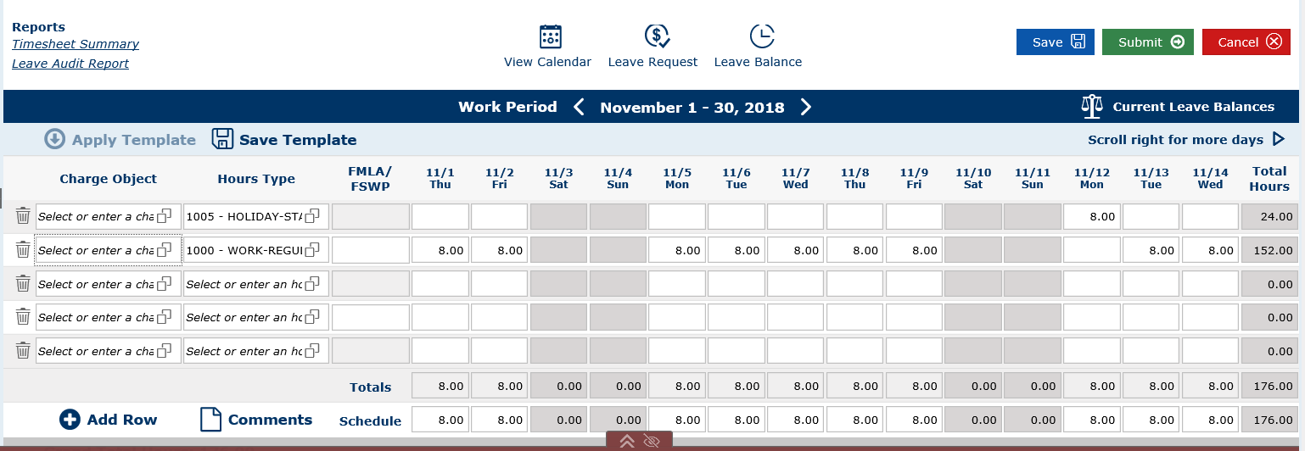
Cost Category: Case Management (Direct Charges)
Merit staff direct-time charges (People First)
Charge Object (TAC)
Based upon services provided to TAA and non-TAA participants
Notes:
People First is the State of Florida’s online human resource information system. In this system, merit staff complete timesheets to record work time and charge that work time to specific charge objects appropriate for the type of work performed. Direct time charges to the TAA grant will be funded through Case Management funds within the People First system by using charge object “TAC.”
Local TAA Coordinators must ensure they are charging their time to the appropriate grants (TAA or Wagner-Peyser) relative to the services provided to TAA participants and the program under which they fall. Merit staff who are designated as local TAA Coordinators are not precluded from providing Wagner-Peyser services to non-TAA participants. In fact, it is encouraged and expected when the local TAA Coordinator is managing a caseload of a limited number of TAA participants. The time spent providing Wagner-Peyser services to non-TAA participants should be tracked and charged to Wagner-Peyser.

Slide 9
Cost Category: Job Search & Relocation
Job Search and Relocation
Job Search
Travel and subsistence50% federal per diem rate (subsistence)
Federal mileage rate
Relocation
Up to $1,250
Reasonable expenses
Secured employment
Issued to LWDBs as requested
TAT cost object
Notes:
The third cost category includes job search and relocation for TAA participants. LWDBs may request funding to provide job search and relocation allowances for trade-certified individuals. These allowances are meant for workers who are unable to obtain suitable employment within the statewide commuting area. Certified workers can receive an allowance equal to 90% of each of their job search and relocation expenses, up to a maximum of $1,250 for each benefit.
A Job Search Allowance may be available to subsidize 90% of transportation and subsistence costs related to job search activities outside the statewide commuting area of 10 miles one-way. Subsistence payments may not exceed 50% of the federal per diem rate and travel payments may not exceed the prevailing mileage rate authorized under federal travel regulations.
A Relocation Allowance may be available to workers who have secured permanent employment outside the statewide commuting area of 30 miles one-way. The benefit covers 90% of the reasonable and necessary expenses of moving the workers, their families, and their household items. Relocating workers may also be eligible for a lump sum payment of up to three times their weekly wage, though the total relocation benefit may not exceed $1,250.
Funding for Job Search and Relocation is issued on an individual basis. Requests should be submitted by the LWDBs Financial Officer directly to the FloridaCommerce Bureau of Financial Management . These funds will be issued directly to the participant to reimburse them for job search or relocation. It is recommended that the LWDB set up the participant in their voucher system so that they may issue payment directly to that individual. For federal rates, see U.S. General Services: https://www.gsa.gov/

Slide 10
Initial Funding Allocation
Email initial funding requests directly to the Bureau of Financial Management Caroline.Womack@commerce.fl.gov
New requests should include:
Current TAA funding level
Funds requested by cost category
If expediting is required
For new trade certifications, requests should be submitted following the TAA informational session.
Notes:
Initial allocations of TAA funds are distributed by LWDB request on an as-need basis. At the beginning of each state program year (PY), FloridaCommerce will automatically carry over the remaining allocation from the previous PY.
If an LWDB does not have TAA funds, and a TAA petition is certified in their service area, the LWDB may request an initial allocation by emailing the request to the FloridaCommerce Bureau of Financial Management at Caroline.Womack@commerce.fl.gov.
It is recommended that LWDBs with recently certified petitions submit the request to FloridaCommerce after the TAA informational session with the trade-affected workers has been held. This will allow the LWDB to submit a request for funds that considers:
The number of trade-affected workers;
Estimated participant levels (based upon the workers who indicated an interest in receiving TAA services and benefits in the informational session or one-on-one meeting); and
The projected cost of training.

Slide 11
Supplemental Funding Request
Email funding request directly to the Bureau of Financial Management at Caroline.Womack@commerce.fl.gov
Requests should include:
Current TAA funding level
Funds requested by cost category
If expediting is required
Supplemental Request Form is no longer required
Notes:
If the LWDB has expended their initial allocation, a request for supplemental funding may be submitted to the Bureau of Financial Management via email to Caroline.Womack@commerce.fl.gov. Within the email, we recommend that the LWDB include: the LWDB’s current TAA funding level, requested funds by cost category, and if the funding requires expediting to ensure the participant’s enrollment in training is not delayed.
The previous supplemental request form is no longer required, nor is the routing of the request to the State Trade Program Coordinator. For initial and supplemental funding requests, we recommend that the LWDB’s Chief Financial Officer review and approve each submission.

Slide 12
Reporting TAA Expenditures
Trade Adjustment Assistance Data Integrity (TAADI):
Cross validation of financial data
Participant Individual Record Layout (PIRL) vs. Employment and Training Administration (ETA) Form 9130
Employ Florida vs. Subrecipient Enterprise Resource Application (SERA)
15% variance allowed
Notes:
Similar to other workforce programs, the TAA program has performance measures that seek to ensure data accuracy and gauge the program’s effectiveness. Quarterly, each state workforce agency receives a report card from USDOL referred to as the Trade Adjustment Assistance Data Integrity (TAADI) report. The TAADI is a standardized review of high-quality data that is essential to evaluating the program’s effectiveness and monitoring service delivery.
Several measures of the TAADI report involve the cross validation of fiscal data. These measures seek to ensure expenditure data recorded in the Participant Individual Record Layout (PIRL), as reported within Employ Florida, is aligned with corresponding data on the state’s TAA financial report, Employment and Training Administration (ETA) Form 9130.
Participant data for TAA is reported quarterly through the Participant Individual Record Layout (PIRL).
Financial reports for the TAA grant are submitted quarterly to USDOL on the ETA-9130 Financial Report. The PIRL report extracts financial data reported by Local TAA Coordinators within Employ Florida and the 9130 report is comprised of financial data from the Subrecipient Enterprise Resource Application (SERA).
The TAADI allows reported expenditures on the PIRL and the financial reports to be within a 15% difference of one another because of the differences that may occur based on when the two reports are submitted.

Slide 13
TAA Expenditure Reporting
Employ Florida Reporting Requirement:
All performance reporting data elements follow accrual reporting
Report the costs as soon as they are accrued (owed)
Notes:
The TAA program requires expenditures funded by TAA be reported in the PIRL. These costs must be reported in Employ Florida as they are accrued as opposed to when billing, payments, or disbursements take place. This methodology is specifically modeled to mirror USDOL reporting. The expenses reported in Employ Florida comprise the PIRL expenditure data required to validate federal financial reports for the TAADI.
Training expenses are considered to be accrued when the participant is obligated to pay for the expenses, as determined by the training provider. With tuition, for example, this training expense is typically considered accrued after the deadline date for dropping classes has passed. This threshold means that as soon as the participant can no longer drop the class, and they have to pay for it, that is when it would be considered accrued. At this point in time, the training provider expects payment although the payment deadline and/or billing may occur at a future date.

Slide 14
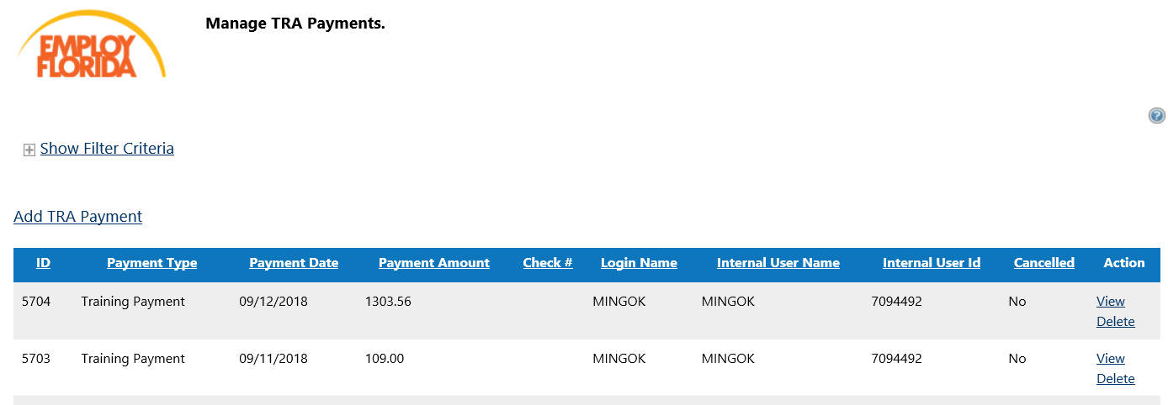
Employ Florida Reporting
Notes:
Local TAA coordinators are required to report all accrued TAA expenditures in Employ Florida under the TRA payment section of the participant’s TAA application. To ensure everyone understands what is required, we are going to provide a brief step-by-step walkthrough.

Slide 15
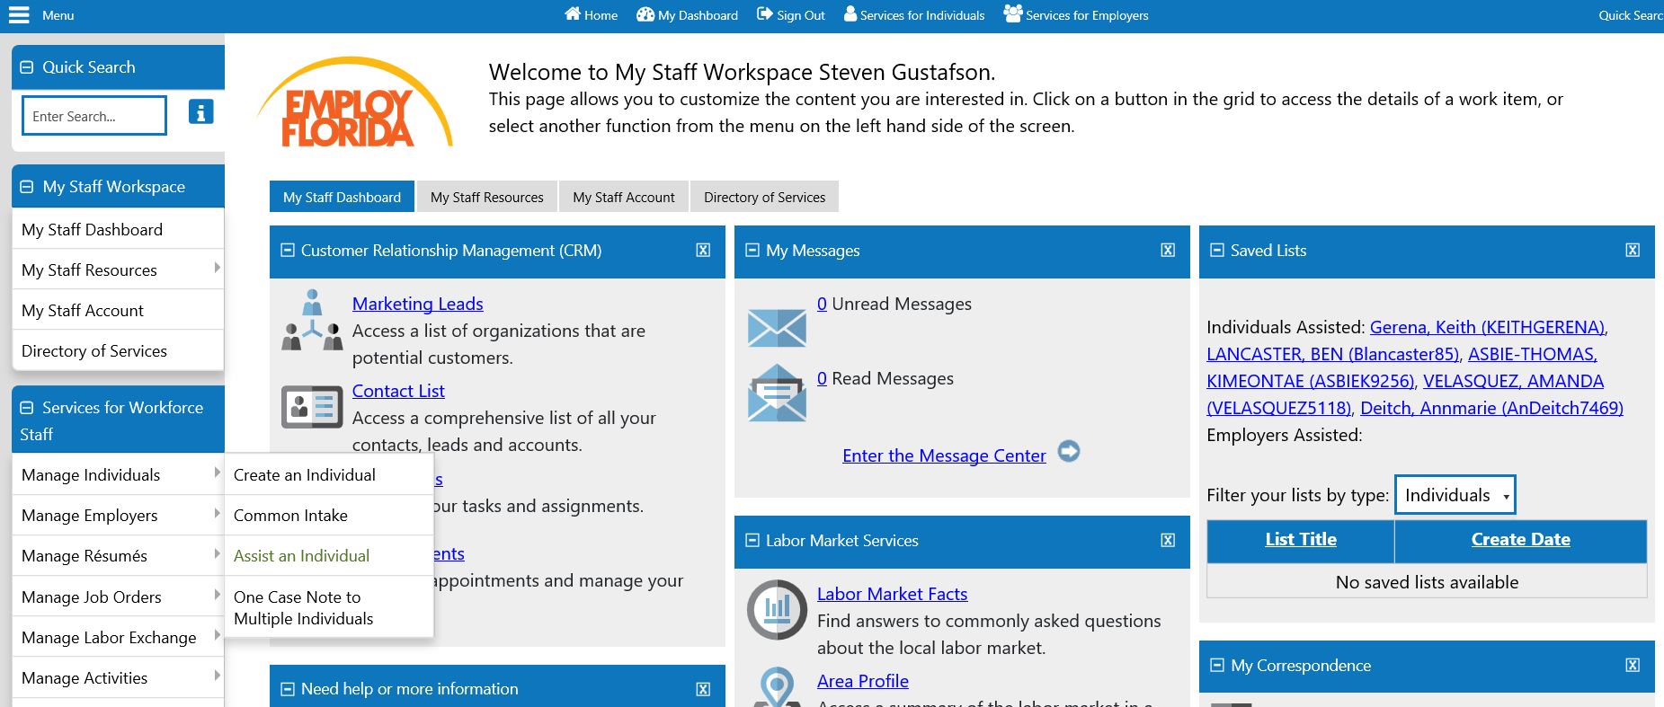
Employ Florida Reporting – Step 1
Notes:
[Read Slide]

Slide 16
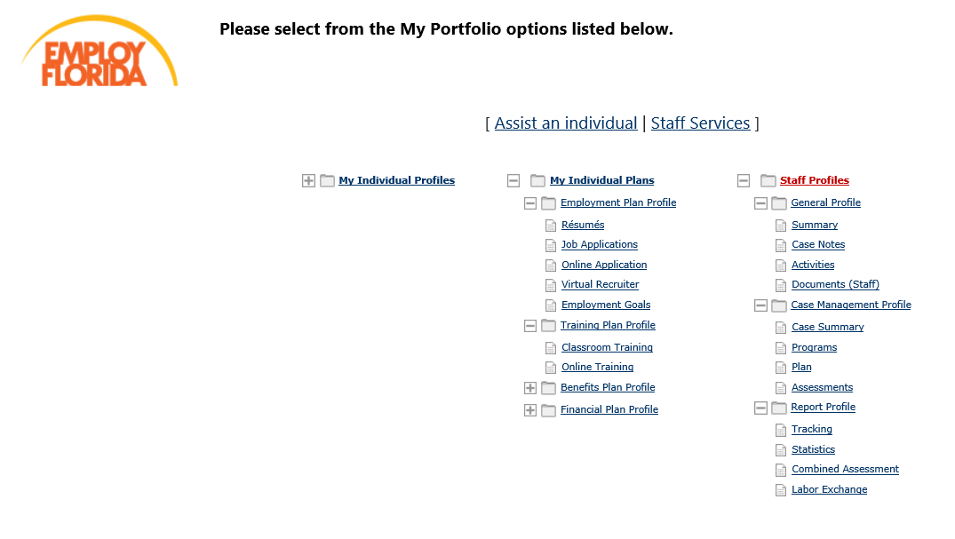
Employ Florida Reporting – Step 2
Notes:
After selecting an individual to assist, open the Staff Profiles tab and select Programs (under the case management profile).

Slide 17
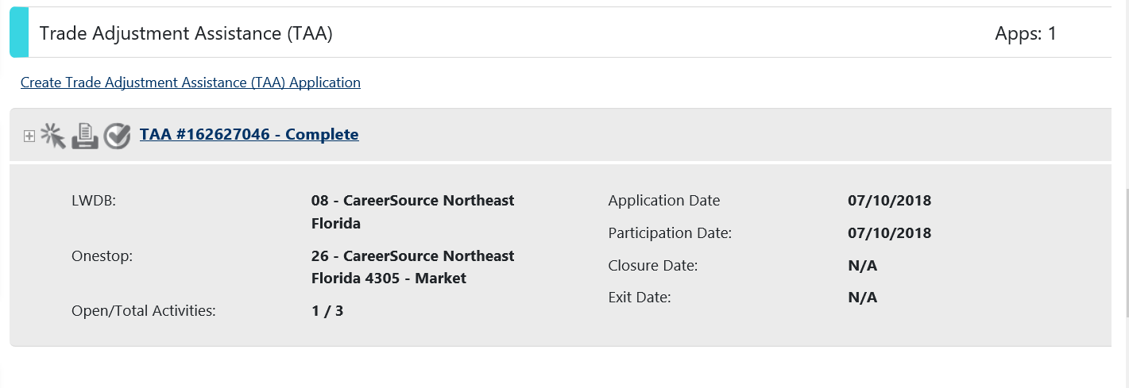
Employ Florida Reporting – Step 3
Notes:
Next, you will want to scroll down to the participant’s TAA Application and click the plus sign to expand the TAA application.

Slide 18
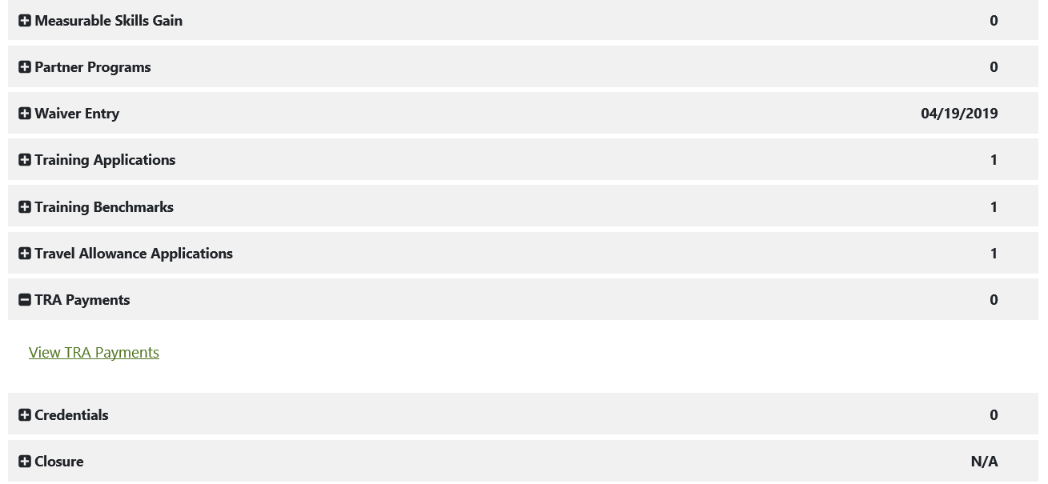
Employ Florida Reporting – Step 4
Notes:
Once the TAA Application has been expanded, you will click the plus sign next to TRA Payments and click the View TRA Payments hyperlink.

Slide 19
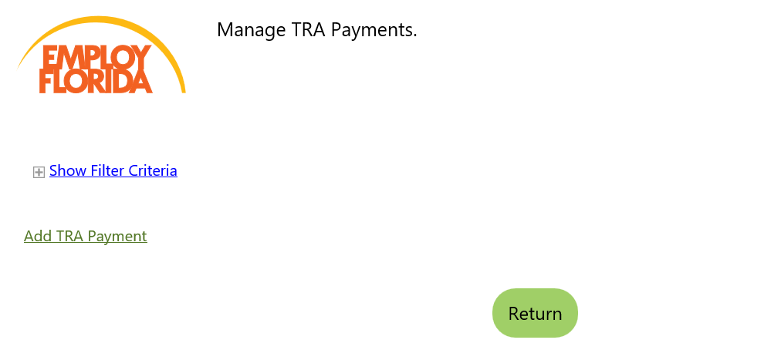
Employ Florida Reporting – Step 5
Notes:
Next, you will be brought to the Manage TRA Payments screen. Here you will click the Add TRA Payment hyperlink.

Slide 20
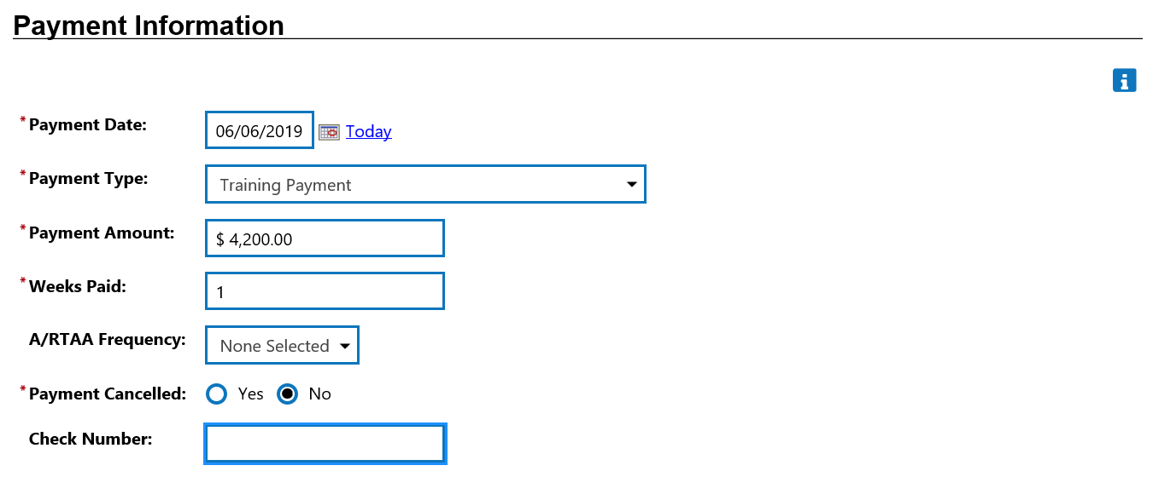
Employ Florida Reporting – Step 6
Notes:
Complete the required fields of the Payment Information section, to include:
Payment Date – The date the payment became accrued or owed.
Payment Type – Select Training Payment from the drop down menu.
Payment Amount – Enter the accrued or owed training cost.
Weeks Paid – Leave this field as 1; it is not applicable.
A/RTAA Frequency – Select None Selected from the drop down menu.
Payment Canceled – Select No.
Check Number – Not required; leave blank.
Although this section of Employ Florida is titled Payment Information, it is important to remember that you are reporting owed or accrued costs and not payments which have been made. To reiterate, payment dates have no correlation to the reporting of TAA training costs; these costs are reported as soon as they become owed or accrued.

Slide 21
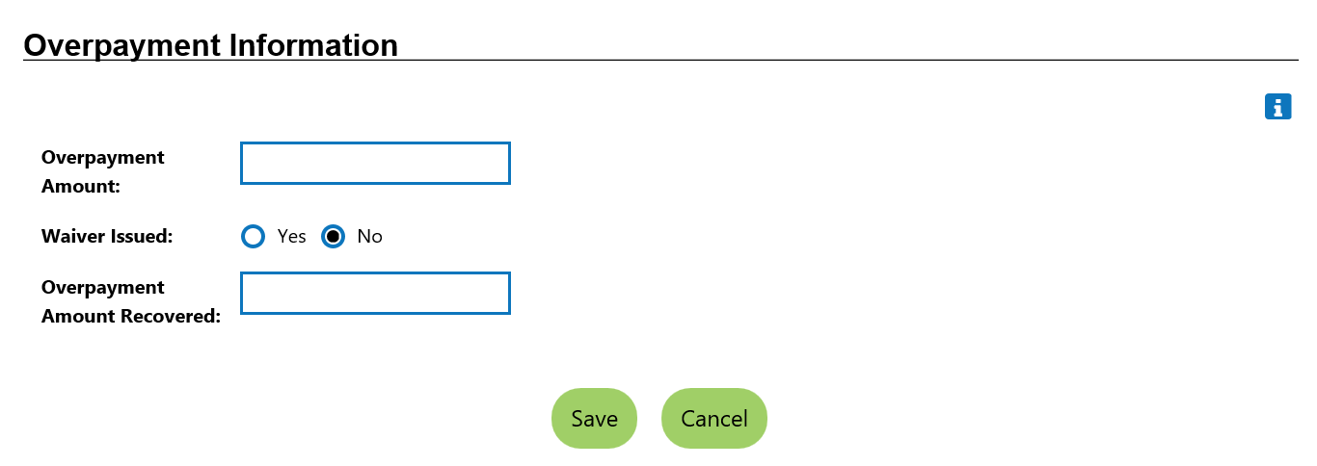
Employ Florida Reporting – Step 7
Notes:
Next, bypass the Overpayment Information section and click the Save button.

Slide 22
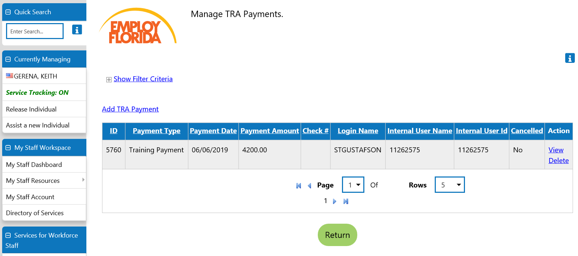
Employ Florida Reporting - Review
Notes:
The training expenditure has been successfully reported. You should now see the expenditure on the Manage TRA Payments screen.

Slide 23
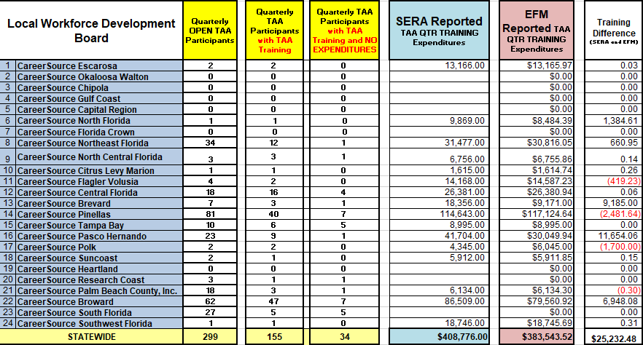
Monthly Reconciliation
Notes:
As stated earlier, the TAADI report requires that the reported TAA expenditures on the PIRL and 9130 have a maximum of 15% variance. FloridaCommerce now conducts monthly reconciliation of expenditures reported by Local TAA Coordinators in Employ Florida and expenditures from SERA. When FloridaCommerce notices anomalies between the two, LWDBs will be contacted individually in order to address any reporting discrepancies.

Slide 24
Knowledge Check
Place your answer in the comment box.
Which cost category supports the TAA program’s indirect costs?
Case Management
Training
Trade Readjustment Allowance (TRA)
WIOA
a) – The Case Management cost category supports the TAA program’s portion of indirect costs.
Notes:
So, before we move into the Q&A session, I thought we could take a brief moment to perform a knowledge check on some of the information you have received here today. Go ahead and type your answer in the comment box whenever you are ready.
[Read Slide]

Slide 25
Knowledge Check
Place your answer in the comment box.
Which TAA cost category is designated for direct participant costs?
Administrative
Program (Training)
Case Management
WIOA
b) - The Program (Training) cost category is designated for direct participant costs.
Notes:
[Read Slide]

Slide 26
Knowledge Check
Place your answer in the comment box.
Training costs should be reported in Employ Florida as soon as the bill is paid.
True
False
b) False - Training costs should be reported in Employ Florida as soon as they are accrued or owed.
Notes:
[Read Slide]

Slide 27
Questions & Answers

Slide 28
Contact Us
Thank You.
If you have questions or comments about this presentation, please contact us.
Yolanda Triplett, State Trade Program Coordinator
Email: TAA@commerce.fl.gov
Main Line: 850-245-7477
Caroline Womack, Chief, Bureau of Financial Management
Email: Caroline.Womack@commerce.fl.gov
Main Line: 850-245-7126

