Slide 1
Welfare Transition (WT) Domestic Violence and Safety Plan

Slide 2
Objectives
Local Workforce Development Areas (LWDAs) responsibility to assist victims of domestic violence.
What is a Safety Plan?
Incorporating safety plan elements into the Individual Responsibility Plan (IRP) or Alternative Requirement Plan (ARP).
What is domestic violence?
Providing information during WT Orientation/Work Registration.

Slide 3
What is Domestic Violence?
Florida Statues 414.0252 defines domestic violence as: “any assault, aggravated assault, battery, aggravated battery, sexual assault, sexual battery, stalking, aggravated stalking, kidnapping, false imprisonment, or any criminal offense that results in the physical injury or death of one family or household member by another.”

Slide 4
WT Orientation/Work Registration
WT Orientation/Work Registration process:
Provide general domestic violence information
Provide general information when giving handouts and community resources
Domestic violence hotline
Provide information to men and women
Be careful of the language used when discussing domestic violence in a group setting

Slide 5
Domestic Violence Disclosure
Self-disclosure
Do not report it to law enforcement

Slide 6
Domestic Violence Disclosure
Suspected domestic violence
Consistent failure to report to assigned activities
Individual is withdrawn and secretive

Slide 7
Domestic Violence Disclosure
Third party or anonymous reporting
Other program staff
Domestic violence counselor

Slide 8
LWDAs Responsibility
Assure participant that any information disclosed to the LWDAs provider regarding domestic violence will remain confidential
Develop a safety plan
Include safety plan elements in IRP or ARP
Provide referrals to support services as needed
Provide information about Diversion Services

Slide 9
What is a Safety Plan?
A safety plan is a personalized plan that includes ways to remain safe while in an abusive relationship, while you’re planning to leave or after you leave

Slide 10
Safety Plan Development
Developing a safety plan
Resources for escape
Plan for a way out
Safe place to sleep
Friends and family
Shelter
Safe meeting places
Domestic Violence Counselor’s Office
Police Department

Slide 11
Keeping The Safety Plan Secure
Ensure you notify the participant to keep the safety plan where their partner won’t find it. They can ask a friend or family member to keep it for them.

Slide 12
Safety Plan Example

Slide 13
Safety Plan

Slide 14
Safety Plan

Slide 15
Safety Plan

Slide 16
Developing the IRP/ARP Steps
After the completion of the safety plan, incorporate elements from the plan into the IRP/ARP steps

Slide 17
IRP/ARP Steps
General- Participating in various levels of safety planning
Specific* I will continue to meet with my advocate to work on improving my safety planning to keep myself and my family safe
General- Attempting temporary or permanent relocation
Specific * I will take the steps discussed with my advocate and identified in my plan to remove me from the situation

Slide 18
IRP/ARP Steps
General- Teach my children how to contact the police. I will make sure they know our address and telephone number
Specific *
Participant will teach his/her children how to contact the police if they suspect danger
Participant will make sure his/her children know their address
Participant will make sure his/her children know the name and phone number of an emergency contact

Slide 19
Assigning Alternative Activities
Alternative Activities
Counseling
Dealing with the mental and emotional pain

Slide 20
Assigning Alternative Activities
Alternative Activities
Social Skills
Communicating with people

Slide 21
Assigning Alternative Activities
Alternative Activities
Parenting
Time management
Dealing with stress

Slide 22
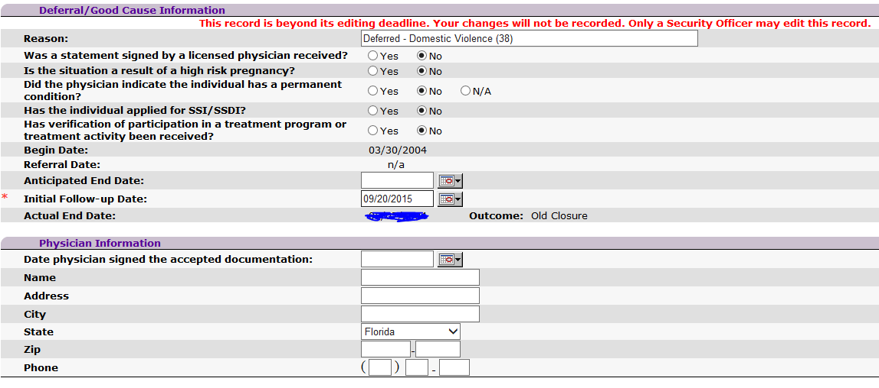
OSST Data Entry Requirement
08/25/2015

Slide 23
Domestic Violence Resources
Domestic Violence
What else should I know about domestic violence?
DEO’s Domestic Violence Guidance
Florida Coalition Against Domestic Violence (FCADV)
http://www.fcadv.org
Domestic Abuse hotline: 800-500-1119

Slide 24
Questions
Please contact us at:
WT.SNAPProgramInfo@deo.myflorida.com

