Slide 1
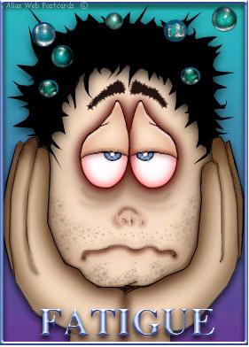
Making Work
Work
How Compassion Fatigue Can Hinder
The Workforce Professional

Slide 2
Words To Know
Burnout
Secondary Traumatic Stress (STS)
Compassion Fatigue (CF)
Chronic Vicarious Exposure
Stress Hardiness
Helper’s High
Energy Vampires
Compassion Satisfaction (CS)

Slide 3
Compassion Fatigue
Compassion Fatigue
The result of an individual experiencing both burnout and secondary trauma
Burnout
Secondary
Trauma
Compassion Fatigue
Notes:
Compassion Fatigue is said to exist when a professional is both experiencing burnout and secondary trauma.

Slide 4
What is Compassion Fatigue
Burnout
Stress related to the job environment in which we work as well as the job requirements
Excessive Paperwork
Long Hours
Difficult Customers

Slide 5
What is Compassion Fatigue
Secondary Traumatic Stress
The reaction to dealing with other’s situations
Secondary Victimization
Secondary Traumatization
Secondary Survivor
Whose Stuff is This?

Slide 6
What is Compassion Fatigue
Compassion Fatigue
Occupational exhaustion associated with deep physical, emotional, and spiritual giving
The inability to feel compassion or the gradual lessening of compassion that exists overtime
Notes:
Compassion Fatigue is said to exist when a professional is both experiencing burnout and secondary trauma.

Slide 7
What is Compassion Fatigue
For some, Compassion Fatigue is also the clash between their current reality and their past expectations
Reality
Expectations
Notes:
Compassion Fatigue is said to exist when a professional is both experiencing burnout and secondary trauma.

Slide 8
Helping Professions
Professions that nurture the growth of or address the problems of a person's physical, psychological, intellectual, emotional, or spiritual
well-being

Slide 9
Helping Professions
Workforce Professionals are
Helping Professionals
Therefore Prone to Burnout and Compassion Fatigue
Who Do We Help?
How Do We Help Them?

Slide 10
Compassion Fatigue
Teaching to Prevent Burnout in the Helping Professions by Debra Damn
“Watching talented and even gifted colleagues struggle with emotional exhaustion and coping through cynicism becomes taxing to the morale of all helping professionals.”

Slide 11
Career Builder Burnout Survey
Notes:
A recent survey by Career Builder.com revealed that 77 percent of American workers say they feel burned out on the job

Slide 12
How Do We Get It
HOW DOES
THE
WORKFORCE PROFESSIONAL
BECOME FATIGUED?

Slide 13
We Came With It
Most people who choose helping professions are usually
burned out or fatigued prior to entering the field
People that are attracted to helping professions…
Are Natural Nurturers
May come from dysfunctional homes or backgrounds
Have a strong identification with the helpless and suffering
Were taught early to care for the needs of others
Seek a Helper’s High

Slide 14
Helper’s High
Helper’s High
A euphoric feeling followed by a period of calm, experienced after performing a kind act
The physical sensation results from the release of endorphins
Individual feels an improved emotional well-being and a sense of self-worth
These feelings reduce stress and improve the health of the helper
Notes:
Helpers’ high is a euphoric feeling, followed by a longer period of calm, experienced after performing a kind act. The physical sensation results from the release of endorphins, and is followed by a longer-lasting period of improved emotional well-being and sense of self-worth, feelings that in turn reduce stress and improve the health of the helper.

Slide 15
We Acquired It
Unfulfilled Expectations-Reality Hits
My Professor Did Not Tell Me This!
Institutional Stress
Information Overload
Chronic Vicarious Exposure
Via Media
Via Customers

Slide 16
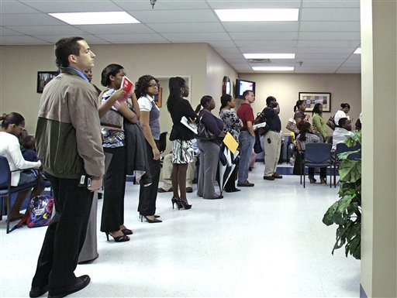
One Stop Career Centers
High degree of responsibility
High degree of paper work
Demanding caseloads
Cubicle Setting
Little Privacy
Daily crisis
Long hours

Slide 17
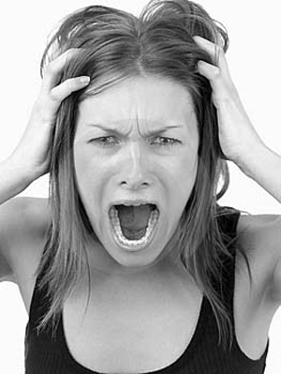
Unfulfilled Expectations
My Professor Did Not Tell Me This
Institutional Stress
Keeping your work space clean
Only 5 personal items allowed
No offensive material
Welcome to the Cubicles!
Only managers get offices
Please eat in the break room
I thought we could wear jeans on FRIDAYS!

Slide 18
Unfulfilled Expectations
My Professor Did Not Tell Me This
Lack of Appreciation
That’s Your Job!
Time & Attendance
But I always work late…
Networking & Competition
Office Politics
Due Process

Slide 19
Information Overload
Remembering Passwords
Learning Local Operating Procedures
Learning Program Standard Operating Procedures
Getting To Know Your Customers and Their Story
Learning Different Management Information Systems

Slide 20
Chronic Vicarious Exposure
We are all socio-biologically connected
I feel your pain…
Helper’s High-Joy from Helping Others
Energy Vampires- Drain Your Energy
Overexposure to problems that are continuous and
irresolvable
Desensitizes individuals
Causes a lack of responsiveness
Repetitive Empathetic Engagements

Slide 21
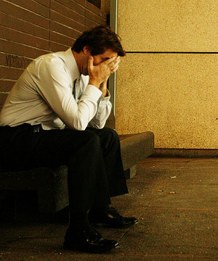
Overexposure
From Our Customers
Participation Pushback
Not attending scheduled activities
Not following through with career plans
Difficult Interaction
Angry or Defensive
Physical or Verbal aggression
Repeated Disappointments
Exhausting benefits prior to reaching self-sufficiency
Not taking advantage of available resources and referrals
Job Abandonment
Notes:
Compassion Fatigue also comes from repetitive empathetic engagements with people that are in stressful situations.

Slide 22
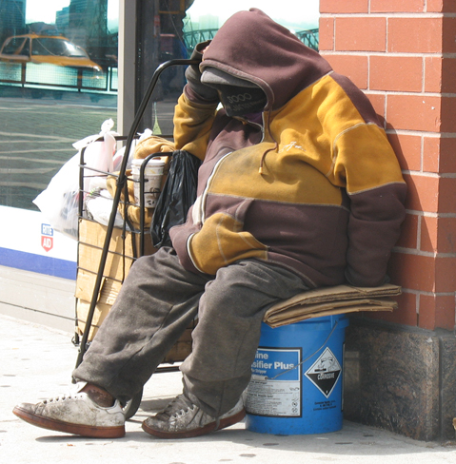
Overexposure
From the Media
Exploitation of Disadvantaged Populations
Homeless
Unemployed
Needy
Exploitation of Vulnerable People
Victims of Trauma
Domestic/Sexual Violence
Child Abuse

Slide 23
Effects of Compassion Fatigue
HOW DOES IT AFFECT
THE
WORKFORCE PROFESSIONAL

Slide 24
Effects of Compassion Fatigue
Psychologically
Biologically
Anxiety
Depression
Hyper vigilance
Over protectiveness
Ulcers
Inability to sleep
Decreased energy
Headaches/migraines
Aggravated pre-existing conditions

Slide 25
Effects of Compassion Fatigue
Individual
Individual
May Appear
May Feel
Cynical
Isolated
Negative
Withdrawn
Unproductive
Easily Agitated
Highly Critical
Inflexible
Defensive
Unfocused
Inadequate
Incompetent
Helplessness
Hopelessness
Powerlessness
Overwhelmed
A diminished desire
to help people

Slide 26
Effects of Compassion Fatigue
Organizational Symptoms of CF
Diffusion of Responsibility
Some One Else’s Problem (SEP)
Allows things to happen in a group that would not allow if the
individual were alone
Bystander Effect
The more people around the less likely anyone will do anything
Group Think
Conformity releases the individual from responsibility
Notes:
Work Strain or institutional stress is never completely contained to the work environment.

Slide 27
Effects of Compassion Fatigue
How Does the Region Suffer?
High turnover rates
Chronic Absenteeism
Lack of a vision for the future
Spiraling worker's comp costs
Strong reluctance toward change
Negativism towards management
Unstable co-worker relationships
Horizontal Violence or Aggression
Lack of flexibility among staff members
Inability for teams to work well together
Inability of staff to respect and meet deadlines
Inability of staff to believe improvement is possible

Slide 28
Combating CF
How Can Organizations Combat CF

Slide 29
Stress-Hardy Staff
Stress-Hardy Personality
Personality traits within some individuals that allow them to be more resistant and better protected from the effects of stress than others
Stress-Hardy Personality Traits
Commitment
Control
Challenge
Notes:
Stress is a reaction to a perceived threat, therefore it lies in the eye of the beholder. Individuals with these personality traits, lowered there chances of developing a stress related health problem by 50% and individuals that do not naturally have these traits can acquire them with time and patience if they are taught the skills.

Slide 30
Developing Stress-Hardiness
Commitment
When individuals are committed to something they tend to be more motivated and willing to put in more effort

Slide 31
Developing Stress-Hardiness
Control
The amount of control that we feel we have over a stressor determines how difficult it will be for us to cope with it
Notes:
Individuals experiencing compassion fatigue can learn to control how they respond to challenges.

Slide 32
Developing Stress-Hardiness
Challenge
Stressful events are seen as challenges instead of threats and the individual is able to accept that change is inevitable

Slide 33
Developing Stress-Hardiness
Individuals must learn how to…
Control the way they respond to challenges
More Confidently
Less Destructively
Notes:
Individuals experiencing compassion fatigue have to learn how to control how they respond to challenges

Slide 34
Developing Stress-Hardiness
Destructive Stress Responses
Emotional Eating-Not Eating
Verbal or Physical Aggression
Self-Defeating Language
Throwing in the Towel
Initiating Workplace Conflict
Defiance-Insubordination
Notes:
Individuals experiencing compassion fatigue have to learn how to control how they respond to challenges

Slide 35
Team Treatment Model
Team Work
Makes
the
Dream Work

Slide 36
Team Treatment Model
Create a positive and supportive environment for teams to work in
Provide opportunities for team members to discuss their stress
Lower the caseload number per team member
Allow team members to split-up or rotate difficult caseloads
Create teambuilding and socialization activities to increase trust and cohesion amongst team members
Notes:
Teams and organizations that create a positive environment that normalizes the effects of
trauma and working in high stress situations can help to lower compassion fatigue…It is
particularly important that difficult cases are shared among staff; this alleviates putting the
burden on only one person.

Slide 37
Team Treatment Model
Encourage
Self-Care & Positive Stress Responses
Healthy Habits
Good Nutrition
Sleep
Exercises
Work Breaks
Educate
Causes of Compassion Fatigue
Effects of Compassion Fatigue
How to Combat Compassion Fatigue
Notes:
Teams that interact and build group bonds have better cohesion and lower compassion
fatigue. Having team parties and social events can increase trust and teamwork.

Slide 38
A Healthy Workforce
Healing an organization takes…
Time
Patience
Commitment
Management must be aware of Compassion Fatigue
and the effect it is having on staff

Slide 39
A Healthy Workforce
A healthier workforce
will lead to better client outcomes and lower
staff turnover
Notes:
A research study was performed to review the affect the STS has on job retention and occupational commitment. The results of the study were that it significantly predicts both job satisfaction and occupational commitment.

Slide 40
Combating CF
How Can Individuals Combat CF

Slide 41
Reconnect & Align
Reconnect & Align
Your purpose-Why are YOU here
Program Purpose-Why are WE here
Your Purpose
Program Purpose

Slide 42
Set S.M.A.R.T. Goals
Specific-Measureable-Attainable-Reasonable-Time Targeted
Set Goals
Things I want to accomplish in my life
Things I want to change about my life
S
T
M
A
R
Notes:
Make sure these goals are set by you and not by others.

Slide 43
Minimize Exposure
Minimize Exposure
Go Home!
Turn the TV Off
Change The Topic
Make New Friends
Leave Work At Work
Use Your Vacation Time
Notes:
Diversify your life by becoming friends with people outside of your profession. Allow yourself to engage with different types of professionals.

Slide 44
Vacation Deprivation Survey
Notes:
Expedia.com's annual "Vacation Deprivation Survey" found that seven out of 10 Americans don't feel they have a healthy balance between work and personal life and nine out of 10 say vacations make them better employees.

Slide 45
Vacation Deprivation Survey
21
Billion Dollars
460 Million Lost Vacation Days
Notes:
Workers hand back to their employers $21 billion in unused vacation days each year. That’s 460 million vacation days.

Slide 46
Pleasurable Experiences
Participate in Pleasurable Experiences
Legal!
No Helping Highs!
Notes:
1 in five working adults feels guilty for taking a vacation therefore 12% of us never take one. Give yourself permission to enjoy your life without any regrets!

Slide 47
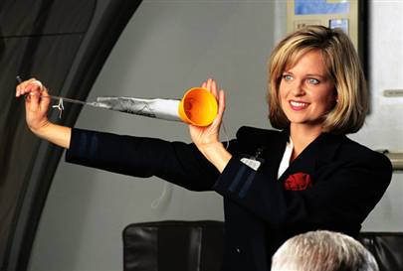
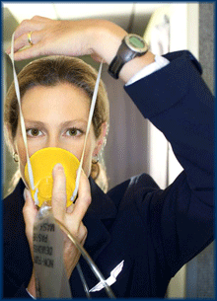
Self Preservation
Save
Yourself
Notes:
Expert Charles Figley uses the example of the oxygen masks on airplanes to sum up this issue. If you have ever been on an airplane, you know that the flight attendants instruct you to put on your own mask first in an emergency, then help others. Fitness for the frontline.

Slide 48
Compassion Satisfaction
Compassion Fatigue
Compassion Satisfaction
Notes:
Compassion Satisfaction is being satisfied with doing the work of caring. This job satisfaction and personal gratification all protect us from compassion fatigue.

Slide 49
Useful Resources
Whose Stuff is This by Yvonne Perry
To Weep For a Stranger by Patricia Smith
Heart at Work www.barbarababkirk.com
Compassion Fatigue www.socialworker.com
Traumatology Journal www.tmt.sagepub.com
Compassion Fatigue in the Helping Professions
www.familystressencyclopedia.blogspot.com
Treating Compassion Fatigue by Charles Figley
Stress Hardiness www.stresscourse.tripod.com
Compassion Fatigue Self Test www.compassionfatigue.org
Vacations Benefit Both Worker and Boss www.businessmainetoday.com
Websites, Articles, & Books

Slide 50
Thank You!
For More Resources
Please Email Nikki Brown nikki.brown@deo.myflorida.com
An equal opportunity employer/program. Auxiliary aids and services are available upon request to individuals with disabilities. All voice telephone numbers on this document may be reached by persons using TTY/TDD equipment via Florida Relay Service at 711.

