Slide 1
Welfare Transition Automation
One-Stop Service Tracking (OSST) Client Login and Client Screens – Part 1
Notes:
Welcome to the Department of Economic Opportunity’s (DEO’s) Welfare Transition (WT) program presentation. This presentation focuses on Client Login and Client Screens for WT applicants in the One Stop Service Tracking (OSST) system who must complete the Work Registration process.

Slide 2
Commonly Used Terms
One-Stop Service Tracking (OSST)
Welfare Transition (WT)
Temporary Cash Assistance (TCA)
Department of Children and Families (DCF)
Supplemental Nutrition Assistance Program (SNAP)
Food Assistance (FA)
Notes:
Throughout this presentation, you will hear commonly used terms.
The One-Stop Service Tracking (OSST) system is Florida’s Management Information System for two of the State’s workforce programs: Welfare Transition and Supplemental Nutrition Assistance Program.
The Welfare Transition (WT) program is designed to provide employment and training assistance to help individuals receiving Temporary Cash Assistance (TCA) to help them gain employment and become self-sufficient. TCA is the cash payment a family may receive if the Department of Children and Families (DCF) determines that the family is eligible for cash assistance. The Supplemental Nutrition Assistance Program (SNAP) is an employment and training program designed to help Food Assistance (FA) recipients become self-sufficient. Eligibility for food assistance is determined by DCF, the agency for determining eligibility for various public benefits such as TCA, Food Assistance, and Medicaid.

Slide 3
Who may access OSST?
OSST
TCA applicants
Supplemental Nutrition Assistance Program (SNAP)participants
WT and SNAP staff
WT participants
Notes:
OSST is Florida’s Management Information System (MIS) for the SNAP and WT programs. There are four types of users that may access this system:
TCA Applicants;
WT participants (TCA recipients required to participate in the work program);
Supplemental Nutrition Assistance Program (SNAP) participants; and
WT and SNAP staff.

Slide 4
Applicant and Participant Referral
Department of Children and Families (DCF)
TCA applicants
Work eligible adults
Work eligible teen heads-of-household
TCA Recipients
Determined eligible for TCA by DCF
FA Recipients
Determined eligible for food assistance by DCF
Notes:
Customers may only enter OSST if they have been referred to DEO by DCF
TCA applicants will be referred to DEO for work registration if DCF determines they must register for work with the WT program. FLORIDA will send a pending applicant referral to OSST via system interface. Work eligible adults and teen heads-of-household will be referred for work registration.
Once DCF determines a TCA applicant eligible for assistance, the customer is considered a mandatory WT program participant and is officially referred to the WT program for program participation. Work eligible adults and teen parent heads-of-household will be referred for mandatory participation.
Food assistance recipients who are determined eligible for food assistance benefits are referred for participation in SNAP E & T.

Slide 5
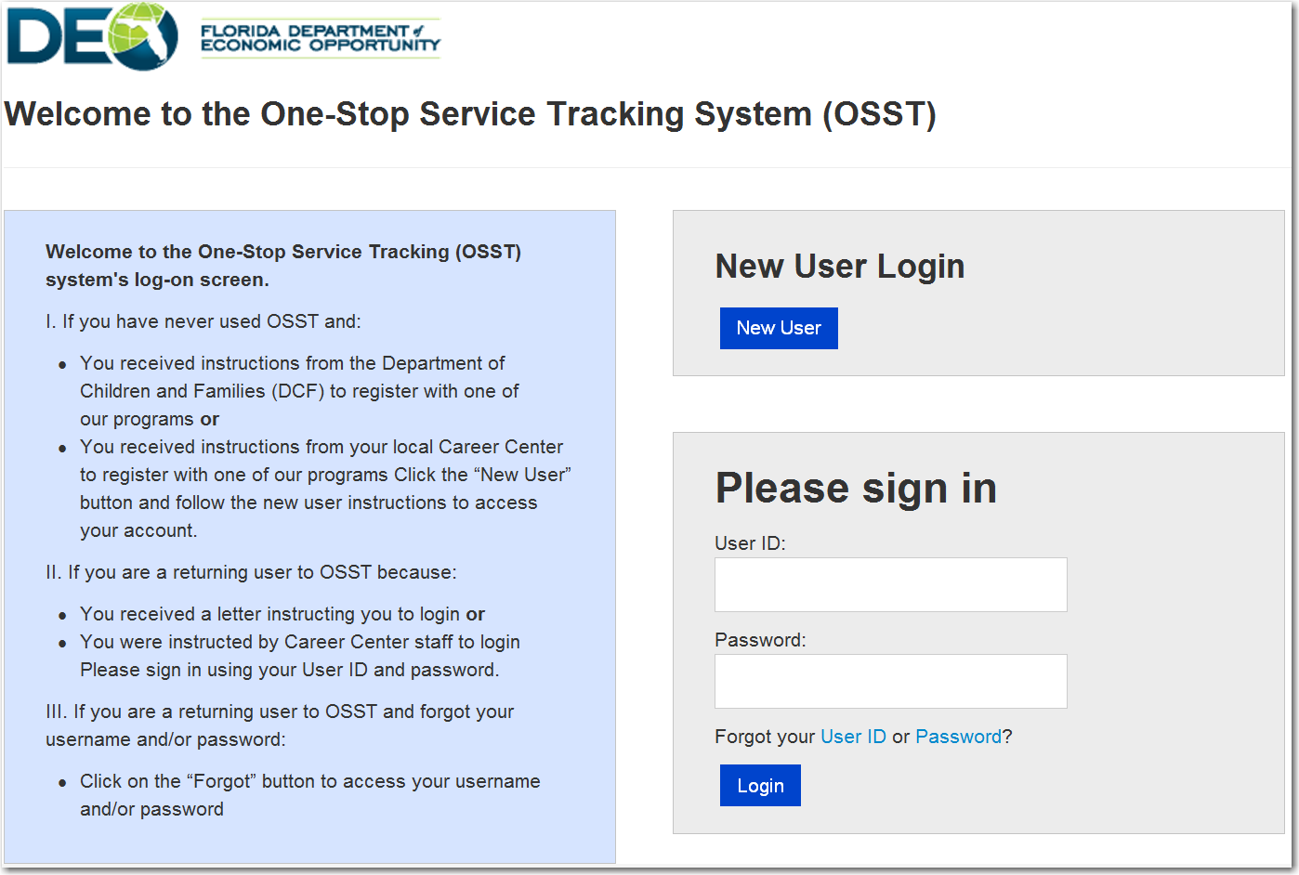
WT Client Login
Notes:
Customers accessing the WT Client URL will land on the “Welcome” page. On the left side of the Welcome page, the customer sees information about why they are being asked to access the system. The customer will receive information about using the system as a new user as well as information on how to access the system if they are a return customer.
On the right hand side of the Welcome page, the customer will see a “New User” button that they can select if they are a new user according to information displayed on the left-hand side of the Welcome page. If the customer is a returning user to the system, the customer is instructed to log-in using their existing credentials. Also provided in the instructions is information about resetting or changing the password if the customer is not able to remember part or all of their login credentials.
In the upcoming slides, we will demonstrate how a new user will access the system.

Slide 6
WT Client Login
Notes:
New users will access their account by clicking on the “New User” button on the Welcome page.

Slide 7
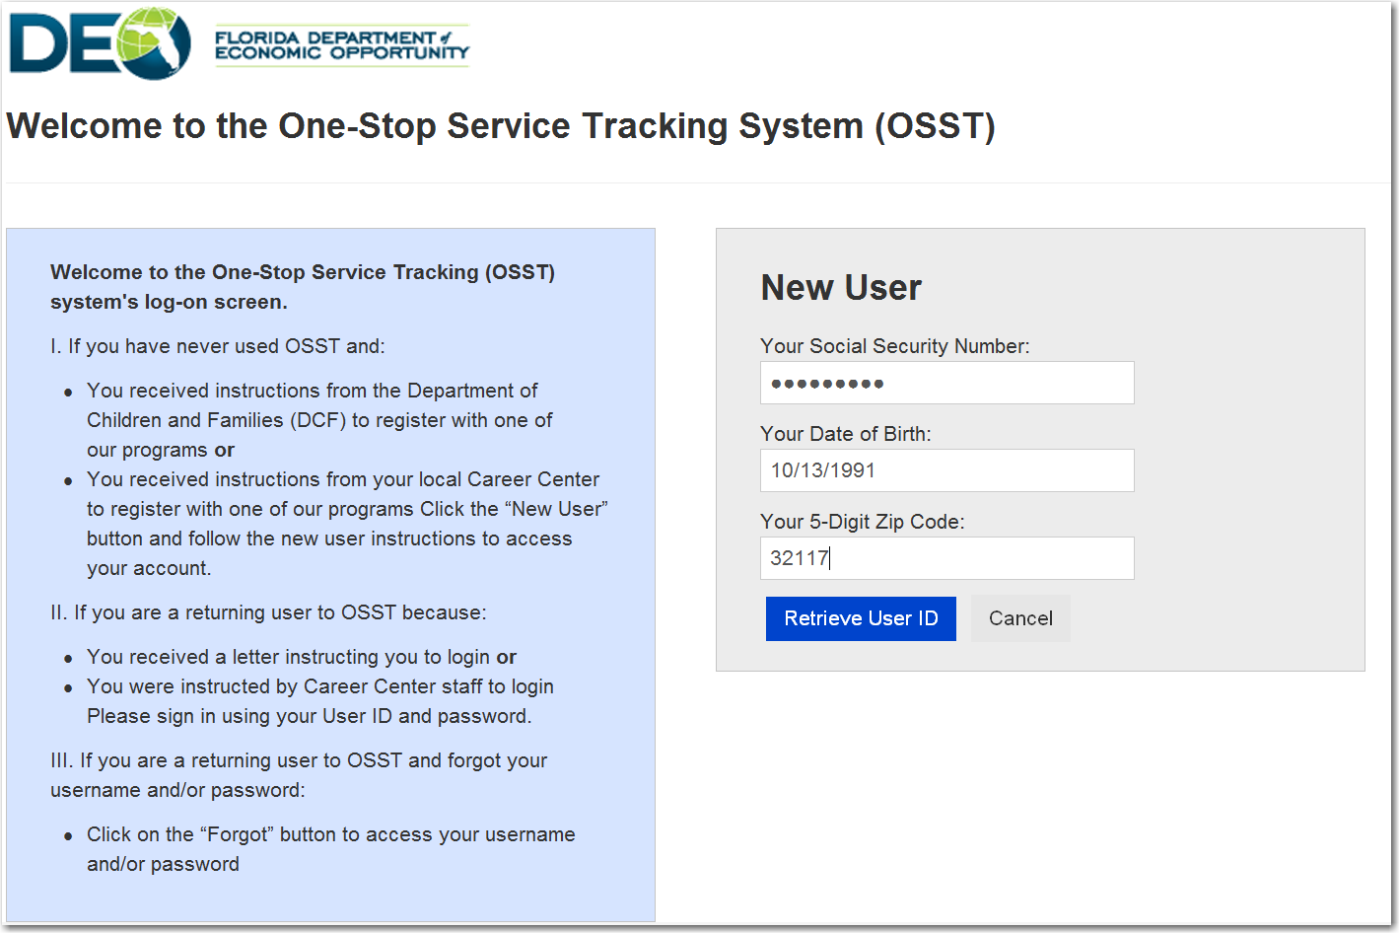
Notes:
Notice that the screen has changed to allow the user to enter information that will allow them to access their case. The customer must be able to provide their
social security number (no dashes);
date of birth; and
the five digit zip code used when they applied for TCA.
For the customer’s protection, their SSN is automatically encrypted as they type it in the field provided. This will prevent viewing of their SSN if they are in a public setting. The birth date must be entered in the two digit month, two digit day and four digit year format (mm,dd,yyyy). Lastly, the user will use the zip code they shared with DCF when they applied for benefits. The user will click the “Retrieve User ID” button to access their information to move forward in the login process.

Slide 8
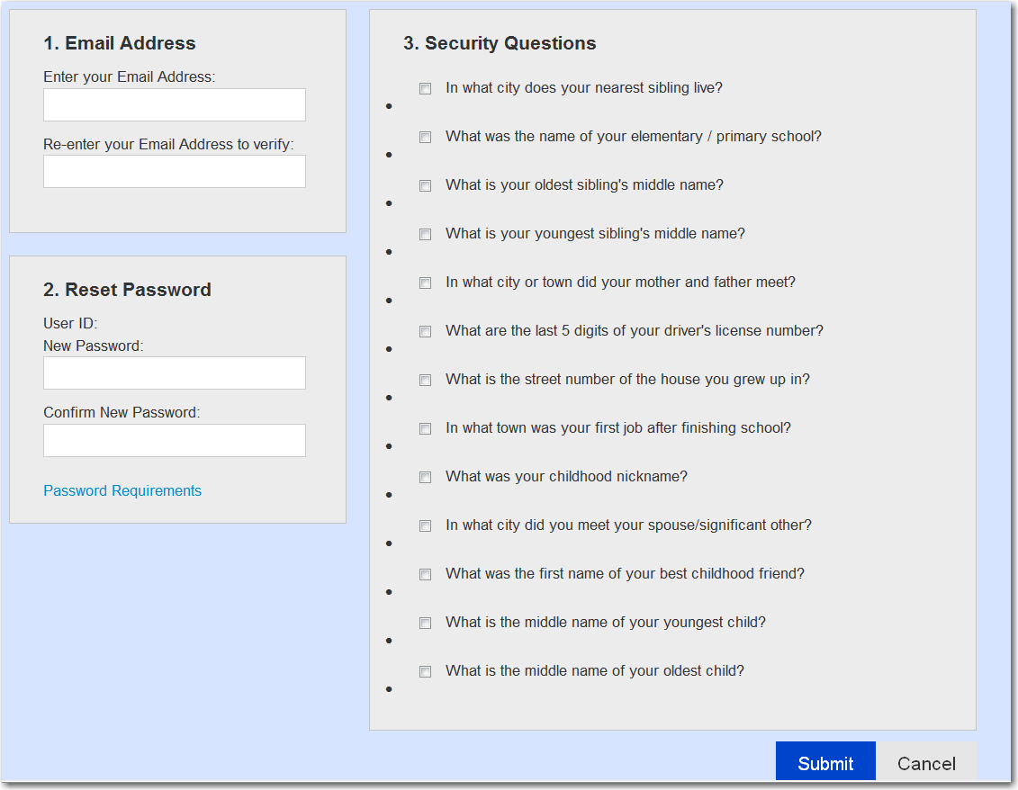
Notes:
Next, the user will be prompted to provide an email address, create a password and answer three security questions as validation for password resets. The email information address will be stored on the customer’s case and the customer will later be given the an opportunity to opt in to receiving correspondence via email. The customer will be asked to re-enter his or her email address to confirm that they have provided the correct email address.
We will discuss Creating a Password and Password Requirements in upcoming slides

Slide 9
Creating a Password
Notes:
Next, the customer will be asked to create a new password and confirm the new password. If the customer is having troubles with creating a password, the criteria for creating a password can be viewed by clicking on the “Password Requirements” text directly beneath the Confirm Password field.
We will discuss the Security Questions in the upcoming slides

Slide 10
Selecting Security Questions
Notes:
Every customer trying to access their OSST account will be asked to select and provide responses for three security questions. In the event that the client can’t recall their password, they will be prompted to answer the three questions they selected when they set-up their account. When the user selects a question, the system will immediately display a box for them to provide a response as illustrated on the right panel.

Slide 11
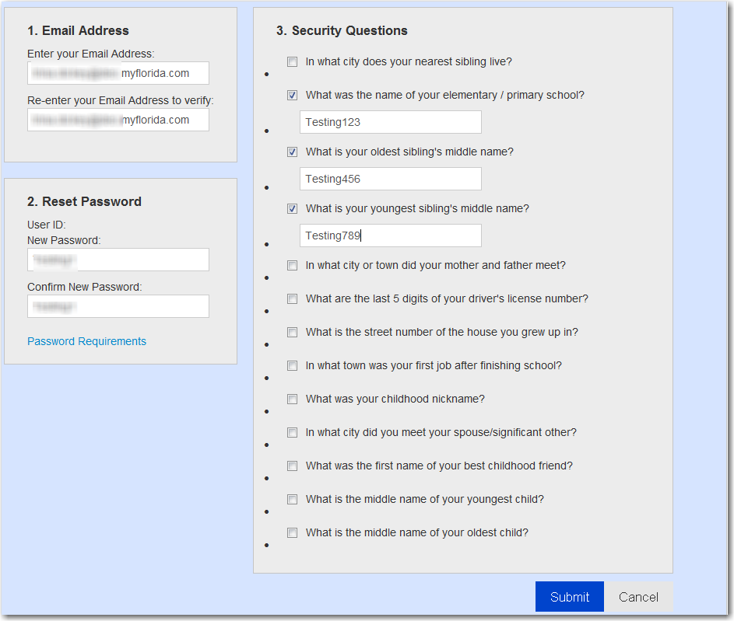
Notes:
Before the customer may click submit, every requirement on the this page must be completed. To recap:
An email address is required;
A password within the guidelines of the requirements must be created; and
Three security questions must be selected and answered.
Once these things are done, the participant will click “Submit”

Slide 12
Client Login
Notes:
After the customer selects “Submit”, the system will refresh and take the user back to the login screen. It now display’s the customer’s User ID in the User ID field as illustrated on the left side panel. The customer will enter their password in the password field and will display in protected format, as illustrated in the right side panel. Once the customer has successfully logged in, they will be asked to review the program Opportunities and Obligations.

Slide 13
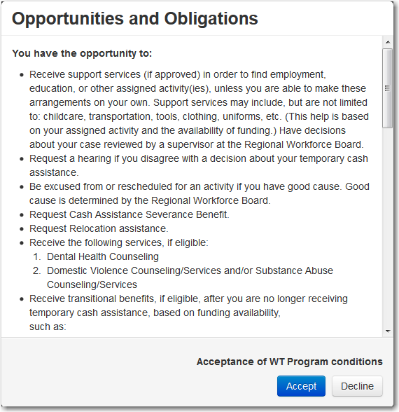
Notes:
Opportunities and Obligations provides the customer with information about what they can expect as a program participant as well as what they are expected to do in the program. It will appear as a pop-up and the applicant cannot move forward until they Accept or Decline the program’s conditions. If the applicant accepts, they will move forward to the reviewing Demographic Information received from DCF during the interface and will be required to review some information and complete other information. The information the applicant will be asked to review or complete will be discussed in upcoming slides. If the applicant Declines, they will be redirected back to the login page and informed of the last date they may come back and complete the process.

Slide 14
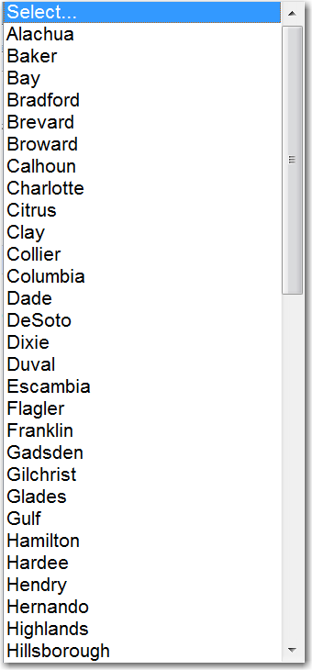
Demographic Information
Notes:
Next, the customer will be asked to complete the same demographic information displayed on the current view of the case manager’s work registration screen. The customer will complete the following under this section:
Select their County of Residence. All of Florida’s county options will display in the dropdown field.
Review the Date of Birth, which will be pre-populated
Select their Gender
Select their Race from the dropdown. The options are displayed in the right side panel of the slide directly across from the red arrow.
Select Yes, No or I do not wish to answer for Heritage. The choices are Haitian Heritage and Hispanic or Latino Heritage.
Answer if they are pregnant. The choices are No or Yes
Answer if they are a refugee. The choices are No or Yes

Slide 15
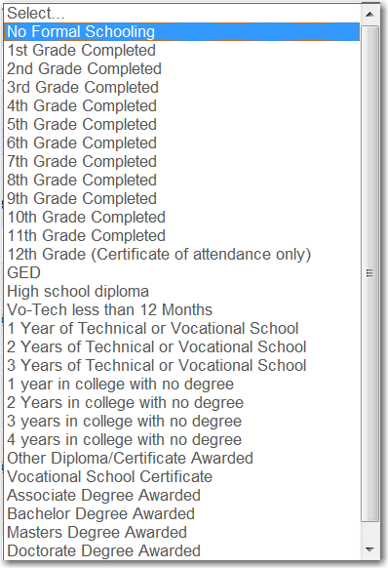
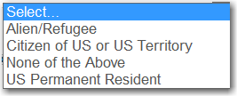
Demographic Information
Notes:
Continuing with demographic information, the customer will be asked to:
Answer the citizenship question. They options from the dropdown field are displayed in the presentation slide
Choose their Highest Grade Completed
Choose an option from the Disability dropdown. The options are displayed in the presentation slide.

Slide 16
Employment Characteristics
Notes:
Next, the customer will see Employment Characteristics. Included in this section are
Employment Desired, which is a dropdown field. The customer will have a choice of
Contract
Internship
Part-time
Unemployed
Volunteer (other)
Preferred Employment Type. The participant may only select one radio button option and the options include: Permanent, Temporary, or No preference.
Minimum Acceptable Salary with choice of hourly or annual wage type
Preferred shift, which is a dropdown option. The options are
Day
Evening
Night
No Preference
Transportation Required. This question asks if the customer will need transportation to get to work.

Slide 17
Employment Information
Notes:
Next, the customer will complete their CURRENT employment status. Selecting the dropdown will display the same options as “Desired Employment”.
They will be asked if they received a notice of termination or layoff or documentation of separating from military service. The options are “No” or “Yes”. If the customer selects “No”, a layoff or military separation date is not needed. If the customer selects “Yes”, the customer may enter the date using the date picker. We will share the difference in how the screen displays when “Yes” is selected and when “No” is selected on the next slide.
Next, the customer will be asked they are currently looking for work. The response options are “No” and “Yes”
Finally, the customer will be asked if they are receiving Unemployment Insurance. The response options are “No” and “Yes”

Slide 18
Separation or Layoff
YES
NO
Notes:
If the customer selects Yes to the recently separated or layoff question, the system will display a date picker that the customer will be able to select the separation or layoff date. If the customer selects “No” the date picker will not display.

Slide 19
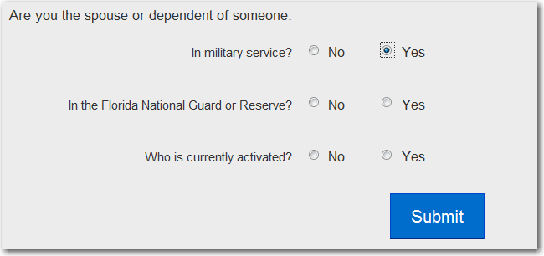
Veteran Information
Notes:
The last section on the Client Form is Veteran Information.
The customer will be asked to select the Veteran Status from a dropdown box. The options are:
Next the customer still select Veteran Disability . The choices are
Disabled
Special Disabled
Not Disabled
Next, the customer will be asked if they are a recently separated veteran. The answer option are “No” and “Yes”
Lastly, the customer will be asked if they are the Spouse or Dependent of someone:
In military service?
The response options for each of these are “No” and “Yes” If the response is “No” the screen will display as shown in the left presentation slide panel. If yes, the screen will display additional selection options for the customer to choose from. Those additional options are:
In the Florida National Guard or Reserve?
Who is currently activated?
Once these questions are answered, the customer will click the “Submit” button

Slide 20
Notes:
When the customer submits the Client Information, they will be allowed to see their status screens. It provides an overview of their steps and requires them to complete the Orientation first. When the user clicks on the hyperlinked “here” the system will display some validations they must check. We have provided a screen shot on the next slide.

Slide 21
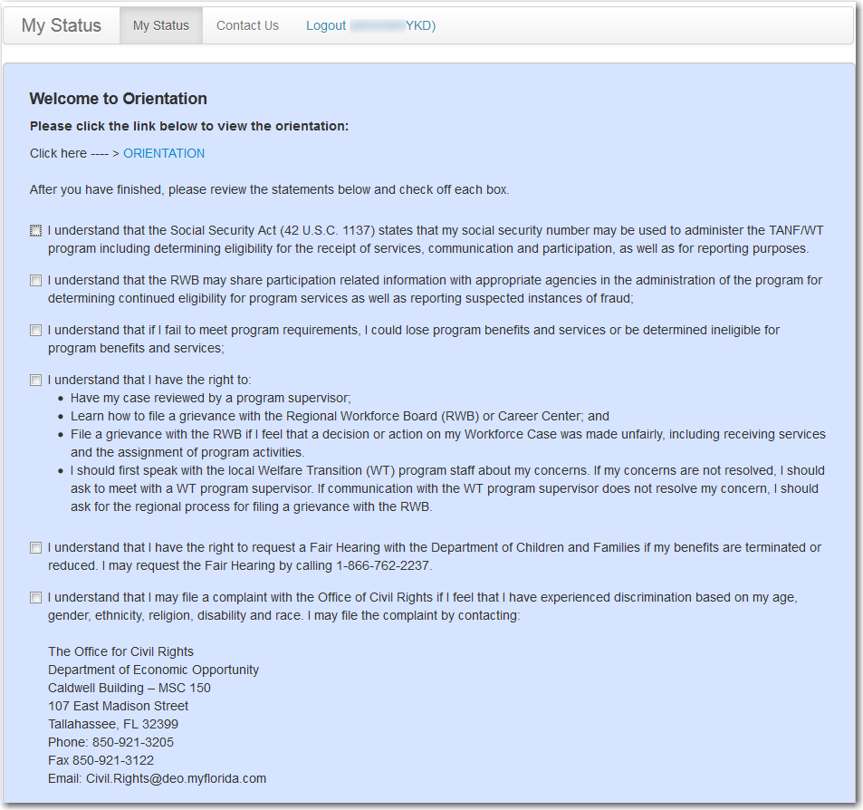
Notes:
After clicking the hyperlink as indicated in the previous slide, the customer will get to this page where they will be required to attest to some acknowledgements. We will talk more about the statements in part 2 of Client Login and Client Screens.

Slide 22
Questions?
Email us your questions at WT_SNAPProgramInfo@deo.myflorida.com
Notes:
This concludes part 1 of Client Login and Client Screens. If you have questions about this presentation or other WT program questions, please email us at WT_SNAPProgramInfo@deo.myflorida.com

