Slide 1


The Hidden Components of a Successful Job Search:
Getting Heard
Notes:
According to the Society for Human Resource Management’s 2009 survey, most hiring managers can tell if a job seeker will not be a good fit within 15 minutes of the start of the interview. Helping our job seekers prepare for the interview is critical to their success.

Slide 2


Objectives
During this lesson, we will discuss the four phases of the interview process
During our discussion of the various phases, we will identify strategies to help our customers move successfully through the interview
Notes:
So, how do we empower customers to change job interviews into job offers? We have to teach them the four phases of the interview process, as well as strategies to move through each phase of the interview process successfully.

Slide 3
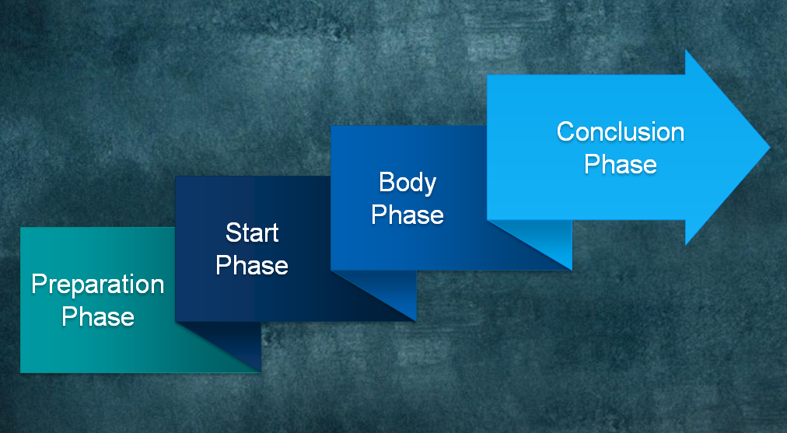
The Four Phases of the Interview
Notes:
There are four phases associated with the interview process. There is the preparation phase, the start phase, the body phase, and the conclusion phase.

Slide 4

The Four Phases of the Interview
Notes:
To be ready for an interview means that job seekers are prepared to navigate through each phase successfully.

Slide 5

Phase One: Preparing for the Interview
Most interviews will last from 15 minutes to an hour
  With certain exceptions, job seeker customer should spend more time getting ready for the interview than in the interview itself
Notes:
Typically, the interview itself is only 15 minutes to an hour. There are exceptions when interviews may take longer, but for the most part, preparing for the interview takes a lot more time than the actual interview itself. Job seeker customers should spend more time getting ready for the interview than in the interview.

Slide 6
Phase One: Preparing for the Interview
When a job seeker goes to an interview, he/she is not just interviewing for “any” job
  The job seeker has to prepare for the interview by getting to know the company and the specific job requirements
The job seeker should research
  The company to find out
    What the company offers (services, goods)
    Who are the company’s major competitors
Notes:
When a job seeker goes to an interview, the job seeker has to realize that he or she is not just applying for any job, the job seeker is applying for a specific job. You, the workforce professional, may have to teach the job seeker that getting ready for each interview is very important to his or her job search success. The job seeker has the unique opportunity to do homework and get ready to impress the interviewer. The job seeker must get to know the company. The job seeker should research what products or services the company offers and who their customers are. The job seeker should also research who the company’s major competitors are. This information should be used to establish a frame of reference to answer interview questions. The information about the company’s goods and services will help the job seeker emphasize the work history and skills that he or she has that relates to what the company is looking for.

Slide 7
Phase One: Preparing for the Interview
The job seeker should also research
  The company’s reputation
  The company’s values
  The job duties
  Responsibilities associated with the position
  Educational requirements associated with the position
Notes:
To relate even further to the employer, the job seeker should also research the company’s reputation, the company’s values, the job duties, responsibilities associated with the position and the educational requirements associated with the position. The job seeker should then practice answering questions based on the information he or she secured during his or her research. The information should be imbedded in answers to the most basic questions. Let’s review an example.

Slide 8


Phase One: Preparing for the Interview
“Working Together” is a major theme of a company that employs over 60,000 individuals in the State of Florida
The job seeker should
  Highlight “team work” in his/her answers
Notes:
For example, one employer in the State of Florida devotes an entire website to the job application and career development process; and, with a staff of over 60,000 individuals, there is no wondering why. Each major section has an overview that highlights how the staff from the entire company must “work together” to make each customer’s experience positive. In just a few minutes of research, we have learned that teamwork is highly valued by this company. So, how does a job seeker applying with this company use this information to his or her advantage? The job seeker makes sure to highlight teamwork in his or her interview answers. For example, most employers ask about the interviewee’s strengths. Teamwork should be a focus in the job seeker’s answer.

Slide 9

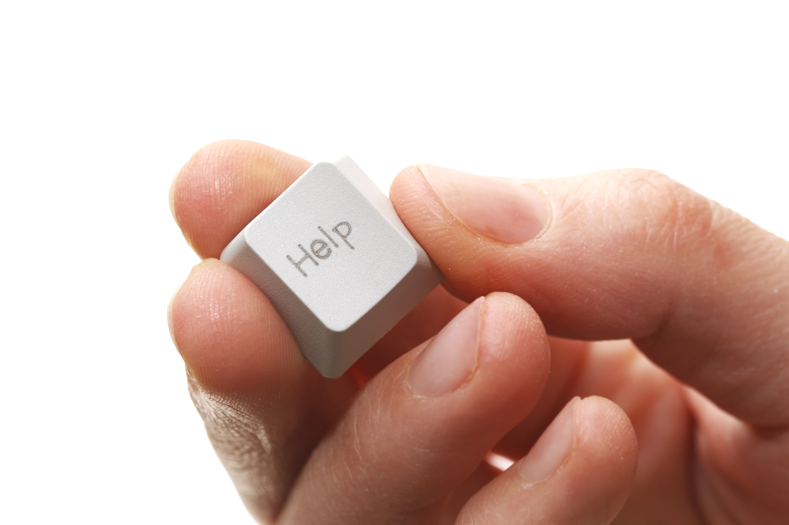
Phase One: Preparing for the Interview
How does a job seeker applying know how to apply research information to his/her interview answers?
Notes:
But, how will a job seeker know how to use this information to formulate answers to critical questions? Some of your job seekers will be comfortable with this process, but others may not. This may be especially true if you find a job seeker who has not worked in a long time and is not getting past the interview. You may have to talk to the job seeker about the interview process and determine if he or she is truly preparing for the job interview and tailoring his or her answers to the employer based on research completed. If not, you may have to guide the job seeker through the interview process.

Slide 10
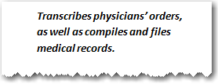


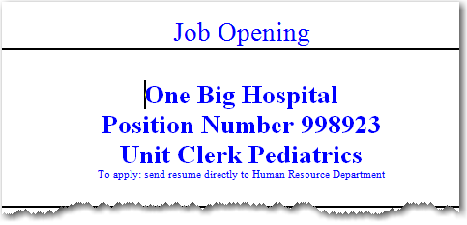
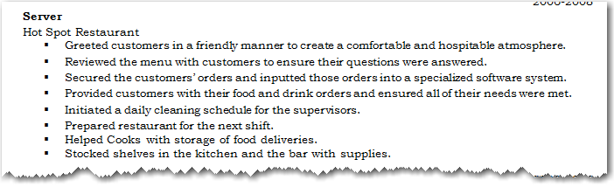
Phase One: Preparing for the Interview
Another example,
  Anny finds a job advertisement for a unit clerk
Notes:
Now, let’s apply what we have discussed to our job seeker customer, Anny. Anny found a job opening at a local hospital. Anny is very interested in the unit clerk position and researches both the company and the requirements associated with the job opening. Anny learns that the job will require her to “transcribe physicians’ orders, as well as compile and file medical records.” Remember, in our previous lessons, we learned that Anny has skills that can be transferred to this job. We highlighted these skills during the application process; however, we must teach Anny to highlight these skills during the interview process as well. When Anny is asked by the employer, “What is one strength that you have that would benefit our unit?” Anny replies, “I have experience taking orders from customers and entering those orders correctly in a computer system. Therefore, I know I can learn the computer system the hospital uses to transcribe doctors' orders into patient records. I know my experience caring for my mother, as well as working in the customer-service industry for over a decade, has prepared me to work hard for you.” In this one answer, Anny has stated she can take orders from customers, relay the information correctly and learn a new computer system. Why is this important? In a survey conducted by the Society for Human Resource Management, 56 percent of hiring professionals polled stated that interviewees who convey they have skills directly related to the job stand out positively during an interview over any other behavior noted.

Slide 11

Phase One: Preparing for the Interview
What are common interview questions?
  Why don’t you tell me a little bit about yourself?
  What are your strengths?
  What are your weaknesses?
  Why should I hire you?
  Why do you want this job?
This leads us to the next step in preparing for the interview
  Job seekers must practice answering interview questions
Notes:
This leads us to the next step in the preparation process. Job seekers must practice answering interview questions so they are comfortable answering questions and are confident in their answers. Failure to practice may lead to several problems. For example, if the individual is not comfortable with the question, the individual may stammer; or, the individual may actually talk on-and-on rather than getting to the focus of the issue and responding with a complete answer. Therefore, the job seeker customer must be comfortable with the most common questions asked by employers. The most common questions asked by employers include:
Why don’t you tell me a little bit about yourself?
What are your strengths?
What are your weaknesses?
Why should I hire you?
Why do you want this job?
Job seekers should be comfortable answering these and other common questions with information specific to the employers and job openings.

Slide 12

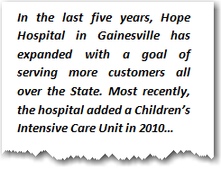

Phase One: Preparing for the Interview
Anny research’s the hospital to prepare for her “Unit Clerk” interview
  She learns the hospital has expanded and plans to continue expanding to reach more customers across the State of Florida
  She also researched the job description in Employ Florida Marketplace (EFM)
  What questions can she ask to show that she has researched the company?
What is the most common question?
  Do you have any questions?
What questions should the interviewee avoid?
  How much does this job pay?
  What does this job entail?
Notes:
There is one question asked in almost every interview which very few people are prepared to answer, “Do you have any questions for me?” And, this question is critical. The answer to this question indicates if the interviewee is engaged in the job search process. The answer to this question must be prepared in advance, and the job seeker customer must be comfortable asking questions that are relevant and appropriate. Questions that are “smart” are focused on the position and are not generic in nature.
Additionally, the job seeker should not ask, “Well what does this job pay?” Pay is negotiated during the job offer phase, but it is typically not discussed at the interview unless approached by the employer. In fact, only 15 percent of hiring professionals stated that salary should be approached by the interviewee during the interview process in a Society for Human Resource Management survey. The job seeker should not ask what job duties are associated with the position unless the job posting was very generic and no other information could be obtained during research. If the job seeker asks this question, the job seeker is basically stating that he or she did not research the company or the job. Instead, the job seeker should demonstrate that he or she has read the job advertisement and is asking for more specific information. Remember Anny? She is interviewing for a job with a growing hospital. In her research, she read that the hospital has expanded to other counties and recently added a children’s intensive care unit. She may decide to ask, “I read where the hospital has expanded and would like to expand even further over the next five years, does this department plan on expanding as well?” Or, she may ask, “I noted in the job advertisement that you are looking for an array of skills. What quality do you think is most important for a candidate filling this position?” When she hears the answer, she can comment on her ability to meet the needs of the department and why she is the best candidate for the job. Anny has planned ahead with a goal of learning more about the hospital and demonstrating she has researched the company.

Slide 13
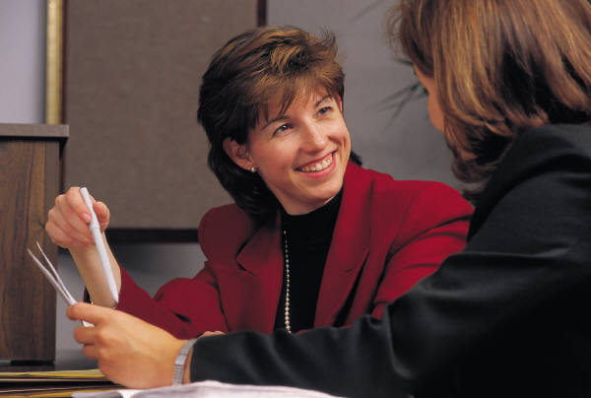
Phase One: Preparing for the Interview
Every interviewer will ask questions that are difficult to answer
When answering these questions, the answers must be
  Prepared in advance
  Sound comfortable
  Sound remarkable
Notes:
Even well prepared candidates, however, will have to face tough questions. Why? Because every interview will include the “difficult to answer” questions. Job seeker customers should be prepared to answer these questions in a manner that highlight positive attributes. The more comfortable job seeker customers are with answering these questions, the easier the interviews will be. These questions are designed to screen out those candidates that will not meet the employer’s needs or fit in at the company. When answering these questions, the answers must be prepared in advance, sound comfortable and sound remarkable.

Slide 14
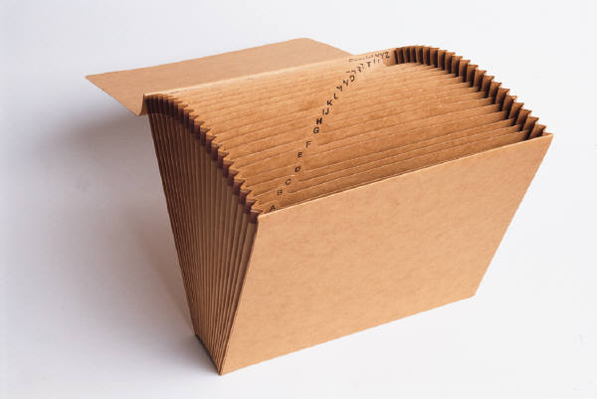
Phase One: Preparing for the Interview
Job seekers must be prepared
  Ensure their document organizers have all critical documents
    Résumés
    Example applications
    Reference pages
Notes:
Before an interview, job seekers should ensure their document organizers are up-to-date and contain copies of their résumés, as well as copies of their example applications. Job seekers need to make sure they have printed their reference pages; the reference page lists the job seeker’s professional references. Reference pages must be grammatically correct; and, reference pages should be printed on the same paper as the résumé.

Slide 15

Phase One: Preparing for the Interview
Before going to an interview, job seekers should make travel plans
  Map out the routes
  Be prepared to arrive early (never late)
    Know where to park
    Know where to check in for the interview
Notes:
Before going to an interview, job seekers should make travel plans. Job seekers need to secure the address for the interview location and map out the route for getting to the interview. Whether job seeker customers are traveling by car or by bus, they need to plan to arrive at least fifteen minutes early to the interview. This requires job seekers to know where to park and where to check-in for the interview.

Slide 16
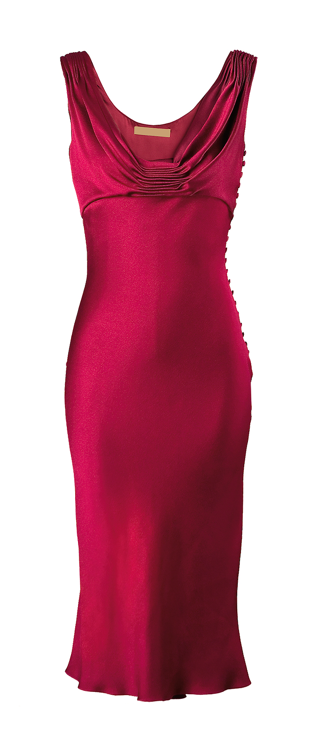



Phase One: Preparing for the Interview
Job seekers must be prepared to dress appropriately for the interview as well
  Many job seeker candidates do not dress appropriately
    Too much cologne or perfume
    Too much make-up
    Inappropriate hair style
    Dress down
    Over dress
    Improper grooming
Notes:
Job seekers must be prepared to dress appropriately for the interview; this is a critical part of being prepared. Many job seeker candidates do not dress appropriately. Many job seekers wear too much cologne or perfume. Some women wear too much make-up, which gives off the wrong impression. Individuals go to interviews with inappropriate hair styles; while some hairstyles may be in fashion, they are not appropriate for a job interview. Some individuals will dress in a manner that is comfortable or fashion forward but not professional, while other individuals will overdress, wearing clothes that are more appropriate for a formal affair. Another issue often noticed by employers is improper grooming. In other words, a male interviewee has not shaved his face or the interviewee has not cleaned his or her nails.

Slide 17



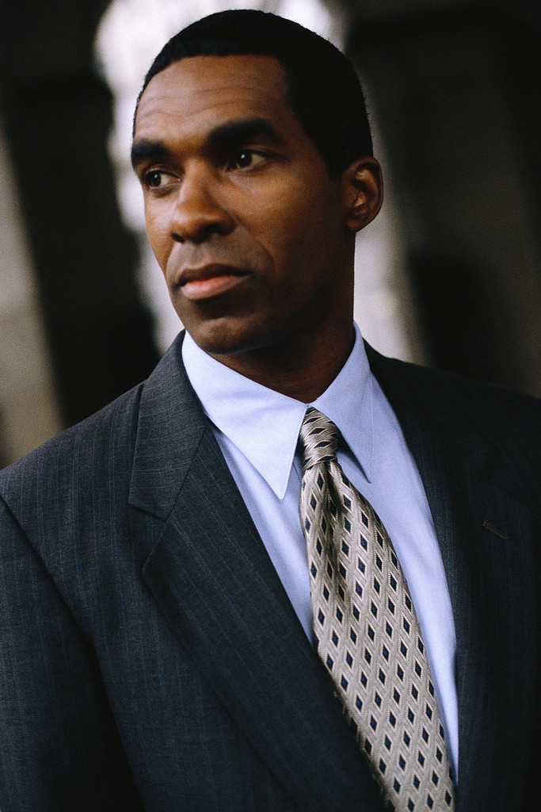

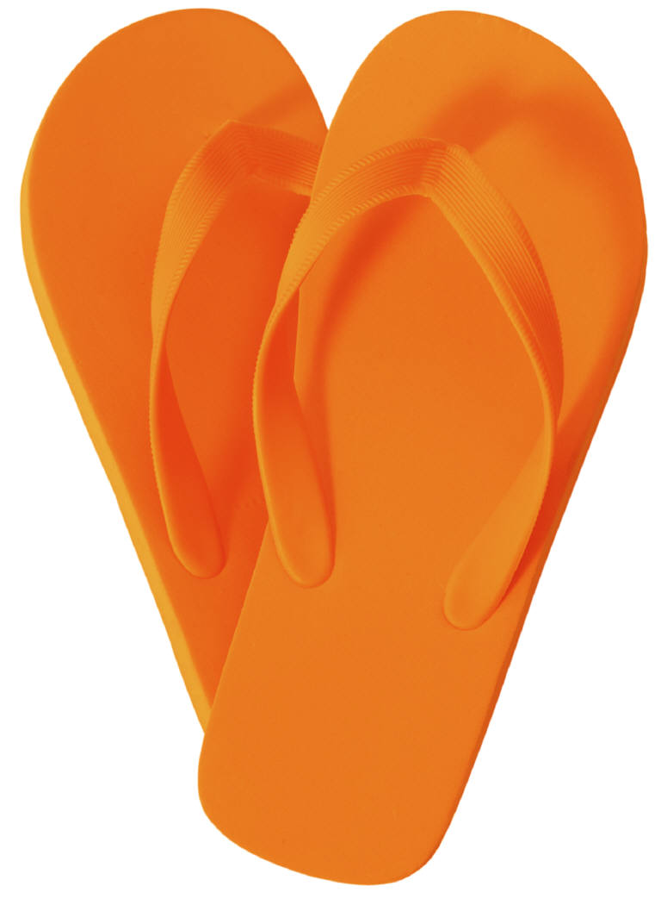
Phase One: Preparing for the Interview
So, how do we prepare job seeker customers for an interview?
  Conservative
    Clothes
  Less is more
    Hair
    make-up
    Jewelry
    Cologne or perfume
  Clean nails
  Clean shoes
Notes:
So, how do we prepare job seeker customers for an interview? We teach our job seeker customers how to dress for interviews.
Job seekers should dress at the same level or a little better than the job they are interviewing for. Job seekers should never wear tank tops, flip flops, or shorts. Clothing should look conservative. It is more important that a woman wearing a skirts wears a skirt that is at or below knee length. If wearing a pant suit, both men and women should wear an appropriate, conservative top. The use of a jacket and tie for men is dependent on the job being interviewed for. The rule, “less is more” is a very good rule to help govern the style of hair, as well as the use of make-up and jewelry. Hair should be simple and clean cut. Women with long hair should not focus on a fancy up-do. If the customer wants to pull her hair back, it should be pulled back in a simple manner. Men should be clean shaven. Make-up should be natural looking; once again the rule, “less is more” applies. Very little jewelry should be worn. Little to no cologne or perfume should be worn to interviews. Job seekers should be prepared by having clean nails and hands, as well as clean shoes.

Slide 18



Phase One: Preparing for the Interview
How do we know how our job seekers will perform during an interview?
Notes:
Many Regional Workforce Boards or RWBs have skill development programs teaching job seekers how to interview. But, how do we know what will really happen in an interview? How do we know our customers will dress appropriately, respond to questions appropriately and interact in a professional manner? Well, you know what they say, “practice makes better.” A strategy for assisting your job seeker customers is to conduct mock interviews. Ask job seeker customers to come dressed for an interview. Review the customers’ clothing, hair, make-up, use of jewelry, and grooming. If customers do not have the right clothing or shoes, offer them referrals to community agencies that can assist them with securing the appropriate attire. During the mock interview, ensure the customers’ document organizers are ready. Additionally, make sure job seekers can answer both the basic and the tough questions with ease and comfort.

Slide 19
Phase One: Preparing for the Interview
What are other strategies that can help customers prepare for an interview?
  Offer customers worksheets that list the most common questions
    Have customers answer those questions and practice tailoring them to different scenarios
  Provide customers with opportunities to interview with employers at the One-Stop Career Center
  Provide customers with examples or pictures of how to dress and groom
Notes:
There are other ways to help job seeker customers prepare for interviews. The RWB can create worksheets with the most common questions asked during an interview. The RWB can also provide customers with opportunities to interview with employers at the One-Stop Career Center and receive feedback from these employers. The RWB can provide examples or pictures of how to dress and groom to help job seeker customers prepare for interviews.

Slide 20
Do’s and Don’ts of Phase One
The customer should
  Know about the job
  Know about the employer
  Know how to answer common questions
  Know how to answer difficult questions
  Know how to get to the employer
  Know what to wear
  Take document organizer
The customer should not
  Fail to conduct research
  Be dishonest when practicing
    All questions must be answered honestly
  Be generic when practicing
    Each employer and job is different
    Failure to plan is failure to “stand out”
  Wait until the last minute
Notes:
Because the preparation phase sets the stage for success for the last three phases of the interview process, let’s briefly review the Do’s and Don’ts of the preparation phase. The customer should know about the job and about the employer. The customer should be prepared to answer questions using research found on the employer and the job opening. The customer should know how to answer both common and tough questions. The job seeker should know where the interview will take place and how to get to the location. The customer should know what to wear to the interview. Finally, the job seeker must ensure critical documents are prepared in his or her document organizer. The customer should not treat every job interview the same by failing to research the employer or the job. The job seeker should not embellish answers or lie to make him or herself look good in the interview. The job seeker should not assume that all answers can be the same for every employer and fail to practice for each interview as a unique event. The job seeker should not wait until the last minute to get ready or ensure that he or she has clothes to wear. Being late to an interview or dressing inappropriately is a sure way to be rejected by an employer.

Slide 21




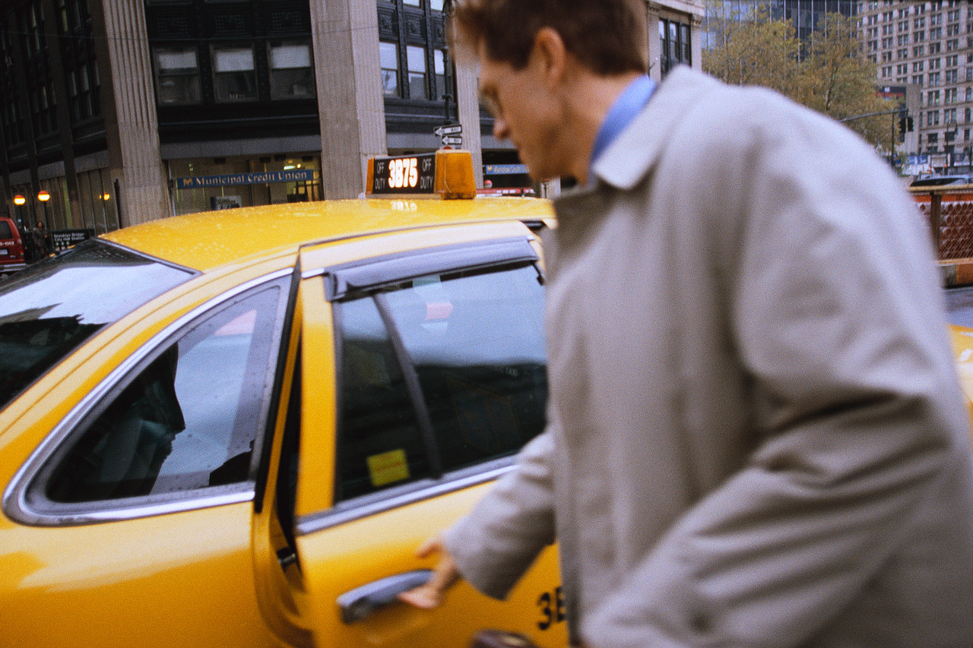
Phase Two: Start of the Interview
The interview starts when the customer leaves his or her house
  The job seeker must leave on time
  The job seeker must be prepared
  The job seeker must be early to the interview
Notes:
Let's move on to the next phase of the interview process. Phase two is the “start” phase of the interview. An interview actually starts when the customer leaves his or her house. The job seeker customer should be prepared to leave on time and arrive early with all required documents. According to the Society for Human Resource Management, 33% of hiring professionals make a decision not to hire an individual in under five minutes. This means first impressions are critical to the interview. One of the fastest ways to lose the opportunity to work for an employer is being late. In fact, 58 percent of hiring managers stated that being late for an interview was a “deal breaker.” Another 39 percent of hiring managers stated it may not be a deal breaker, but it was still a problem if the candidate was late for the interview. This means that over 90 percent of hiring managers had a problem with candidates being late for the interview.

Slide 22



Phase Two: Start of the Interview
The job seeker candidate must check in with the appropriate party upon arrival
  Be polite
  Be friendly
  Be upbeat
When the interviewer approaches, the job seeker candidate should
  Stand up
  Greet the interviewer formally
  Offer a firm handshake
  Offer an upbeat and approachable smile
Upon arrive, the job seeker should turn off his/her cell phone
Notes:
Upon arrival, the job seeker should turn off his or her cell phone. This is critical as 40 percent of hiring managers found that the applicant’s cell phone ringing during the interview was a deal breaker. Next, the job seeker must check in with the appropriate party, which is often a staff member at a security desk or receptionist. The job seeker candidate should understand that first impressions from all staff are important. The job seeker must be polite, friendly and upbeat when speaking with the receptionist. If the job seeker does not know the name of the interviewer, he or she should ask the receptionist for the person’s full name in order to greet the interviewer formally. If sitting when the interviewer approaches, the job seeker candidate should stand up to greet the interviewer. It is important that the job seeker customer be prepared to shake hands and offer a greeting using the interviewer’s last name. An example may be, “Thank you for seeing me today Ms. Johnson. I am very excited to be interviewing with your company.” The job seeker must offer a firm, but not crushing, handshake. When speaking, the job seeker candidate must be upbeat and offer an approachable smile. Basically, the job seeker customer should look glad to be there.

Slide 23

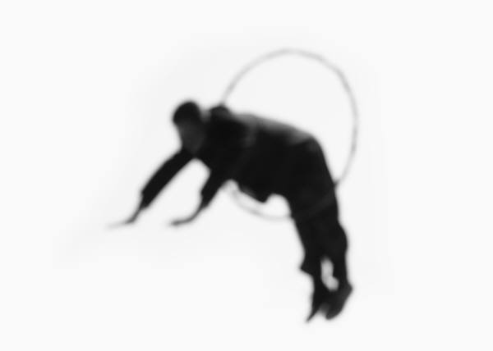
Phase Three: Body of the Interview
Most job seekers want to jump right into answering questions
The interview often starts with small talk
  Job seeker customers should relax and talk with the employer
    Use restraint
    Listen to what is being said
Notes:
Phase three of the interview is called the "body" of the interview. The body of the interview is often the focus of most job seekers’ attentions. Being that this is the time when employers start to speak with job seekers about items of substance, job seekers often focus on what is going to occur during this hour. Many times, job seekers want to jump right into the questions to get the interview over. Instead, job seekers should take a deep breath and relax. Job seekers should know that most interviews start with small talk. This is normal and should be expected. Job seekers should be comfortable making conversation while using restraint by listening as well as talking. Job seekers may find that they have something in common with interviewers. Job seeker customers should practice using small talk and become accustomed to conversing with employers so they feel comfortable conveying information, as well as receiving information.

Slide 24

Phase Three: Body of the Interview
At the beginning of the interview, the job seeker customer should
  Offer the employer a current résumé
Notes:
At the beginning of the interview, the job seeker customer should offer the employer a copy of his or her current résumé printed on nice paper. This copy should not be a text document but a formatted document that is professionally constructed.

Slide 25

Phase Three: Body of the Interview
The job seeker customer will be asked a host of questions
The job seeker customer should speak with confidence and keep answers
  Clear
  Concise
The job seeker customer should show that he/she knows something about the company
Notes:
During this phase of the interview, the job seeker customer should expect to be asked a host of questions. Many times, the employer will start with, “Tell me a little bit about yourself” to create an opportunity of engagement and to make the interview more like a conversation. The job seeker must ensure that he or she is prepared to remain professional and “on-point”. The job seeker should be able to answer all questions with confidence and keep answers clear and concise. While answering questions, the job seeker should be prepared, having conducted research on the company. The job seeker should show that he or she knows something about the company while answering and asking questions.

Slide 26

Phase Three: Body of the Interview
If the job seeker is asked about a skill that he/she does not have, the job seeker should show a “CAN DO” attitude
Notes:
If the job seeker is asked about a skill that he or she does not have, the job seeker must be careful. The job seeker should not indicate that he or she has the skill; this would be dishonest. The job seeker should indicate that he or she can learn the skill. With each question, the job seeker should demonstrate a “can do” attitude.

Slide 27

Phase Four: Conclusion of the Interview
Have you ever felt weird ending a conversation or a date?
  This is how many job seekers feel while awkwardly trying to successfully conclude an interview
Notes:
Have you ever felt weird or awkward at the end of a conversation or date? This is how many job seekers feel at the end of an interview. They are not sure who should have the last word or how to exit gracefully. Helping the job seeker conclude the interview successfully is very important.

Slide 28

Phase Four: Conclusion of the Interview
Before leaving, the job seeker should
  Ask questions that are informative
Notes:
In phase four of the interview process, our customers have to exit gracefully at the conclusion of the interview. Often, the conclusion begins when the interviewer asks, “Do you have any questions for me.” This is a sign that the interview is coming to an end. Before leaving, the job seeker should ask questions that show he or she prepared in advance. This includes using research about the company and demonstrating that he or she is interested in the job. The job seeker should have practiced this and be able to ask questions with confidence.

Slide 29

Phase Four: Conclusion of the Interview
Before leaving, the job seeker should
  Offer his/her reference sheet
  Shake the interviewer’s hand and say thank you for the interview
Notes:
To move towards a successful conclusion, the job seeker can state, “Before I leave, I would like to leave you with a copy of my professional references.” The job seeker should then offer the employer a reference sheet from his or her document organizer. When leaving, the job seeker should shake the interviewer’s hand and thank the interviewer for the opportunity.

Slide 30

Conclusion
Notes:
This concludes this lesson for the Job Search Skills module. In lesson five, we will discuss the process for helping job seekers turn job interviews into job offers.

