Slide 1
Career Plan Development – Career Exploration
Notes:
Welcome to lesson three of the Career Plan Development module. In this lesson, we will discuss the next steps in helping customers develop a career plan. Career exploration is critical to the career plan development process. Career exploration affords our job seeker customers the opportunity to research different potential careers.
Many of your customers are unaware of the many different careers that are available to them. They may only know about those jobs that are located in their immediate communities. Additionally, your customers will need to set realistic goals. While it will be important to be supportive, the career exploration process will help your customers make realistic plans based on skills they already have and skills they are willing to get by going to school or working in their field of choice. The ultimate goal of exploring all the different career opportunities is for your customer to become a successful and satisfied member of the workforce. In this lesson, we will identify ways to help your customers locate the information they need to make career decisions. We will do this by discussing career exploration resources.

Slide 2
Career Plan Development
There are many resources that you can use to help your job seeker customers define their career goals
Using O*Net, you can help your job seeker customers look up jobs that match their interests
Using the Employ Florida Marketplace (EFM) system, you can help job seekers look up information about the careers that interest them
Notes:
There are many resources that you can use to help your job seeker customers define their career goals. For example, you can use the O*Net system, which is available right on the Internet, to help your job seeker customers look up jobs that match their interests. In fact, if you have your customers complete the O*Net interest assessments, you can plug that information right into the system to find different jobs that they may find interesting or enjoy. Using the career categories that they find in O*Net, your job seekers can then go to the Employ Florida Marketplace system or (EFM) and find out more information about job opportunities in that specific occupational field. Why is this important? Well, job seekers need to be able to find a job that is both interesting and available in the community.

Slide 3
O*Net OnLine
Notes:
O*NET, is a comprehensive database of worker attributes and job characteristics. O*NET has replaced the Dictionary of Occupational Titles (DOT) and is the nation’s primary source of occupational information. As you work with your customers in the area of career development, you will need access to such a database in order to compare the skills that a job requires with the skills of your job seeker customers. By clicking “Find Occupations” on the main page, your customers can enter the key words to search for career information based on careers of interest. Your customers can also look for those jobs that have a bright outlook under “Bright Outlook."

Slide 4
O*Net OnLine
Notes:
From the main page, the job seeker customer may also focus on careers that use a specific tool or software through an advanced search option. Therefore, if a customer enjoyed working with a specific tool or program, the customer can look to see if there are other jobs that use the same tool or software program.

Slide 5
Employ Florida Marketplace
Notes:
Job seeker customers can also look up information about careers they are interested in through the EFM system. By clicking “Labor Market Information," the job seeker will be able to search for information on an occupation through a keyword search.

Slide 6
Employ Florida Marketplace
Notes:
In EFM’s Labor Market Information section, the user selects the “Occupational Profile” hyperlink to navigate to the search page.

Slide 7
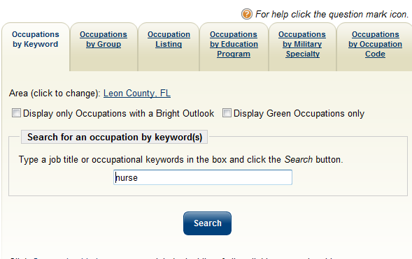
Employ Florida Marketplace
Notes:
In this example, the job seeker customer enters the word “nurse” in the “Occupation by Keyword” search. He then selects the Search button to learn what type of nursing jobs are available in his community. .

Slide 8
Employ Florida Marketplace
Notes:
The job seeker customer receives a host of information from his search. He is able to see over 20 jobs in the nursing field that are located in Leon County. Additionally, he can see that there are several with a “Bright Future” based on national projections and other information posted in the EFM system.

Slide 9
Employ Florida Marketplace
Notes:
Clicking on the Registered Nurse link to learn more about the occupation, the job seeker customer is able to see the summary of job duties.

Slide 10
Employ Florida Marketplace
Notes:
Scrolling down, the job seeker customer is able to review the number of jobs that are open based on the number of active advertisements in EFM for Leon County.

Slide 11
Employ Florida Marketplace
Notes:
The job seeker customer is also able to see the estimated mean annual wage for the occupation in question in several counties throughout the state, as well as the respective job openings in those areas.

Slide 12
Employ Florida Marketplace
Notes:
Critical to the career exploration process, the job seeker customer can review the amount of school and work experience that are required for the occupation selected. This is important because our job seekers must determine if they will put in the time and effort it takes to secure a degree or certificate. Go to the EFM system and search Labor Market Information for information about nursing jobs in your area.

Slide 13
Practice
Notes:
Next, we will look up information with Anny. Go to www.onetonline.org; on this screen, click Advanced Search. Why? Because you know that Anny tested high in Investigative and Social during her O*Net assessment, so you are now going to review with her the occupations that show us possible interests for her based on her interest assessment results.

Slide 14
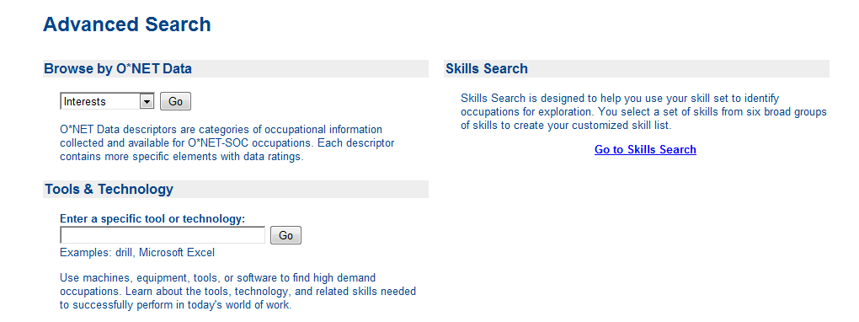
Practice
Notes:
In the “Browse by O*Net Data” dropdown, select Interests and click “Go."

Slide 15
Practice
Notes:
Click on the hyperlink titled “Investigative” to move to the next screen.

Slide 16
Notes:
In the first drop down, ensure “Investigative” is selected. Next, ensure that “Social” is in the second drop down box and click “Go.” This will refresh the screen with the most appropriate options for Anny. You can further limit the outcomes by selecting a job zone of “3” to show that she wants to prepare without having to get an advanced degree.

Slide 17
Practice
Next, you enter “Critical Care Nurse” in the text box and click “Search”
Notes:
Next, you enter “Critical Care Nurse” in the text box and click “Search."

Slide 18
Conclusion
You have now reviewed the process for helping a customer look for a job occupation using the information gathered during an interest assessment
Next, we will explore the development of the career plan
Notes:
During this lesson in the Career Plan Development module, you worked with Anny to review her interest assessment results, as well as occupations she is interested in researching. You also reviewed with Anny the occupational outlook and education requirements outlined in the EFM system. In the next lesson, we will explore the development of the career plan.

