Slide 1
Veteran Readiness and Employment
(VR&E) Program
State Veterans’ Program Office

Slide 2
Objectives
Authorization & Purpose
Co-Management
Questions & Answers
Referral Process
Employ Florida Recording
Employment Information
Case Management Process
Monthly Progress Reports
Program Benefits
Successful/Unsuccessful Contact Attempts
Initial Contact Attempt
Reasons to request Case Closure

Slide 3
Authorization and Purpose
Title 38, U.S.C., Chapter 31
Veteran Readiness & Employment (VR&E) Program
Assists veterans whose service-connected disabilities limit their ability to:
prepare for;
obtain; and
maintain suitable employment.

Slide 4
Program Benefits
Education
Referrals to Career Centers
Exploring employment options
Employment
Evaluation of abilities, aptitudes, and interests
Addressing training needs
Vocational counseling
Job training
Post-secondary training
Medical
Medical referrals
Rehabilitation planning
Counseling/case management

Slide 5
Co-Management
VR&E participants are co-managed by both:
Intensive Service Coordinators (ISC) are the point of contact between:
Disabled Veteran Outreach Program (DVOP) specialists report to:
Local Workforce Development Board (LWDB)
Department of Veterans Affairs (VA)
Local Workforce Development Board (LWDB)
Veteran Readiness Coordinator (VRC)
Director of Veterans Employment and Training Service (DVET)
Veteran Program Manager (VPM)
Intensive Service Coordinator (ISC)

Slide 6
Referral Process
Veteran’s 60-day graduation mark is met
Respective ISC receives notification
Email referral is sent to appropriate LWDB
LWDB assigns new VR&E participant to DVOP specialist
Initiate contact attempts must be within 10 calendar days of referral

Slide 7
Initial Contact Attempt
Within 10-calendar days of referral receipt
Various times of the day
3-contact attempt minimum during the initial week
Contact attempts must be meaningful

Slide 8
Employ Florida Recording
All contact attempts must be recorded in Employ Florida (EF) through case notes.
Excel spreadsheet
Word document
Outlook calendar
Other locally- developed tracker
If no EF account is present, consider:
Case note must be thorough and include contact outcome (if any) to ensure accurate reports.

Slide 9
Successful/Unsuccessful Contact Attempts
Successful Contact Attempts
Explain next steps of VR&E program
Provide instruction on EF account creation if necessary
Unsuccessful Contact Attempts
First 2-months (60-days), ISC must be notified for case closure
Must continue attempting contact until notified by ISC of closure
Schedule first meeting (in-person or virtual)
Exhaust contact methods

Slide 10
Case Management Process
Update local tracking document
Complete Objective Assessment Summary wizard
Create Wagner-Peyser program application
Record code V01 to create JVSG participation
Complete Individual Employment Plan/Service Strategy wizard
Auto-generated code 205 – Individual Employment Plan (IEP)
Obtain signature for IEP
Generate Progress Report
Select Yes for Veterans Voc. Rehab (Ch. 31) and enter JVSG participation date

Slide 11
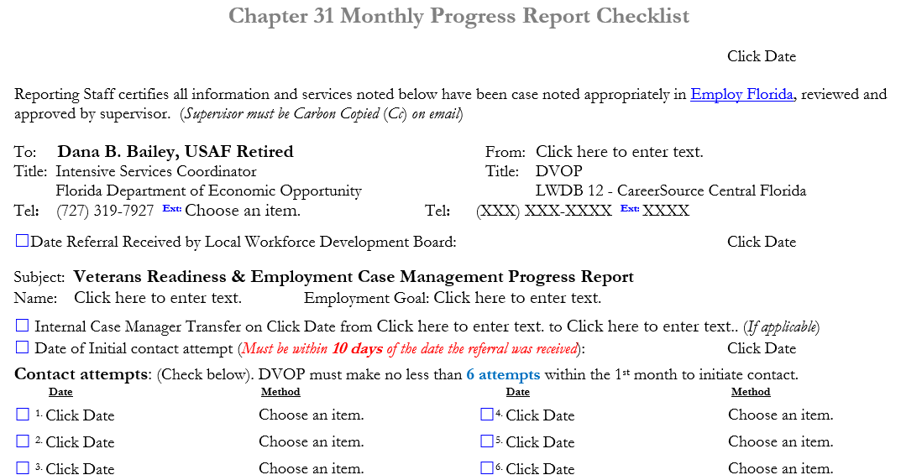
Monthly Progress Reports

Slide 12
Monthly Progress Reports (cont’d)

Slide 13
Employment Information
The following information must be gathered and immediately provided to the ISC:
Company/employer name, location, and contact information
Actual start date (not hire date)
Employment type (full/part/seasonal)
Job title/work duties (at least two)
Hourly/yearly wage (conversion calculator in form)
Suitability
30–60-day employment verification follow-ups

Slide 14
Monthly Progress Reports (cont’d)

Slide 15
Reasons to Request Case Closure
Employed
Declines
School
Unresponsive Contact
Financial
Satisfaction
Family
Medical
Relocation
Rehabilitated
Limitation
Other
Non-compliant

Slide 16
Questions & Answers

