Slide 1
Community Outreach and Wraparound Services
State Veterans’ Program Team
Division of Workforce Services, Bureau of One-Stop of Program Support (OSPS)

Slide 2
Objectives
Authorization
Outreach Lifecycle
Advantages and Strategies for Conducting Community Outreach
Employ Florida Recording
Reasons for Conducting Community Outreach
Coordination of Wraparound Services
How to Build Your Network of Resources

Slide 3
Authorization - Federal
In accordance with VPL 07-10 and 03-14, the primary focus of the DVOP specialist is to:
Meet the needs of those participants unable to reach their employment goals without individualized career services and
Conduct relationship building, outreach and recruitment activities to local agencies that serve veterans with Significant Barriers to Employment (SBE) in order to enroll those veterans in the American Job Center (AJC)
Notes:
Identify potential participants in need of employment assistance.

Slide 4
Authorization - State
In accordance with Administrative Policy 117, DVOP specialists conduct outreach activities to:
build capacity with community resources
engage with current participants
actively recruit eligible veterans or covered persons to increase their caseload

Slide 5
Reasons for Conducting Community Outreach
Building a Comprehensive Network of Community Resources
To sustain, identify, and build new relationships to help connect participants with the resources they need to overcome barriers.
To reach out to those who are not using or unable to obtain our services and inform and educate them about CareerSource and the JVSG Program.
Recruiting Eligible Veterans or Covered Persons
Engaging Current Participants
To conduct outreach to actively case manage participants and provide necessary services in person.
Notes:
What areas should we not conduct outreach?

Slide 6
Community Outreach Advantages
What are the advantages of outreach?
Develop a liaison between the career center and the community.
Improve community awareness, trust and accurate understanding of the JVSG program and mission.
Increase collaboration and communication with community members, stakeholders and key partners.
Share resources and exchange ideas.
Increase program participation.
Notes:
Two-way Street
Increase community awareness
Speed no lag time. Improve process.

Slide 7
Outreach Lifecycle
1. Planning Phase
Needs assessment
Goals and objectives
Identify stakeholders
2. Development
3. Execution
Implement your outreach plan
4. Evaluation
Analyze the outcome/results
Message
Tailor an outreach plan
Tools and materials
Share best practices
Make necessary corrections
Notes:
After action report – E-49 include a copy.

Slide 8
Community Outreach Strategies
Strategies for conducting Community Outreach:
Build trust and become a familiar face
Be friendly and a conversationalist
Maintain consistent and ongoing communication
Tailor your strategy, message and materials for your intended audience
Identify the people/organization you are trying to reach

Slide 9
How to Build a Network of Community Resources
DVOP specialists should grow and build relationships with the following organizations:
Department of Veterans Affairs Hospital (VA)
Disabled American Veterans (DAV)
Faith-Based Organizations (FBO)
Food Banks
Goodwill
Homeless Shelters
Homeless Veterans Reintegration Program (HVRP)
Housing and Urban Development – VA Supportive Housing (HUDVASH)
Salvation Army
Supportive Services for Veteran Families (SSVF)
Veteran Service Officers (VSO)
Veterans of Foreign Wars (VFW)

Slide 10
Identifying the Needs
In order to provide a wholistic level of service for the participant, we must identify the needs.
Veteran’s Basic Needs
Food & Water
Clothing & Sleep
Security & Safety
Shelter & Health
Employment

Slide 11
Coordination of Wraparound Services
The DVOP specialist must coordinate wraparound services to assist the participant in overcoming any barriers specified in the objective assessment and individual employment plan.
Notes:
One-on-One needs

Slide 12
Coordination of Wraparound Services
What are wraparound services?
Referred partnered services that the DVOP tracks to document outcomes. These services are coordinated by outreach activities to assist participants in eliminating SBEs.
Such services may include and are not limited to transportation, sustenance, housing, health, and legal services.
Notes:
Delete or merge with previous.

Slide 13
Coordination of Wraparound Services
providing a direct referral
scheduling an appointment
assisting to prepare necessary documentation, and
conducting consistent contact to determine the outcome of the referral
In addition to making a referral, the DVOP specialist must take an active role in assisting the participant by:

Slide 14
Partner Program Referrals
When making a referral think about the internal resources available to you.
State Vocational Rehabilitation (VR) (WIOA title IV)
Wagner-Peyser (WP)
CareerSource Workshops
Workforce Innovation Opportunity Act (WIOA)
Senior Community Service Employment Program (title V)
Notes:
SNAP is not a resource in the one-stop. SNAP is a workforce program for SNAP benefit recipients who are designated as ABAWDs and must complete employment activities to continue to receive their benefits. There is no way to refer someone to the SNAP program in the one-stop, but they can refer then to DCF to apply for SNAP benefits (who is not in the one-stop).

Slide 15
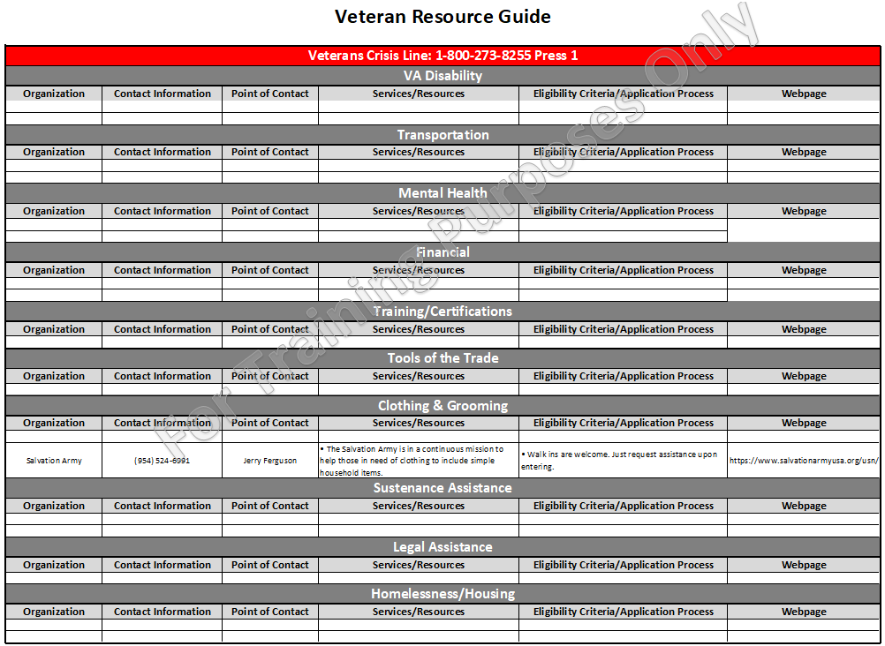
Community Resources Guide

Slide 16
Employ Florida Reporting
Participant Engagement
When a DVOP specialist provides a service to a current participant during outreach.
When a DVOP specialist provides a service to a new participant during outreach.
When a new participant is enrolled in the JVSG program as a result of a DVOP specialist’s outreach efforts.

Slide 17
Employ Florida Reporting
V06: JVSG – COORDINATION OF WRAPAROUND SERVICES
Recorded when a DVOP specialist takes an active role in assisting the participant access resources required to overcome barriers to employment.
A case note attached to the service code is required and must indicate what agency/community resource the participant was referred to, reason for referral, appointment date, any additional actions coordinated by the DVOP specialist, and the expected outcome.

Slide 18
Employ Florida Reporting
V10: JVSG – DVOP Outreach Engagement
Recorded when services are immediately provided by a DVOP specialist to participants while conducting outreach activities.
A case note attached to the service code is required and must include the location the outreach activity occurred, service provided (if applicable), and outcome

Slide 19
Employ Florida Reporting
E49: DVOP – Organizational Visit
Recorded when staff conducts an on-site visit to a veteran organization to discuss services the career center can offer the business.
Case note the name and title of the person(s) spoke with, the topics discussed, and the outcome of the outreach.

Slide 20
Questions & Answers

