Slide 1
Reemployment Services and Eligibility Assessment (RESEA) Program

Slide 2
Agenda
RESEA history and purpose
RESEA program operations
Claimant selection and pool generation
RESEA functionality in the Employ Florida Marketplace
Required services and documentation
Constructing an Employability Development Plan (EDP)
RESEA quality assurance checks

Slide 3
RESEA – Section 1
History and Purpose

Slide 4
History of Reemployment Programs
2005 - 2016 Reemployment and Eligibility Assessment (REA) pilot
Florida participated in the pilot
2016 Reemployment Services and Eligibility Assessment (RESEA) designated as a permanent unemployment insurance program

Slide 5
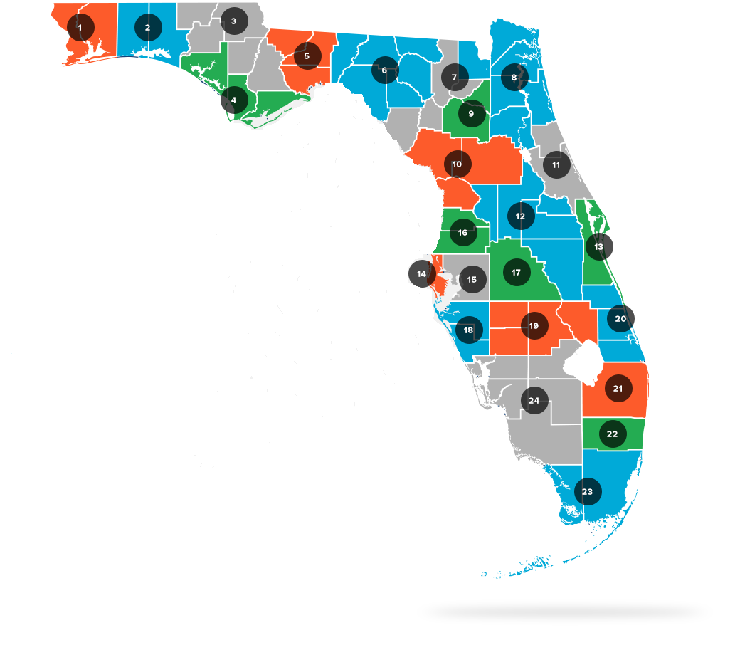
RESEA Local Workforce Development Boards

Slide 6
Goal and Purpose of the RESEA Program
Provide early intervention services to reemployment assistance (RA) claimants to:
Shorten the claimant’s duration on RA
Return claimants to work quicker

Slide 7
RESEA – Section 2
RESEA Program Operations

Slide 8
Claimant Selection Process
File RA claim
Claimant is profiled
Exemptions are explored
First payment within six weeks of filing
Notes:
Florida’s WPRS examines certain data elements that are collected at the time a person files initial RA claim, some examples of which are:
Number of jobs claimant held over finite period;
Claimant’s job tenure and wages;
Industry from which claimant laid off;
Time of year layoff occurred;
Availability of comparable jobs in their area

Slide 9
RESEA Pool Generation
Least likely to exhaust
Most
likely to exhaust
Transitioning
service members
(UCX)
UCX
Pool
Notes:
Florida’s WPRS examines certain data elements that are collected at the time a person files initial RA claim, some examples of which are:
Number of jobs claimant held over finite period;
Claimant’s job tenure and wages;
Industry from which claimant laid off;
Time of year layoff occurred;
Availability of comparable jobs in their area

Slide 10
Exclusions from the RESEA Pool
Union hiring hall
Definite return to work date within eight weeks of lay-off date
Participating in approved training
Transitional claimants
Seasonally unemployed workers
Interstate claimants
Received Orientation and Initial Assessment services within last 28 days

Slide 11
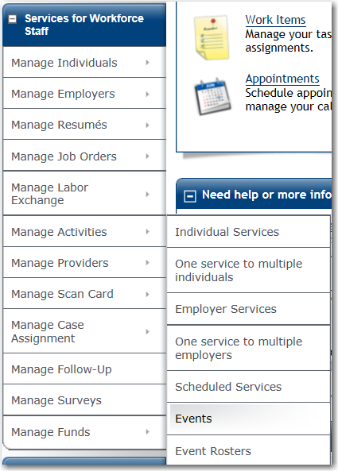
Scheduling the Pool Count
Weekend – RESEA pool created
Monday – Staff manage pool count
Monday – Staff create RESEA events

Slide 12
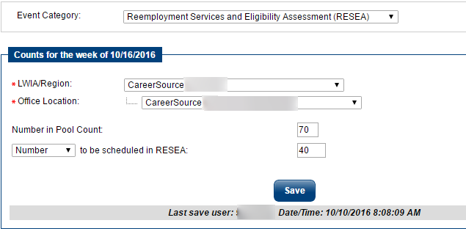
Managing the Pool Count

Slide 13
Scheduling
SUN | MON | TUES | WEDS | THURS | FRI | SAT
 |  |  |  |  | 1 | 2
3 | 4 Manage pool count Create events | 5 | 6 | 7 | 8 | 9
10 | 11 Manage pool count Create events | 12 | 13 | 14 | 15 | 16
17 | 18 | 19 Events scheduled 19th-25th populated using pool from the 4th | 20 | 21 | 22 | 23
24 | 25 | 26 Events scheduled 26th-1st populated using pool from the 11th | 27 | 28 | 29 | 30
31 | 1 | 2 | 3 | 4 | 5 | 6
Notes:
Monday night, EFM system takes all information entered in the manage pool count and event calendar to schedule the claimants.
REMEMBER: Event population purely driven by counts recorded by career center staff.
Events are scheduled 14 days in the future from when the pool was created.
Scheduling week is Tues-Mon.
Any pool counts not managed by Monday at 5:00 PM? System uses previous week’s settings for recurring events, or not schedule anybody at all if you have no events set up.
System fills preset events chronologically, starting with any that are scheduled for Tues, then Weds, then Thurs, and so on, until the available pool has been exhausted or all of the events have been filled, whichever occurs first.
Unless there is an interruption in regular programming (failed file transfer, for example), or there’s a holiday to take into account, staff should expect the process to run based on this schedule.
HOLIDAYS: The scheduling process does not populate events on State observed holidays. Each year, FloridaCommerce staff enter all said holidays into the EFM administrative site
STAFF REMAIN AWARE OF HOLIDAYS to ensure they remember to adjust event calendars (add more to class size, add new event(s)) to avoid missing claimants and thus a drop in service numbers

Slide 14
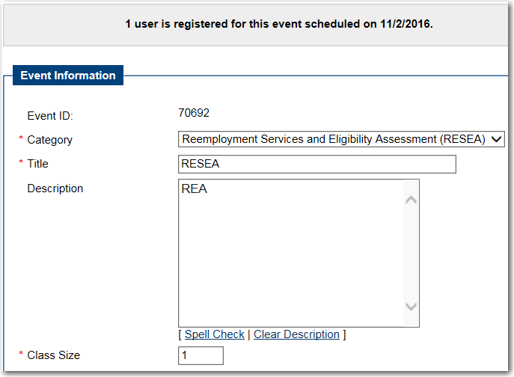
RESEA Event Creation

Slide 15
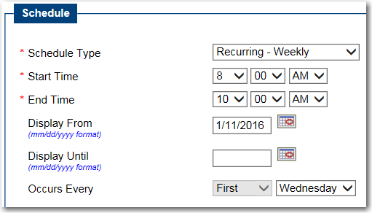
Event Creation – Schedule Type

Slide 16
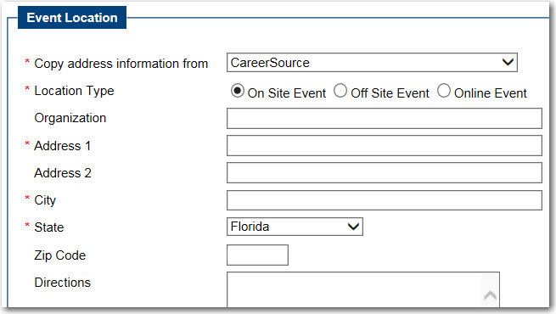
Event Creation – Office Address
123 Career Source Street
Tallahassee
32399

Slide 17
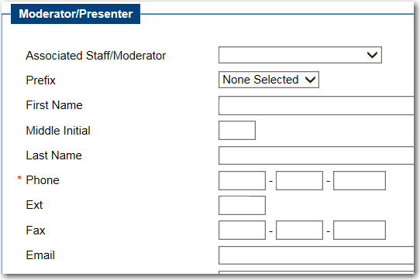
Event Creation – Moderator Information

Slide 18
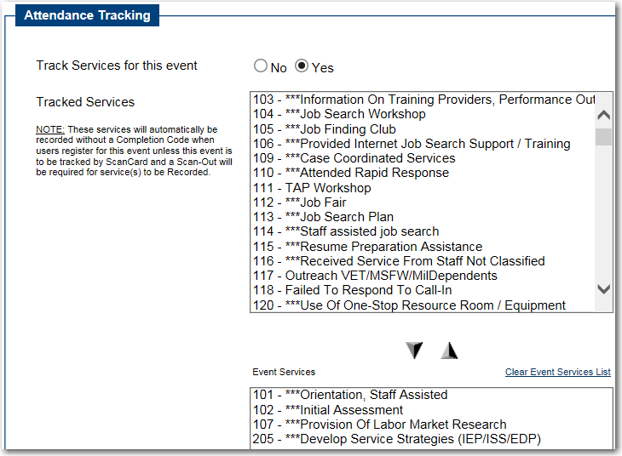
Event Creation – Activity Selection

Slide 19
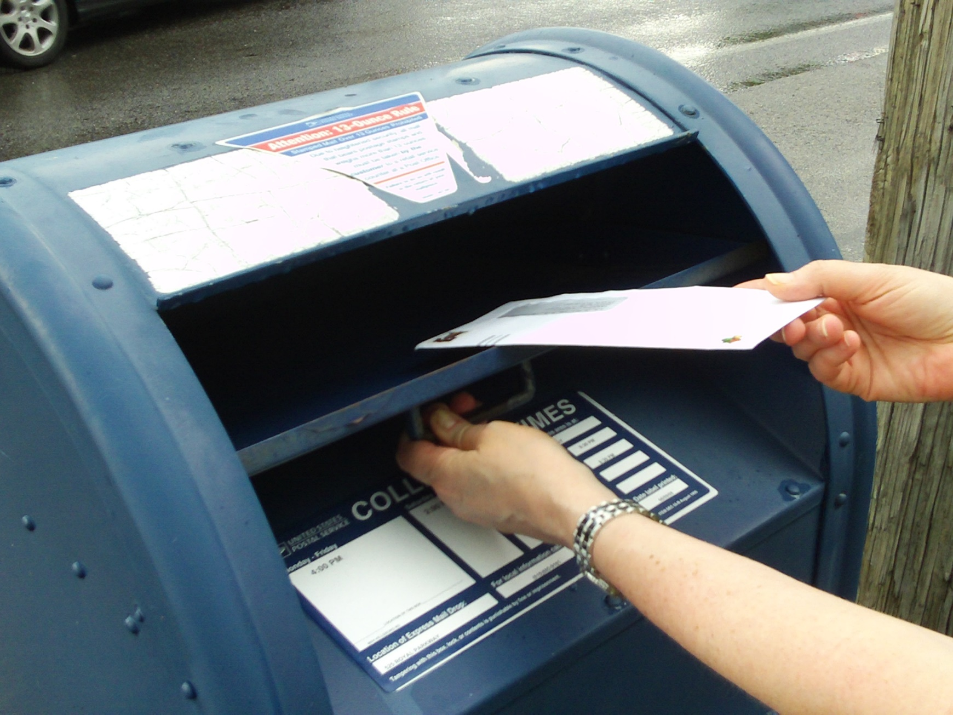
Scheduling

Slide 20
RESEA – Section 3
RESEA Required Activities

Slide 21
Federal Minimum Required Services
Orientation
Initial Assessment
Labor Market Information (LMI)
Employability Development Plan (EDP)
Additional Work Search Activities

Slide 22
Orientation
Service Code 101
Overview of career center services
Overview of the RESEA program
Delivered in either a group or individual setting

Slide 23
Initial Assessment
Service Code 102
One-on-one interview
Formal or informal collection of information
Standardized assessments may be used

Slide 24
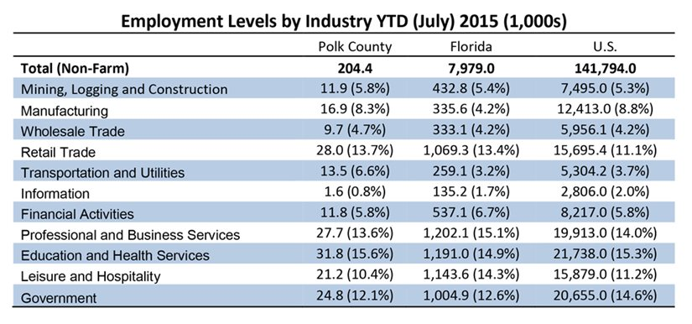
Labor Market Information
Service Code 107
Must be specific to claimant’s past or future career goals
Assist claimant to recognize trends

Slide 25
Employability Development Plan
Service Code 205
Completed jointly with the claimant
Specific to claimant’s past or future career goals
Identify at least one short-term and one long-term goal
Each goal must include specific next steps to achieve it

Slide 26
Employability Development Plan
Avoid Health Insurance Portability and Accountability Act (HIPAA) information
Must list the specific work search activity:
Title
Workshop date and time

Slide 27
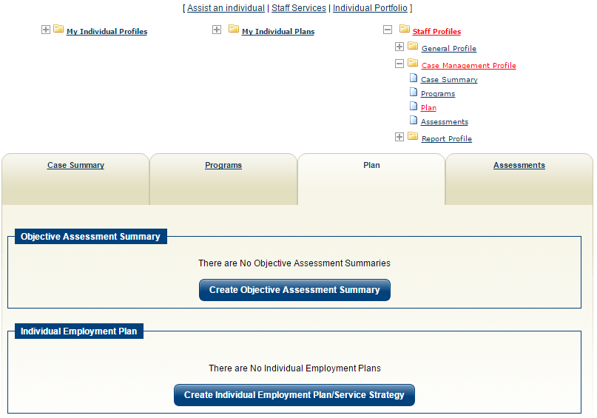
Objective Assessment Summary (OAS)
Service Code 203
Must be completed in EFM if the employability development plan is created electronically using the EFM plan wizard
Staff must record service code 203 upon completion of the OAS

Slide 28
Additional Work Search Activities
Resume Writing
Workshop
Job Finding Club
Interviewing Skills Workshop
Referrals to Education and/or Training

Slide 29
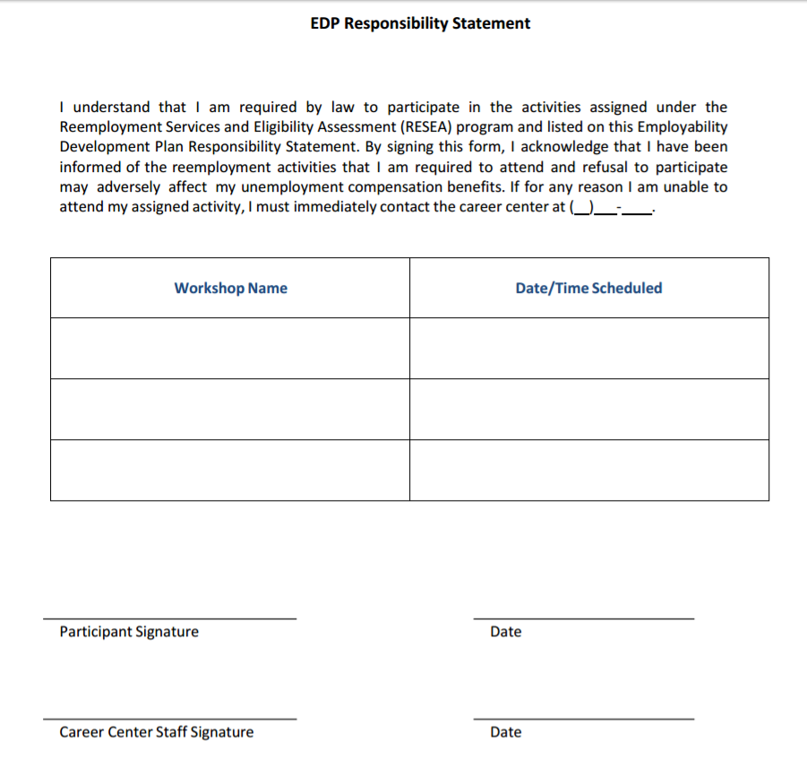
EDP Responsibility Statement
Must list the specific work search activity:
Title
Workshop date and time
Include date and signatures of both the claimant and case manager
Provide copy to claimant, retain original in claimant’s file (hard or electronic)

Slide 30
RESEA – Section 4
Attendance Documentation and Scheduling Conflicts

Slide 31
Resulting Events – Documenting Attendance
Manage attendance as soon as possible, preferably as soon as the appointment is completed
Attendance information is interfaced to CONNECT for RA benefit continuation or interruption
Attendance concerns should be immediately forwarded to the RESEA Coordinator

Slide 32
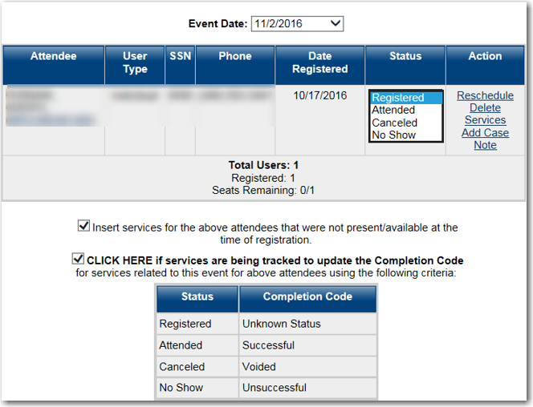
Resulting Events – Documenting Attendance

Slide 33
Resulting Events – No Show Reasons
Address Undeliverable
Claim Ended
Deceased
Disqualified on Other Issues
Exhausted Benefits
In Trade Readjustment Assistance (TRA) Training
Incarcerated
Medical
Relocated In-State
Relocated Out-of-State
Out of Reporting Status
Refused to Participate
Returned to Work
Other (Explain)

Slide 34
Scheduling Conflicts – Reset vs. Reschedule
Reset (Active)
Reschedule (Inactive)
Allows claimants to move their existing appointment due to scheduling conflicts
May be completed verbally or manually in EFM
Must be completed within seven days (before or after) the original appointment
Locally controlled by staff
Provides claimants determined by FloridaCommerce to have “good cause” a second opportunity to comply
May only be completed through the CONNECT – EFM interface
Functionality is determined by FloridaCommerce
Staff do not have separate processes for this function

Slide 35
Questions & Answers

Slide 36
RESEA – Section 5
Constructing Employability Development Plans

Slide 37
EDP – Purpose and Goal - Before

Slide 38
EDP – Purpose and Goal - After
Commitment
Inspiration
Guidance
Employment
Training
GED
Volunteer

Slide 39
What is an Employability Development Plan?
A written blueprint developed jointly with a customer
Outlines short and long term goals
Documents actions to be taken to achieve the outlined goals

Slide 40
EDP Components
Plan Development
Assessment and Consultation
Orientation
Employability Development Plan

Slide 41
Assessment and Consultation
Thoroughly assess the customer
Utilize standardized assessments, if needed
Review the assessment results with the customer

Slide 42
Plan Development
Incorporate each component from the RESEA appointment
Develop tangible and specific short- and long-term goals
Attach specific action steps to each goal

Slide 43
RESEA – Section 6
Goal Development

Slide 44
What is a goal?
An observable and measureable end result having one or more objectives to be achieved within a more or less fixed timeframe
The end toward which efforts are directed

Slide 45
Short-Term and Long-Term Goals
Short- Term Goal
Smaller goals
Motivates the customer
Long- Term Goal
1 - 6 month timeframe
Overall perspective
1 - 5 year timeframe
Lifetime goals

Slide 46
S.M.A.R.T. Goals
BOUND

Slide 47
S.M.A.R.T. Goals - Specific
Goals should be well-defined and precise
Goals should be unambiguous

Slide 48
S.M.A.R.T. Goals - Measurable
Goals should be observable and tangible
One should be able to determine when the goal is complete

Slide 49
S.M.A.R.T. Goals - Achievable
Goals should be within the customer’s reach
Knowledge
Skills
Abilities

Slide 50
S.M.A.R.T. Goals - Realistic
Make sure resources are available or accessible for the customer to achieve the goals
Ensure the goal is within the individual’s knowledge and time limits

Slide 51
S.M.A.R.T. Goals – Time Bound
Ensure there is enough time to achieve the goal
Ensure there is not too much time to allow the goal to falter

Slide 52
Goal Development– Common Pitfalls
Don’t set goals for the wrong reason
Choose goals to create a journey
If the goal doesn’t work, change it

Slide 53
Goal Development– Common Pitfalls
Improper or incomplete assessments and documentation
Unclear and vague short- and long-term goals
Missing action steps and timeframes

Slide 54
Goal Development– Common Pitfalls
Action steps that don’t link to goals
Use of templates and lack of customization
Illegible documentation

Slide 55
Goal Development– Helpful Tips
Create a checklist with the required components
Work backwards to help set goals and matching action steps
Break down big goals into smaller pieces

Slide 56
Questions & Answers

Slide 57
Contact Us
Thank You.
If you have questions or comments about this presentation, please contact us.
Marcia “Marcie” Mullins
Email: RESEA@commerce.fl.gov
Phone: 850-245-7422

