Slide 1
Participation Rate Basics
Welfare Transition (WT) Program,
Division of Workforce Services
Bureau of One-Stop and Program Support
February 2024
Notes:
Good morning/afternoon.
Welcome to today’s presentation on Participation Rate Basics in the Welfare Transition program. At the end of this presentation, you will be provided with an opportunity to ask questions. Let’s get started.

Slide 2
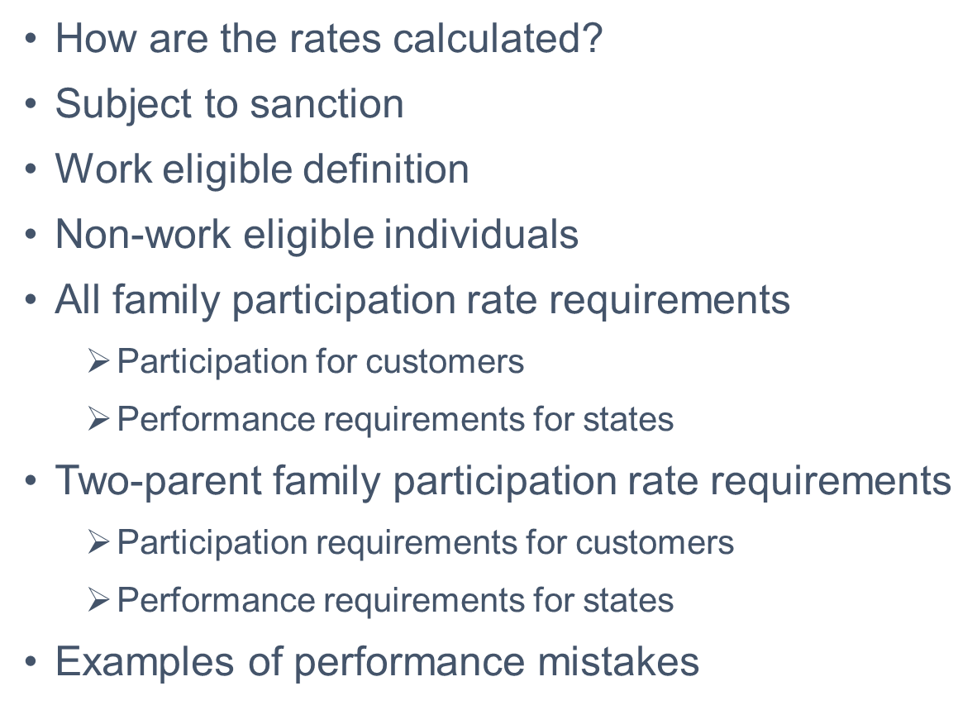
OBJECTIVES
Notes:
During this presentation, we will outline:
A brief explanation of how the rates are calculated;
The definition of subject to sanction;
Work eligible individuals;
Non-work eligible individuals;
All family participation rate requirements, including participation requirements for customers and performance requirements for states; and,
Two-parent family participation rate, including participation requirements for customers and performance requirements for the states.
Lastly, we will provide some common performance mistakes keeping families from getting into participation rate numerators.

Slide 3
HOW ARE THE RATES CALCULATED?
Work Eligible and
Engaged
All Work
Eligible
minus those subject to sanction
Notes:
Generally, both rates are derived by dividing the numerator by the denominator, which is expressed in a percentage. The numerator consists of work eligible individuals who are “work engaged” in the minimum number of required hours for the month in the applicable rates. We will discuss the rates in upcoming slides. The denominator consists of all work eligible individuals minus those subject to sanction. We will discuss subject to sanction in the next slide.

Slide 4
WHAT IS SUBJECT TO SANCTION?
Notes:
Subject to sanction is defined as a reduction in or termination of a family’s cash benefit due to noncompliance with the WT program. Because the definition is a reduction in or termination of the cash benefit, any family’s benefit reduced because of a sanction will be removed from participation rate denominator. An example of a reduction will include a family in which a level 1 sanction has been requested and the noncompliant individual complies prior to the penalty being assessed. The penalty will generally be assessed for a minimum of 10 days in the following month. The family will receive a prorated benefit for the penalty month. In this instance, the family will be removed from the participation rate denominator because their benefit was reduced because of the penalty. For levels 2 and 3, the family will experience a complete termination of their benefit and will be subject to sanction in the month in which the termination occurs.

Slide 5
ALL FAMILY NUMERATOR AND DENOMINATOR
Work Eligible and
Engaged
All Work
Eligible
minus those subject to sanction
Notes:
Remember, the denominator of the all-family participation rate consists of all work eligible individuals minus those subject to sanction, and the numerator consists of those work eligible and engaged at the minimum number of participation hours.

Slide 6
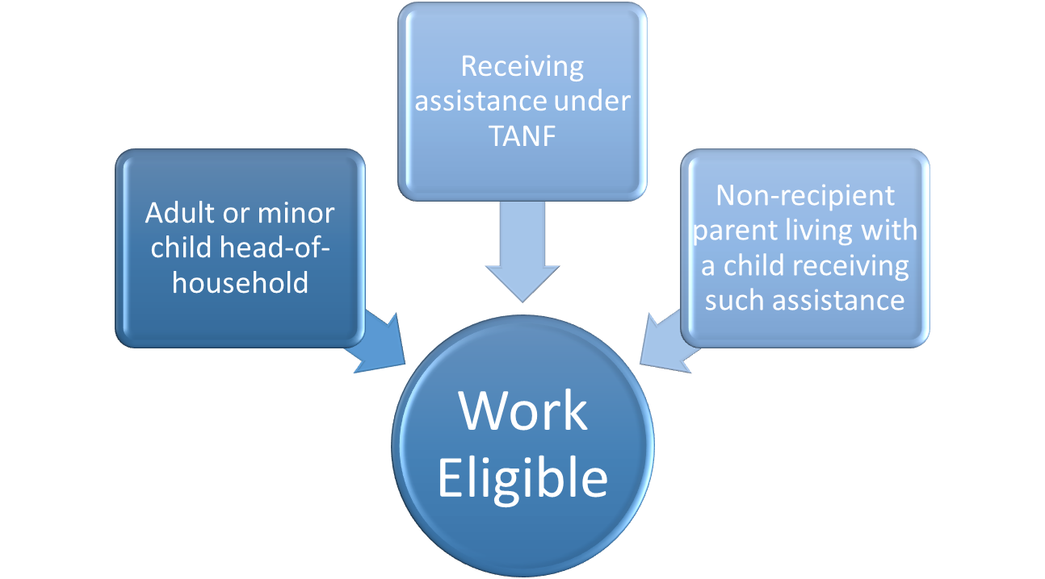
WHO IS A WORK ELIGIBLE INDIVIDUAL?
Notes:
By now you may be asking, “who is considered work eligible”? A work eligible individual is defined as an adult or minor child head-of-household who is receiving assistance under Temporary Assistance for Needy Families (TANF) or a non-recipient parent living with a child receiving such assistance.
Part of this definition talks about a “non-recipient” parent living with a child receiving such assistance. An example of this scenario would be a parent who has a level 2 or level 3 sanction because of noncompliance with the WT program but has opted for a protective payee to continue receiving the benefits for their minor child or children. Such families are considered work eligible and part of the participation rate denominator.

Slide 7
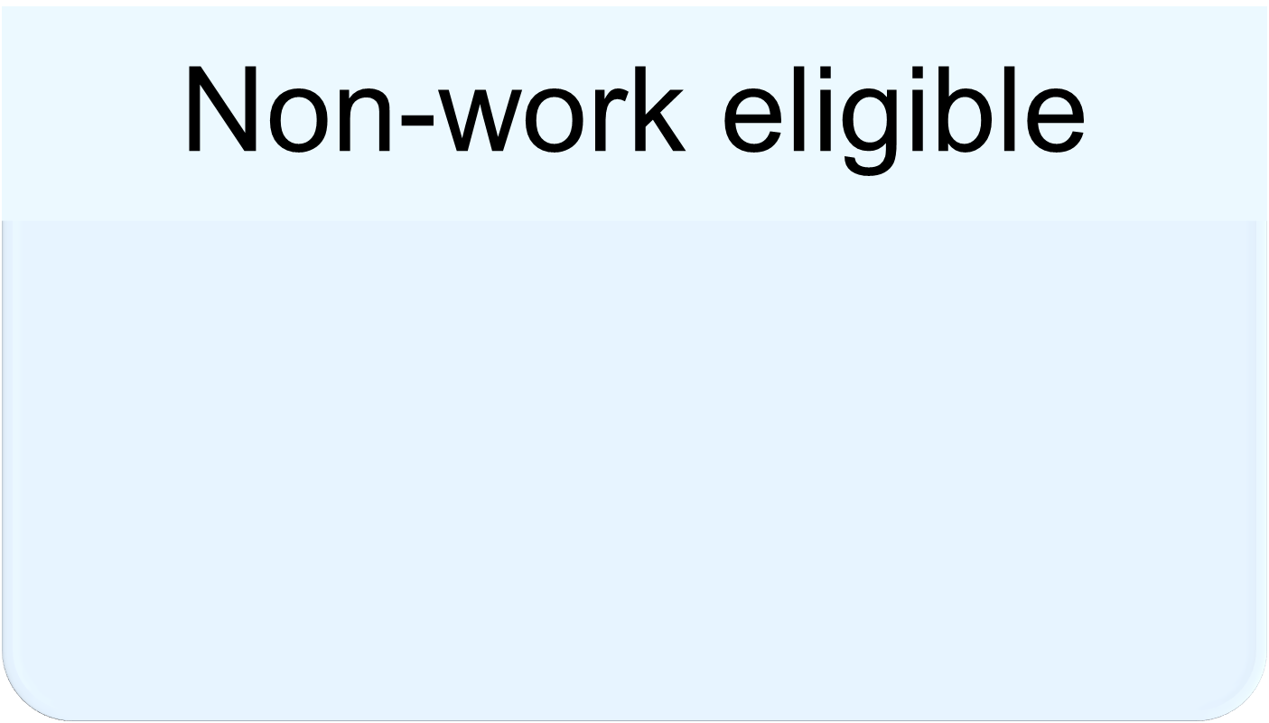
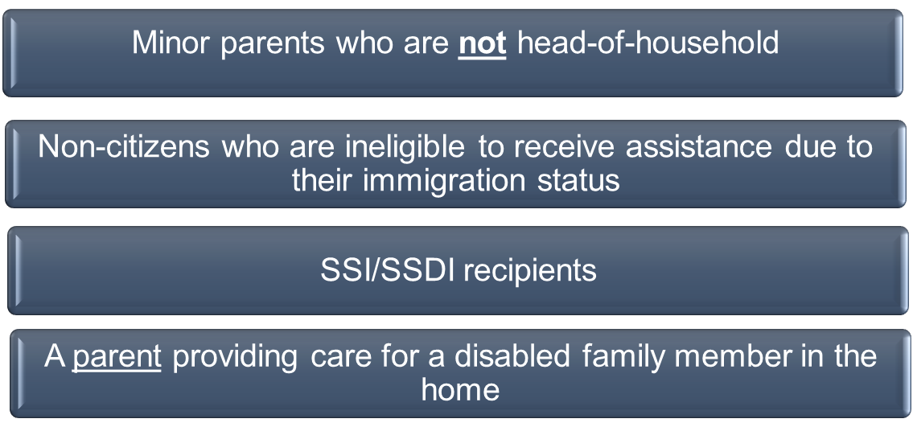
WHO ISN’T INCLUDED IN THE WORK ELIGIBLE DEFINITION?
Notes:
The following are considered “non-work eligible” individuals:
Minor parents who are not head-of-household;
Non-citizens who are ineligible to receive assistance due to their immigration status;
SSI/SSDI recipients; or,
A parent providing care for a disabled family member in the home (documentation is required)

Slide 8
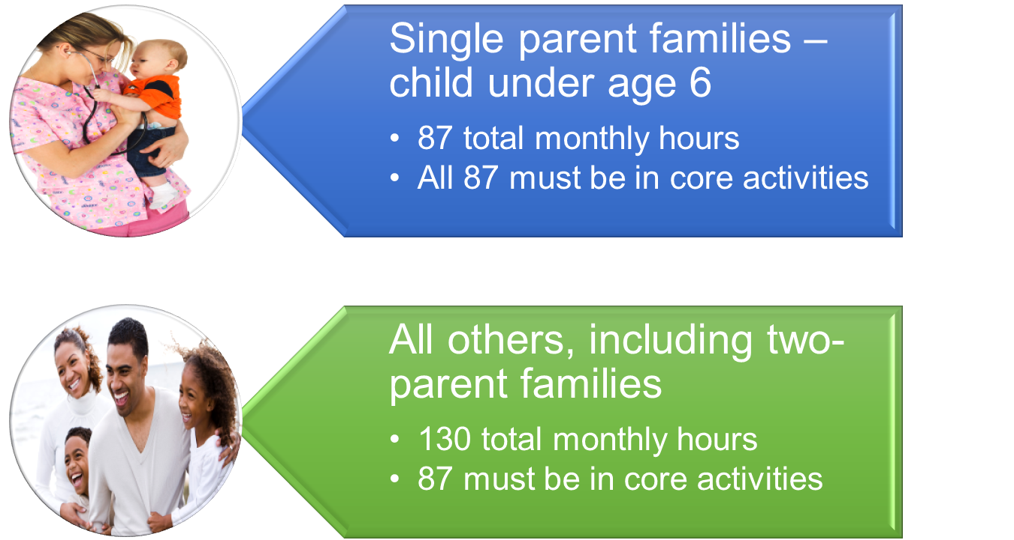
ALL FAMILY PARTICIPATION REQUIREMENTS
Notes:
In “An Introduction to the WT Program,” we briefly introduced participation requirements and the different family types. Now, we will discuss how many hours the different family types must participate to be included in the all-family participation rate numerator.
A single parent family whose youngest child is under the age of six, must complete 87 total monthly hours. All 87 of those hours must be in core activities. Remember, a core activity is one that can stand alone and count towards participation. A core plus activity requires participation in a core activity at the minimum number of hours to count towards participation.
All other families, including two-parent families, must complete a total of 130 monthly hours. 87 of those hours must be in core activities.

Slide 9
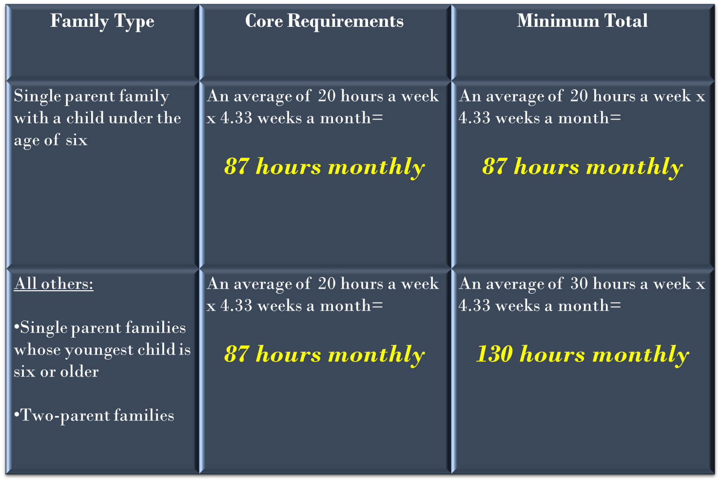
ALL FAMILY PARTICIPATION RATES
Notes:
For simplification, we have provided a chart displaying the minimum required hours families to be included in the all-family participation rate numerator.

Slide 10
ALL FAMILY RATE – STATE REQUIREMENT
Notes:
45 CFR 261.21 requires states to meet a minimum overall participation rate of 50 percent for all families. What this means is that of all work eligible families in the state, 50 (including two-parent families) must be engaged in work at the minimum required hours to be counted as work engaged. For example, if the state has 500 work eligible families, at least 250 of those families must be participating at the minimum required hours, based on family type, to be counted in the numerator of the state’s all family numerator.
While the federal requirement for states is 50 percent participation, our goal is to engage all families and provide them with the skills needed to become self-sufficient.

Slide 11
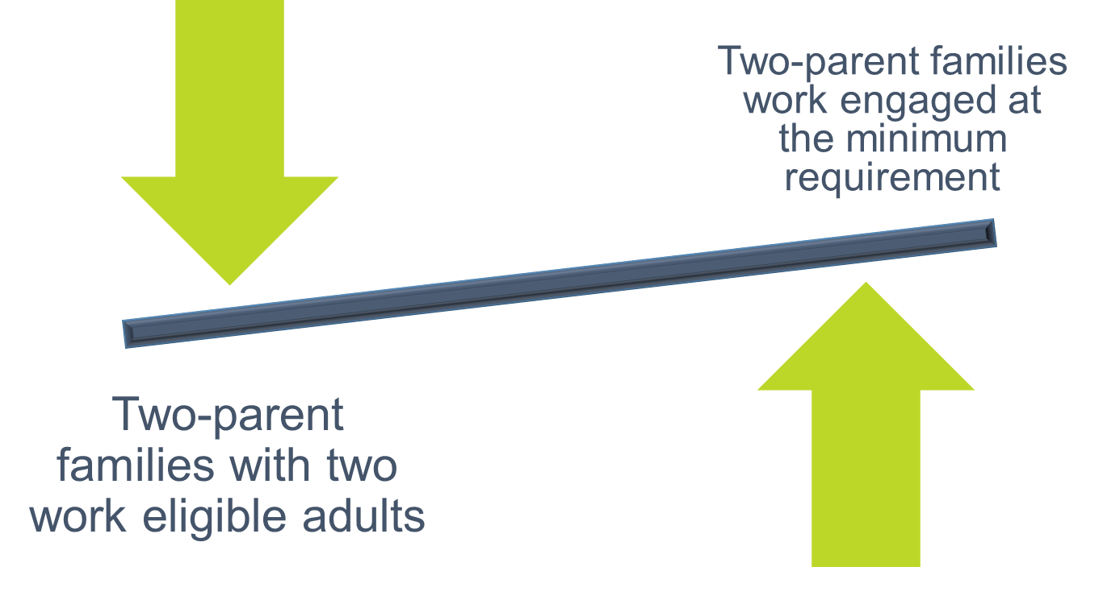
TWO-PARENT NUMERATOR AND DENOMINATOR
Notes:
Now let’s discuss who’s in the two-parent family denominator and numerator. The two-parent family denominator consists of all two-parent families where both parents are work eligible. Federal law states that both parents must be “work eligible” to fall into the denominator for the two-parent family rate.

Slide 12
DEFINING TWO PARENTS
Notes:
It helps to understand how two-parent families are defined for the two-parent family denominator. The Department of Children and Families (DCF) has a broad definition of two-parent families. DCF defines these families as in-tact families or families where the parents live in the same household and share a mutual child. However, not all these families will be included in the two-parent family denominator for participation rate purposes. The families that will be included are those where the parents live in the same household, share a mutual child and both parents are work eligible.

Slide 13
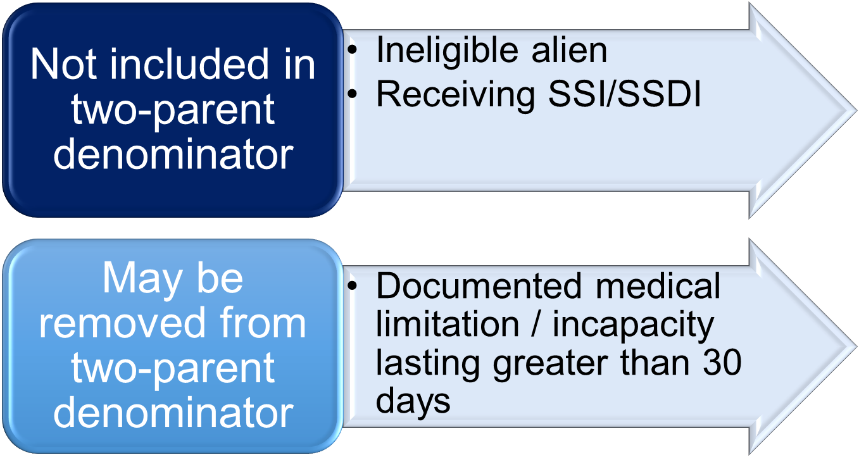
DEFINING TWO PARENTS FOR TWO-PARENT DENOMINATOR
Notes:
Just because two parents live in the same household and share a mutual child doesn’t mean they are both work eligible. For example, a two-parent family is not included in the two-parent family denominator if one of the parents is:
An ineligible alien; or,
Receiving SSI/SSDI.
Additionally, a two-parent family may be removed from the denominator if one of the parents has a documented medical limitation or medical incapacity lasting greater than 30 days. However, it is important to remember that all two-parent families (with at least one work eligible adult) will be included in the all-family participation rate denominator.

Slide 14
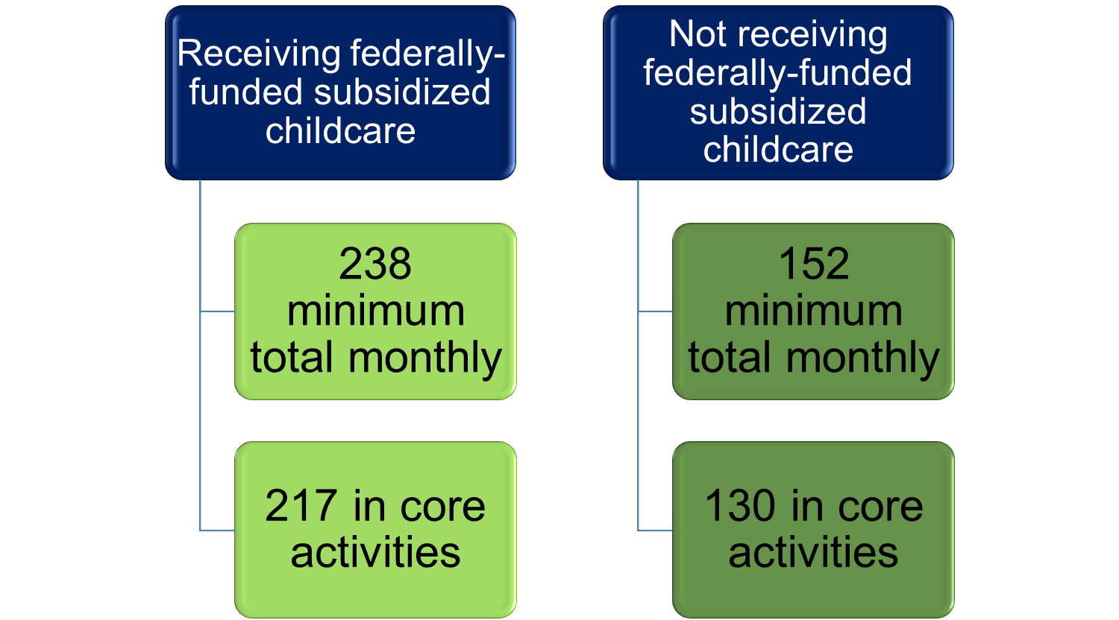
TWO-PARENT PARTICIPATION REQUIREMENTS
Notes:
Participation hours for two-parent families depend on whether they are receiving federally-funded subsidized childcare. If the couple is receiving federally-funded childcare, they are required to perform a minimum of 238 hours per month. 217 of those hours must be in core activities. Two-parent families that are not receiving federally-funded childcare, the minimum total monthly participation hours is 152. 130 of those hours must be in a core activity.

Slide 15
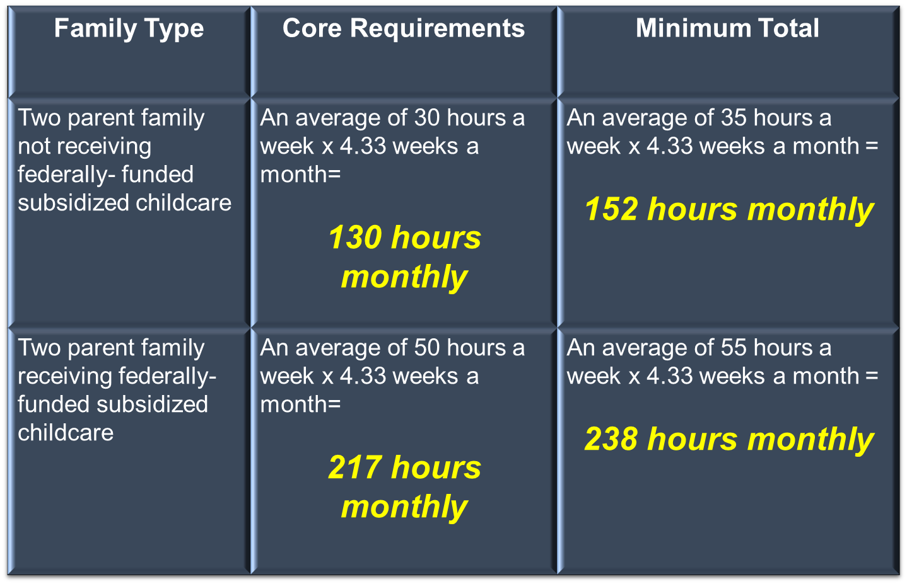
TWO-PARENT FAMILY PARTICIPATION RATES
Notes:
Again, for simplification, we have provided a chart outlining the participation requirements for two parent families to be included in the two-parent family participation rate numerator.

Slide 16
TWO-PARENT FAMILIES – STATE REQUIREMENT
Notes:
45 CFR 261.23 requires states to meet a minimum overall two parent rate of 90 percent.

Slide 17
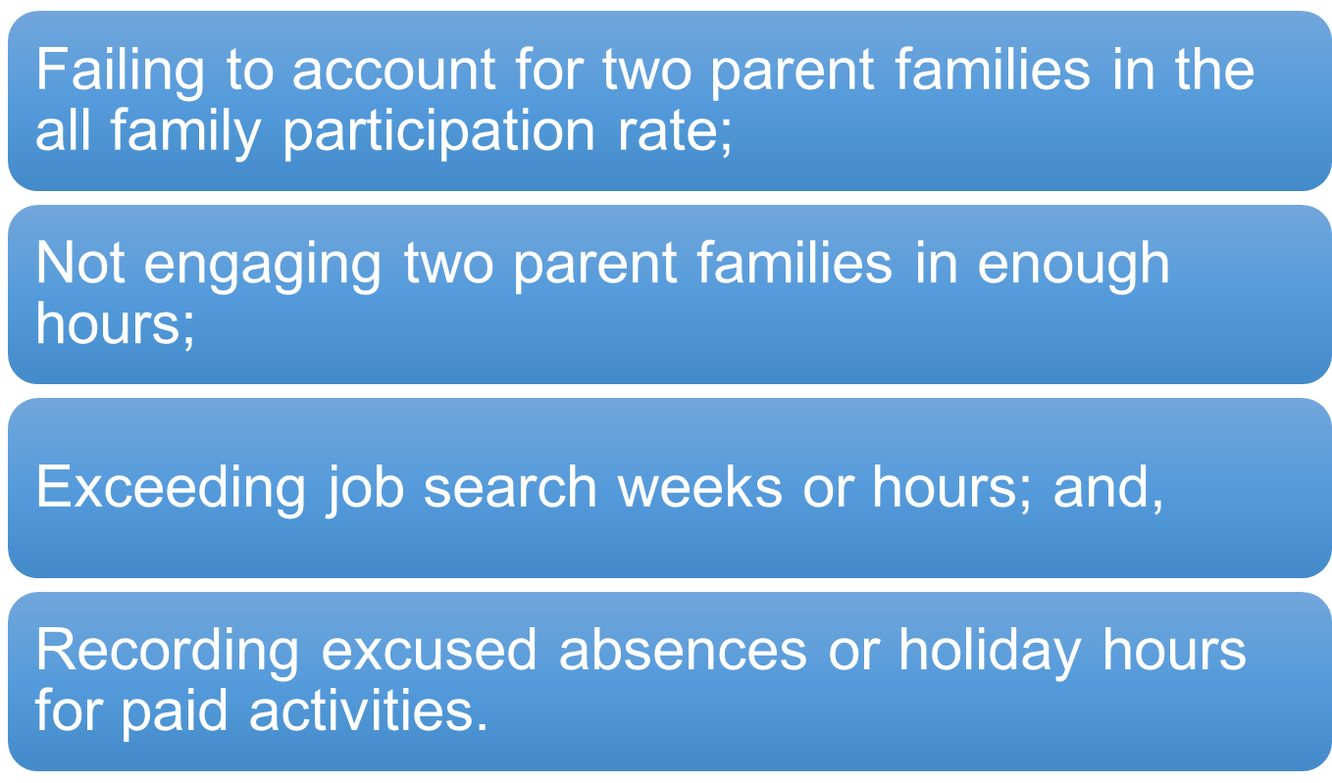
COMMON PERFORMANCE MISTAKES
Notes:
In the next set of slides, we will provide examples of things that are keeping families from getting into the participation rate numerators. These mistakes are not participant related but related to common mistakes made in assigning activities and/or recording participation hours. Now that you have reviewed the various work activity modules, you should be aware of core and core plus activities and activities that have time limit restrictions. First, we will list the most common mistakes and provide examples of each. The most common mistakes include:
Failing to account for two-parent families in the all-family rate;
Not engaging two-parent families in enough hours;
Exceeding job search weeks or hours; and,
Recording excused absences or holiday hours for paid activities.

Slide 18
NOT ACCOUNTING FOR TWO PARENT FAMILIES IN THE ALL-FAMILY RATE
Notes:
One the most asked questions is “how did this two-parent family meet the two-parent family rate, but not the all-family rate”? For reference, we provided a quick reminder of the requirements for both rates. First, you must take into consideration whether your two-parent family is receiving subsidized childcare. If they are, you should ensure that the parents are completing 238 total hours with 217 of those being in core activities. If they are not receiving subsidized childcare, the family should complete 152 total with 130 of those being in core activities. The tricky part is knowing for sure if they are or aren’t. We will cover this issue in the next common mistake. However, one often overlooked element is that while for the two-parent family rate, the parents may share hours towards meeting the rate, they cannot share hours for the all-family participation rate.
Remember, at least one of the parents must complete 130 hours total, with 87 of those hours being in core activity. How do you get around this?
Well, you can start with making sure that one of the parents meets the all-family participation rate requirements of 130 hours total, with 87 being in core activities. The family may still share the hours for the two-parent rate but at least one should cover the all-family requirement.

Slide 19
NOT ACCOUNTING FOR TWO PARENT FAMILIES IN THE ALL-FAMILY RATE
Notes:
Another common mistake is not engaging two parent families in enough hours. In a previous slide, we mentioned that it may be tricky figuring out whether the family is receiving federally-funded subsidized childcare. The reason this is tricky is because families may receive childcare assistance from other agencies that receive federal funding. Families may receive childcare from the DCF’s Family Safety unit or the Office of Early Learning (OEL). It’s possible that the childcare is not connected to the WT program or because of a referral from the program.
The common mistake in this instance is using the requirements for a two-parent family without subsidized childcare, which is 152 total hours with 130 of those being in core activities. However, because the family is receiving federally-funded childcare, they should be engaged at 238 total hours with 217 of those being in core activities.
You may ask, “how can we assign them to the higher requirement if we don’t know”? That’s a very good question. One way to address this issue is to think of the two-parent family as individuals as well. If every individual is required to complete 35 or 40 hours per week in work activities, it will help eliminate the possibility of not engaging these families in enough hours. Requiring a set number of hours for every individual in the work program takes the guess work out of meeting the hours. You must remember, though, there are core hour requirements. So, when assigning hours, you must ensure that the core hours and total hours are satisfied.
Not everyone will be able to complete 35 or 40 hours per week, so you will look at every situation on a case-by-case basis and adjust participation for people with medical limitations, Substance Abuse and Mental Health (SAMH) issues, and other circumstances beyond their control.

Slide 20
EXCEEDING JOB SEARCH WEEKS OR HOURS
Notes:
Another common mistake is that staff may allow the customer to exceed the number of weeks or the number of hours they may complete in a rolling 12-month period. To learn more about job search time limits and the rolling 12 months, please view the module on Job Search and Job Readiness Assistance, which is part of the WT Tier II curriculum.

Slide 21
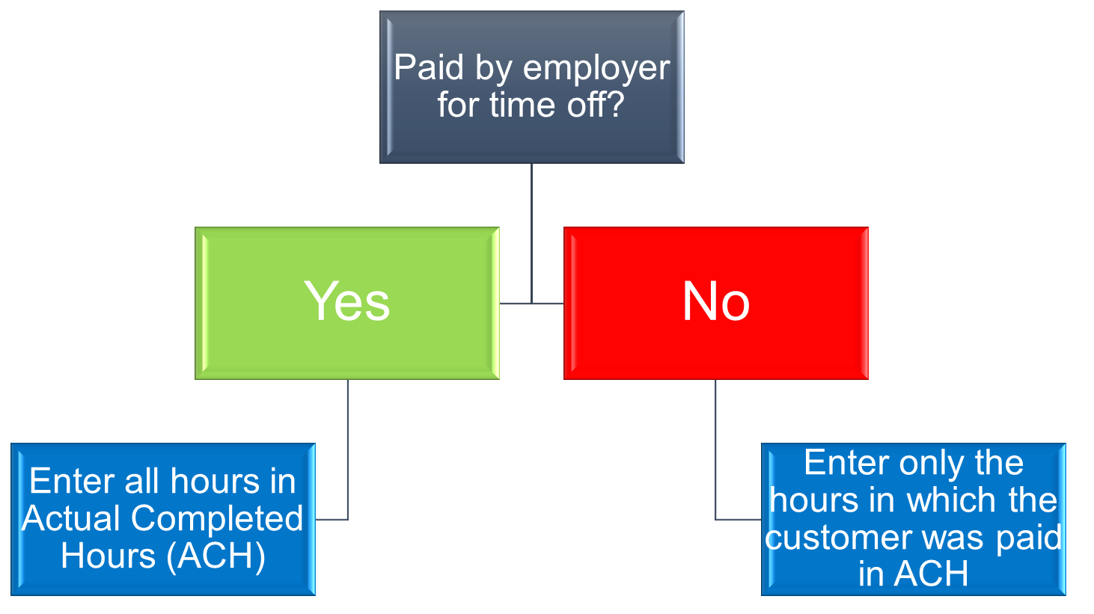
RECORDING EXCUSED ABSENCE/HOLIDAY HOURS FOR PAID ACTIVITIES
Notes:
The last most common mistake is that staff record excused absence or holiday hours for paid activities. As a reminder, paid activities include unsubsidized employment (including self-employment), subsidized employment, and On-the-Job Training (OJT). The state can’t grant credit for holiday hours or an excused absence for a customer’s paid activity. If a customer is employed and was paid by the employer for a holiday or leave, these hours will be recorded in actual hours worked and not in the holiday hours or excused hours in the One Stop Service Tracking (OSST) system. An easy way to remember this is to ask, “did the employer pay the participant for their time off from work on a particular holiday or were they paid by the employer for sick leave”? If the answer to these questions are yes, you will enter all of the hours in “Actual Completed Hours” or “ACH” in OSST for the paid activity. If the answer is no, you will enter only the hours in which the participant was paid in ACH. Do not enter any hours in the holiday or excused absence sections of OSST for the paid activity.
In the next few slides, we will provide Job Participation Rate (JPR) screen illustration of the correct way to enter JPR hours for paid activities and the incorrect way to enter them.

Slide 22
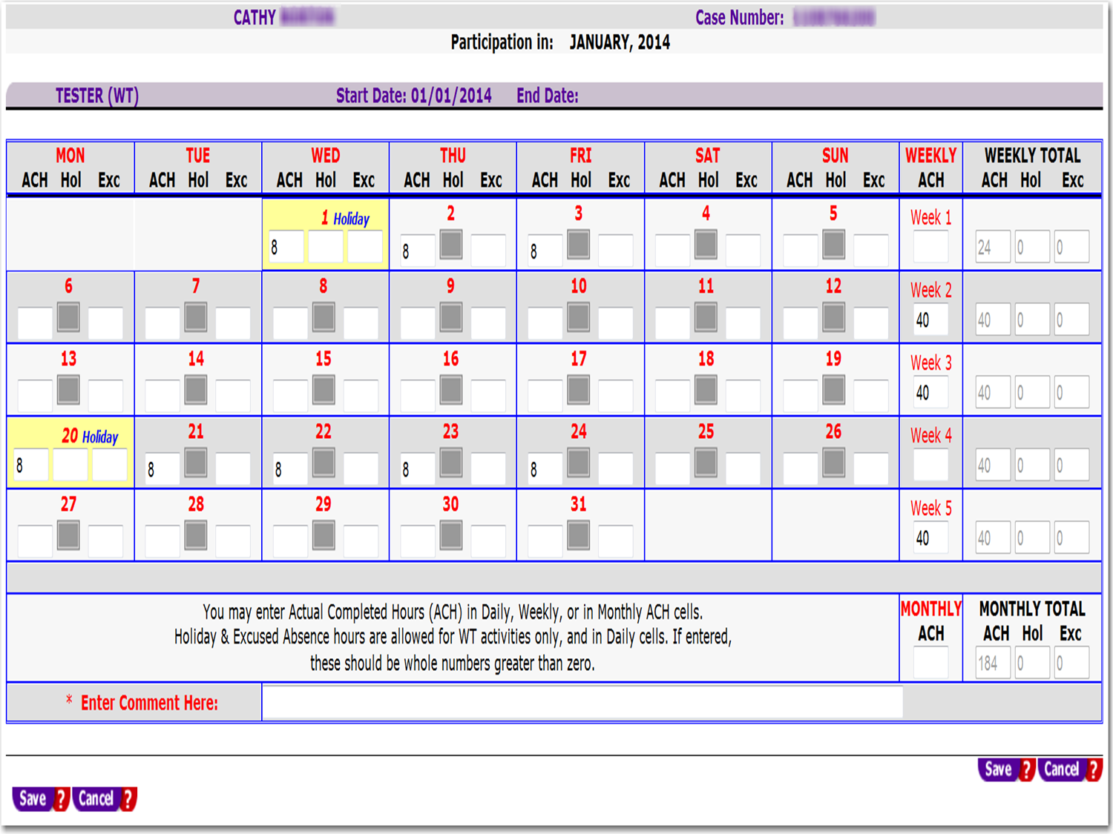
Notes:
In this example, we will assume that the customer was paid by the employer for the two holidays in January. In a typical work week with working days being Monday through Friday, we entered 8 hours in the ACH column for January 1, 2014, and 8 hours in the ACH column for January 20, 2014. Since we started entering hours daily for this week, we continued entering ACH daily. The same is true for the week of January 20th through 24th. Keep in mind; however, that you will have a paid stub for your customer’s hours. On the stub, it will indicate if the customer was paid for a holiday or any sick leave. This illustrates one of the correct ways to enter hours for an employment activity in which the employer paid for the customer’s time off.

Slide 23
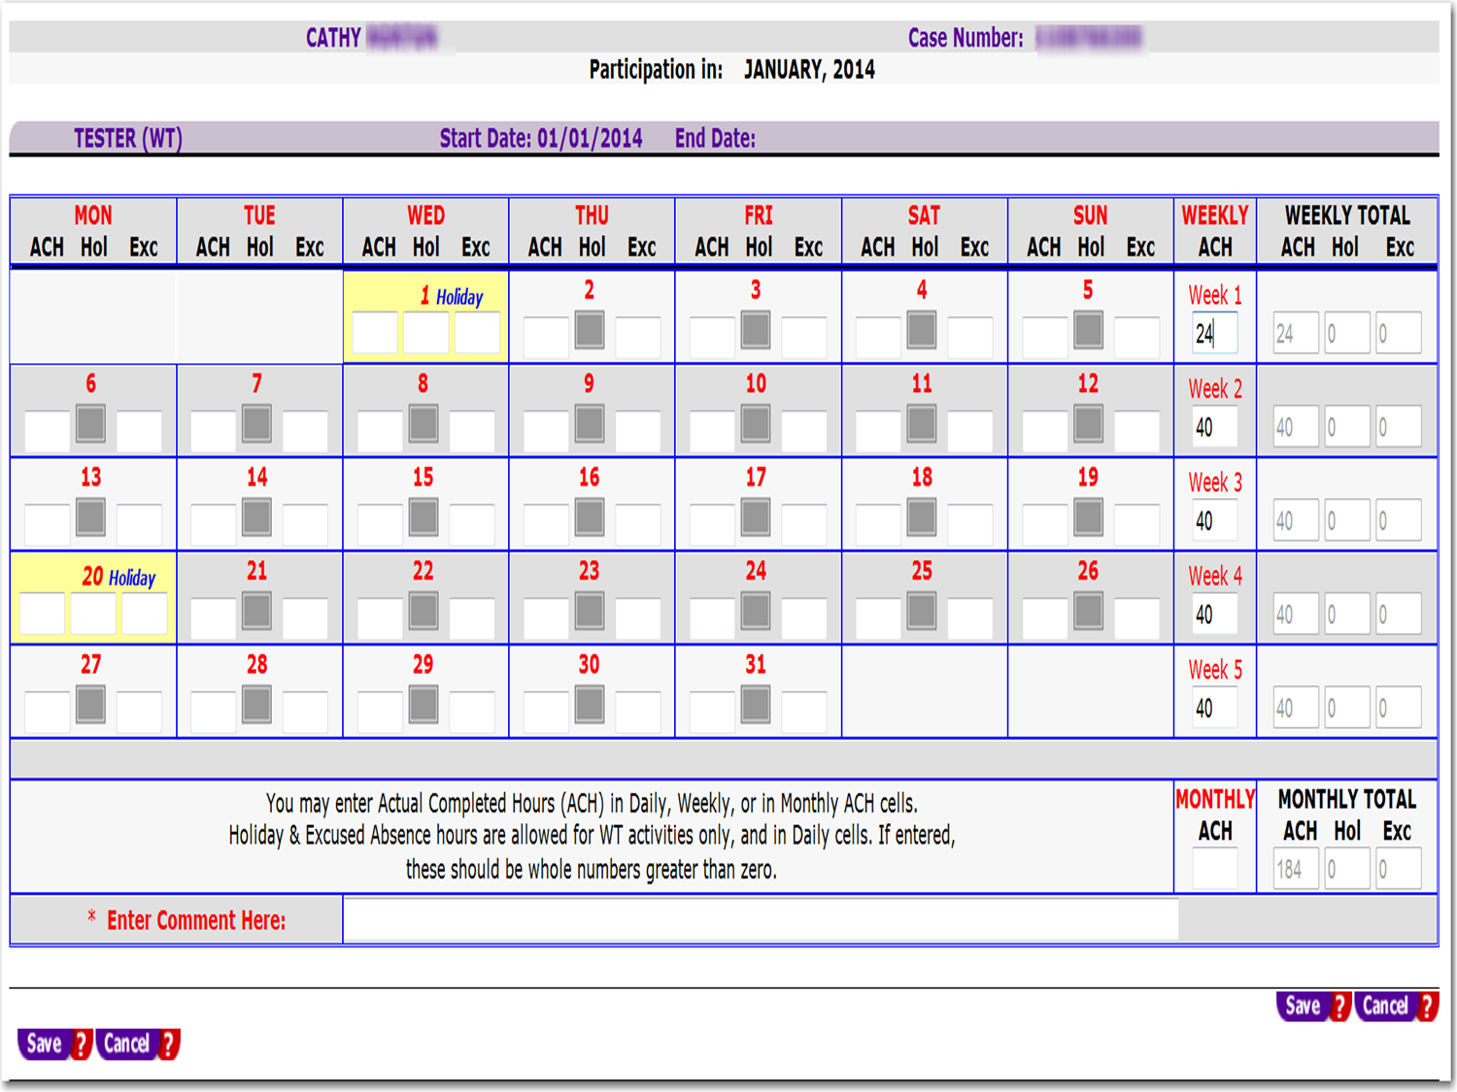
Notes:
Another way to enter actual completed hours is by entering the hours in the Weekly column of the JPR page. This may include the hours in which a participant was paid for a holiday or excused absence. However, you must make sure that the pay stub or other documentation accurately, reflects the total number of hours completed. For example, the pay stub or other documentation should show what the customer worked and the number of paid holiday hours in which she was paid. In this example, the total would be 24 hours for January 1 through January 3, 2014. Sixteen hours would be for the hours worked and 8 would be for the paid holiday, but it is recorded in a total of 24 ACH hours in the weekly column.

Slide 24
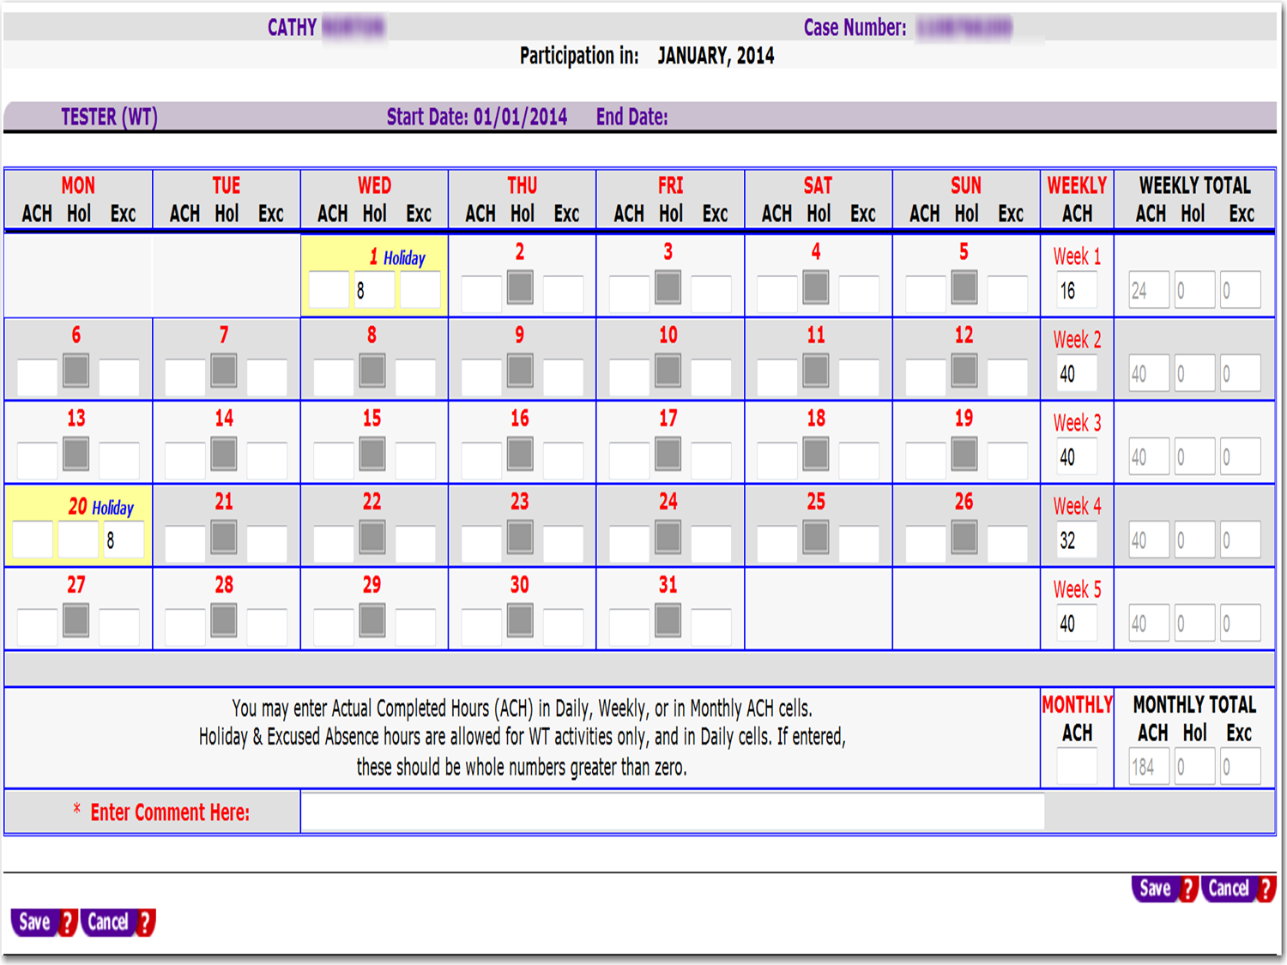
Notes:
This is the incorrect way to record JPR hours for a holiday or an excused absence in which a customer was paid by the employer. The customer will not receive holiday hours or excused absence credit if hours are entered here for a paid or employment activity. DCF will bypass these hours towards reporting participation in the program. However, if the customer was paid for the holiday or for leave time and the hours are recorded in ACH, the hours will be picked up by DCF and reported for participation.

Slide 25
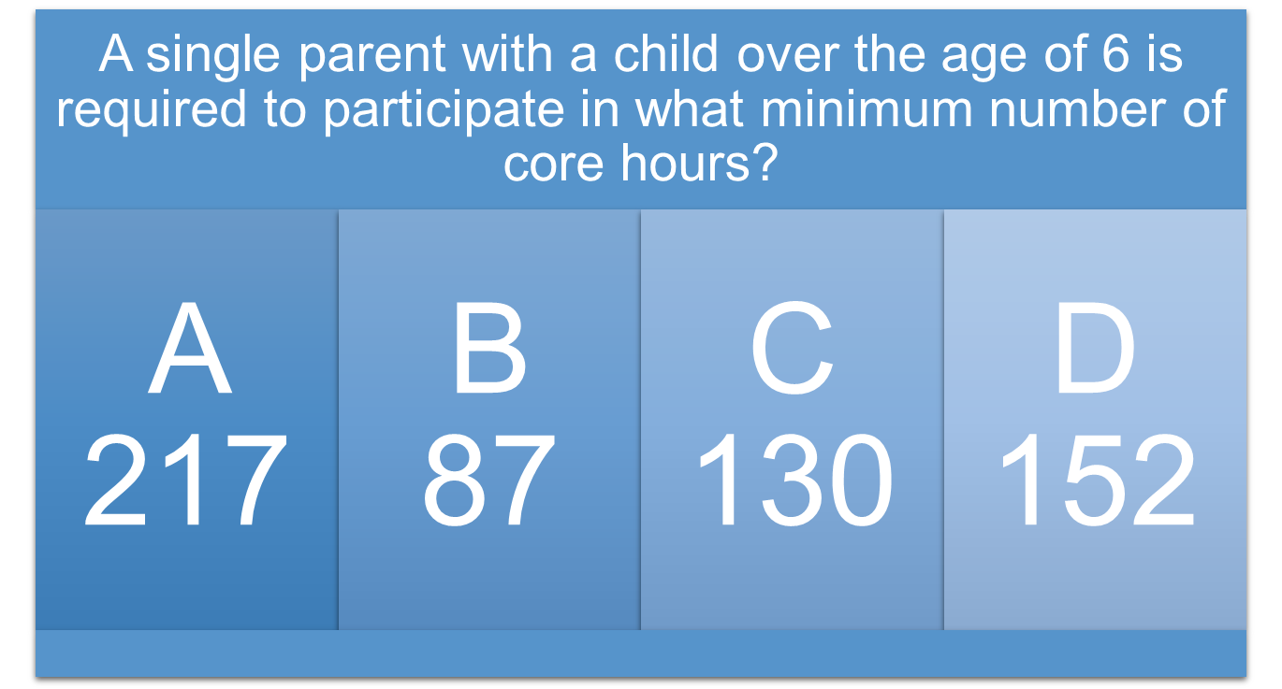
QUESTION
Notes:
A single parent with a child over the age of 6 is required to participate in what minimum number of core hours?

Slide 26
ANSWER
B - 87
Notes:
The answer is B or 87 hours.

Slide 27
QUESTION
Notes:
Is this statement true or false: to be included in the numerator, an individual must be work eligible and engaged.

Slide 28
ANSWER
Notes:
The answer is True.

Slide 29
QUESTION
Notes:
Is this statement true or false: the WT Program is the only way a family may receive subsidized childcare assistance.

Slide 30
ANSWER
Notes:
The answer is False. Families may receive subsidized childcare assistance from other agencies.

Slide 31
Questions & Answers
Notes:
Are there any questions?

Slide 32
Contact Us
Thank You.
If you have questions or comments about this presentation, please contact us
WT Program
Email: WTProgram@commerce.fl.gov
Office: Bureau of One-Stop and Program Support
Notes:
This concludes the presentation on participation rate basics. If you have questions about this presentation or questions about the WT program, in general, please contact us at WTProgram@commerce.fl.gov.

