Slide 1


Managing Employer Services
In the Employ Florida Marketplace

Slide 2

Objective
To provide guidance and clarification to one–stop staff of the procedures for providing and recording services to employers from the one-stop perspective .

Slide 3

Employer Search
    To search for an employer, from the navigation menu, select:
    Manage Employer
    And then select
    Assist an Employer

Slide 4
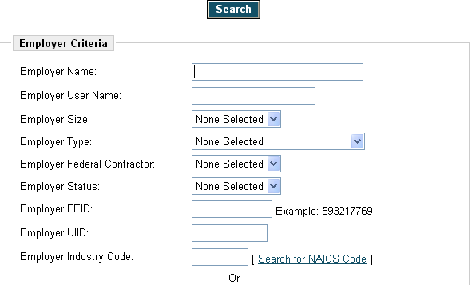
Search
Notes:
This brings up the search page where you can search by these fields or you can select by
Employer Industry Sector:
Employer Benefits: [ Check All | Uncheck All ]
Contact Criteria
Location Criteria or
Staff Criteria
* Employer User Status:
* Registration Source:
If I enter an employer’s name, say ABC Aluminum

Slide 5
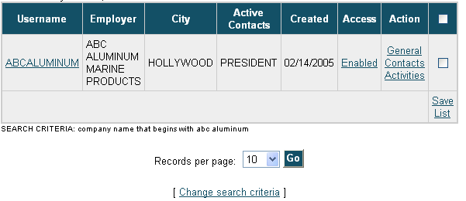
Search Results
Notes:
If the employer did not show up in your search, you will have to register the employer in order to add the services. Or if you get a list, you are to find the correct employer and click on Activities

Slide 6
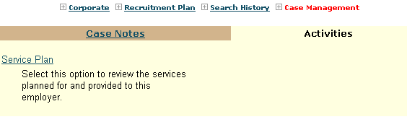
To View Services
Notes:
Now click on the Service Plan

Slide 7
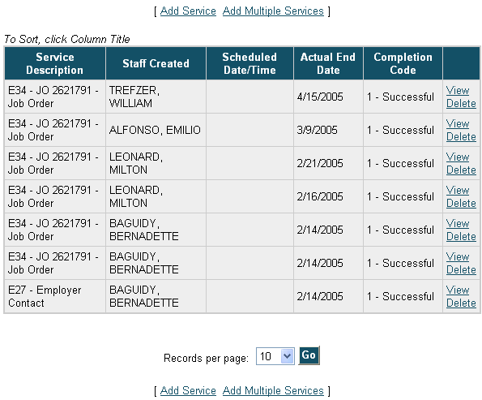
Notes:
This brings up the list of services that have already been given to this employer. Click on Add Service or Add Multiple Services

Slide 8
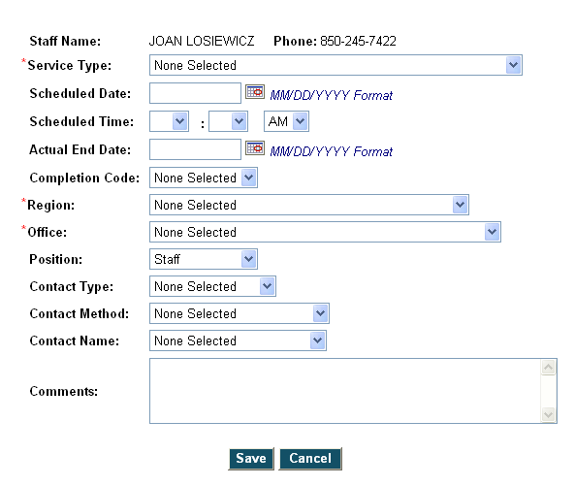
Notes:
When you click on the service type, you get a long list of services you can choose from.

Slide 9
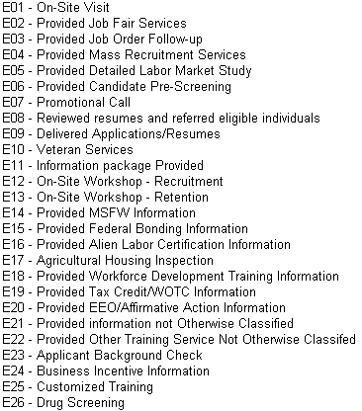
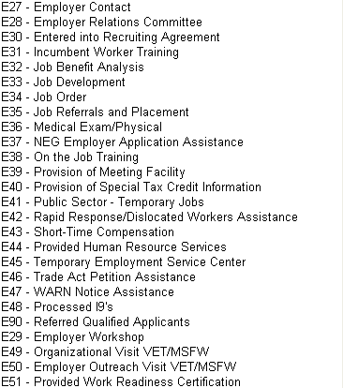
Notes:
These are the services that are currently listed in EFM. A little later we will look at which of these services will now be included as triggers for the Brandt survey which is the basis for the Employer Satisfaction Survey which determines “Employer Satisfaction” on the Balanced Scorecard.

Slide 10
Notes:
You can schedule a service such as a job fair on a future date but unless you input an actual end date, and a

Slide 11

Notes:
Completion code of successful, the service will not count.

Slide 12
Notes:
Fill in the region, office and position

Slide 13

Notes:
Whether you are an LVER, DVOP or staff person.

Slide 14

Notes:
Fill in contact type whether it was initiated by staff or the employer requested the service.

Slide 15
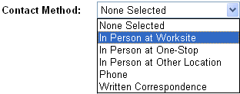
Notes:
Then fill out the Contact Method, how the employer was approached. Whether you visited the employer at their worksite, whether the employer came into the one-stop center or was the employer contacted at a job fair, a chamber meeting or other location-which should be put into the comment section. Was it a phone call or did you write a letter or e-mail to the employer.

Slide 16

Notes:
A contact name should be selected if listed here. Otherwise, put the person’s name and title in the comments section. After you enter your comments, click on save.

Slide 17

Notes:
Once a service has been input, to view the actual details, you would select “View” on the service you are interested in from the Service Plan.

Slide 18
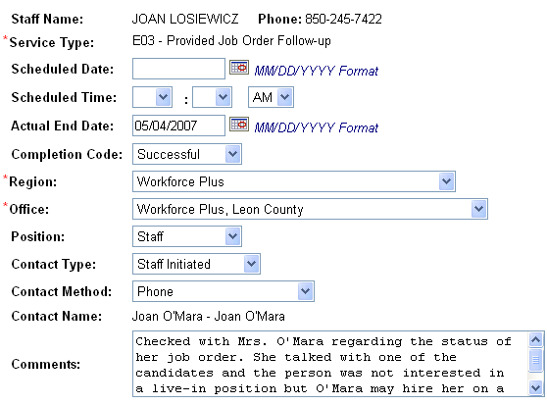
Notes:
Then you are able to see all the details regarding the service.

Slide 19
E01 On-Site Visit
Staff actually went to the employer’s place of business.
Should be used to track employer visits.
Compares to J270 service

Slide 20

E02 Provided Job Fair Services
Can be used when the one-stop center conducts a job fair in which the employer participates.

Slide 21
E03 Provided Job Order Follow-Up Services
If the staff provided follow-up on a job order, either by contacting the employer when they need to make changes to a new order, or
If the staff does verification on the referrals on a job order, or
The staff reviews the job order and there have been no referrals, staff may contact the employer with suggestions to attract job seekers, i.e., raise the pay.

Slide 22
E04 Provided Mass Recruitment Services
Mass recruitment services are being provided for an employer whether the recruitment takes place in the one-stop center, the employer’s business location or some other outside location.

Slide 23
E05 Provided Detailed Labor Market Study
Studies are usually undertaken for businesses contemplating opening in the area or expanding their current operation.
May consist of prevailing wage, labor force availability information, etc.

Slide 24
E06 Provided Candidate Pre-Screening
Can be used when providing screening for suppressed job orders.

Slide 25

E07 Promotional Telephone Call
Good marketing technique to call new businesses regarding the one-stop center’s business services.
Calls can target employers who have not recently used one-stop center services.
Follow-up with on-site visit or mail promotional packet.

Slide 26
E08 Reviewed Resumes and Referred Eligible Individuals
Can be used when staff does a file search on a job order.
Can be used when a recruiting agreement is in effect and staff reviews the applications/resumes and selects and refers qualified individuals.

Slide 27

E09 Delivered Applications/Resumes
Staff delivers the applications/resumes that have been collected to a specific employer.
Usually used in recruiting agreements, mass recruitment situations.

Slide 28

E10 Veteran Services
Code can be used by Vet staff when outreach is not the goal of the visit. Can be used when providing information to a federal contractor about their required use of local one-stop services.
Office of Federal Contract Compliance Programs
Final Rule April 7, 2008
41 CFR Part 60-250.5
The contractor agrees to immediately list all employment openings . . . at an appropriate local employment service office of the state employment security agency wherein the opening occurs.

Slide 29

E11 Information Package Provided
Staff has provided the employer with a package of information detailing the services of the one-stop center.

Slide 30
E12 On-Site Workshop-Recruitment
Staff has provided a workshop at the employer’s business on the recruitment of qualified, work-ready individuals.

Slide 31

E13 On-Site Workshop-Retention
Staff has provided a workshop at the employer’s business on how to retain the present work force.

Slide 32

E14 Provided MSFW Information
Usually provided by MSFW Outreach Workers.
Gives employers information regarding the current availability of this population.
Gives information regarding processing of I-9s.

Slide 33

E15 Provided Federal Bonding Information
Can be used when processing a bond for a job seeker.
Can be used when advising an employer about the one-stop center’s ability to provide bonding.

Slide 34
E16 Provided Alien Labor Certification Information
Can be used when contacted by employer/law office regarding a current job order.
OOPS! Wrong Alien.

Slide 35
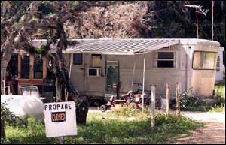
E17 Agricultural Housing Inspection
Yes, FloridaCommerce still has to inspect the migrant housing provided by agricultural employers in Florida.
FloridaCommerce staff can use this service to report the inspection in the system.
Paul J. Milette / The Palm Beach Post

Slide 36
E18 Provided Workforce Development Training Information
Staff informed the employer of the training opportunities available through the one-stop center.
Less specific than OJT, customized, encumbent worker services.
Use comments section to detail information provided.

Slide 37

E19 Provided Tax Credit/WOTC Information
Information was specific to WOTC.

Slide 38
E20 Provided EEO/Affirmative Action Information
Staff can take this service if they talked to an employer about an EEO issue on a job order.
Staff may be contacted by an employer who has to list an affirmative action job order.

Slide 39
E21 Provided Information NOT Otherwise Classified
Catch-all service but must enter the information provided in the comments field.

Slide 40
E22 Provided Other Training Service NOT Otherwise Classified
Catch-all service for training information.
Must provide information given in the comments field.

Slide 41
E23 Applicant Background Check
This service can be taken if one-stop staff provides information on where the employer can obtain a background check.
New section of “Terms of Use” has this information.

Slide 42
E24 Business Incentive Information
Staff provides the employer with latest information regarding incentives, i.e., EZ Tax Credit.

Slide 43
E25 Customized Training
Staff provides the employer with information regarding the use of customized training for individuals to obtain the skills required to operate the employer’s business.

Slide 44
E26 Drug Screening
This service can be taken when a one-stop center staff advises an employer of where to obtain drug screening services.

Slide 45
E27 Employer Contact
Can be used to record a contact made at an event such as a Chamber meeting or a job fair not sponsored by the one-stop center.
Comment should reflect the event and the type of information provided.

Slide 46
E28 Employer Relations Committee
Florida no longer has an organized employer committee (formerly Job Service Employer Council or JSEC).
Regional boards are required to have employers representing 55% of the composition of the board.

Slide 47
E30 Entered into Recruiting Agreement
The one-stop center has a written or verbal agreement with an employer to provide recruitment services.
May be one type of job or may be all jobs for the specific employer.

Slide 48
E31 Incumbent Worker Training
One-stop center has entered into an agreement with the employer to provide incumbent worker training.

Slide 49
E32 Job Benefit Analysis
One-stop center has provided an employer with an analysis of the benefits package the employer offers versus the package offered in similar types of businesses.

Slide 50
E33 Job Development
Staff can take this credit when a job development for this specific company is provided to the job seeker.
Staff must actually talk to the employer to set up an interview for the job seeker.

Slide 51
E34 Job Order
Staff can take this credit when they were instrumental in obtaining a job order from an employer i.e., the job order resulted from an employer visit or an employer contact.
Staff should not take this credit if there was no involvement with the employer.

Slide 52
E35 Job Referrals and Placement
Staff can take credit for referring candidates and getting placements on a job order with this code.
Credit for referrals and placements already occur on the job seeker and the job order.

Slide 53
E36 Medical Exam/Physical
Most one-stop centers do not conduct medical exams on the job seekers but may be instrumental in setting up this service.
One-stop centers who refer the employer to licensed entities who conduct this service can take this credit.

Slide 54
E37 NEG Employer Application Assistance
One-stop centers who advise and aid in the application process for the National Emergency Grant can take this service.

Slide 55
E38 On-the-Job Training
One-stop centers who contact the employer and write up the OJT contract can take this credit.

Slide 56

E39 Provision of Meeting Facility
One-stop centers who provide a meeting room to an employer may take this credit.
Can be with or without charge for the meeting space.

Slide 57
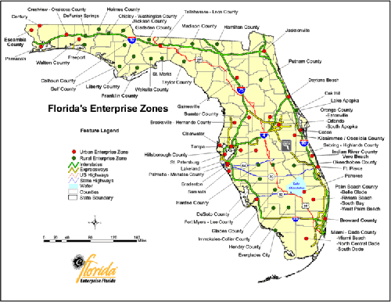
E40 Provision of Special Tax Credit Information
One-stop center staff provide the employer with information on special tax credits such as EZ Zone.
http://www.floridaenterprisezones.com/PageView.asp?PageType=R&edit_id=1

Slide 58
E41 Public Sector – Temporary Jobs
One-stop center staff provide the employer in the public sector with temporary help for disaster clean-up or special survey or national census.

Slide 59

E42 Rapid Response/Dislocated Workers Assistance
One-stop center staff provide information on one-stop center services, registration information for EFM, etc. for Rapid Response events.

Slide 60
E43 Short-Time Compensation
One-stop center staff provide information on short-time compensation.
The Short Time Compensation (STC) Program is a voluntary employer program designed to help employers maintain their staff by reducing the weekly hours of their employees, instead of temporarily laying off employees, when the employer is faced with a temporary slowdown in business.
http://www.floridajobs.org/unemployment/ITN/solicitation/additional%20ITN/asis/UCMod-As-Is-STC-Core-Overview-20091112-v1.00.pdf

Slide 61
E44 Provided Human Resource Services
One-stop center staff provided some type of personnel service to an employer.
Type of service should be stated in the comments.

Slide 62
E45 Temporary Employment Service Center
One-stop center staff can take this credit when using the one-stop center as a temporary employment service center such as in disaster relief.

Slide 63

E46 Trade Act Petition Assistance
One-stop staff can take this credit when assistance in filing a petition for TAA is given.

Slide 64
E47 WARN Notice Assistance
One-stop center staff can take this credit when assistance is given to an employer who needs to file a WARN notice.
This credit may also be given if staff provide any other services as a result of a WARN notice being filed.

Slide 65

E48 Processed I-9’s
One-stop center staff can take this credit if they were required to do I-9’s on all referrals.
Can take this credit for employers who are requesting H2a workers.

Slide 66
E90 Referred Qualified Applicants
One-stop center staff can take this credit for any employer who requested a suppressed job order and staff subsequently screened and referred qualified applicants.

Slide 67
E29 Employer Workshop
The one-stop center provided a workshop with topics relevant to the employer’s needs.

Slide 68
E49 Organizational Visit VET/MSFW
The veteran’s outreach program and the MSFW outreach program require that the specific staff make visits to organizations:
to contact potential job seekers, and
to let the organizations know what services the one-stop center provides.

Slide 69
E50 Employer Outreach Visit VET/MSFW
The veteran’s outreach program and the MSFW outreach program require that the designated staff make visits to employers:
to let the employers know what services the one-stop center provides,
to solicit jobs on behalf of their job seekers and,
To apprise the employer of any regulations regarding their specific participants i.e., federal contractor job order requirements.

Slide 70

E51 Provided Work Readiness Certification
One-stop staff contacted the employer to provide a copy of a Work Readiness Certification on behalf of a job seeker.

Slide 71
Questions & Answers

Slide 72

Contact Us
Thank You.
If you have questions or comments about this presentation, please contact us.
Danielle McNeil
Email: Danielle.McNeil@commerce.fl.gov
Phone: 850-245-7498
Tammellia Bacon
Email: Tammellia.Bacon@commerce.fl.gov
Phone: 850-921-3868

