Slide 1


I-9
How a One-Stop Center Processes an 1-9

Slide 2

What is an I-9?
The purpose of the I-9 form is to document that each new employee (both citizen and non-citizen) hired after November 6, 1986 is authorized to work in the United States.

Slide 3
Who can work in the United States?
•U.S. Citizens
•Lawful Permanent Residents
•Non-immigrants with work authorization from the USCIS
•Students with work authorization (typically an “EAD”)
•Others (refugees, asylees, TPS) with work authorization
Notes:
If a non-US citizen possesses an Employment Authorization Document, he/she is authorized to work in the US without having the employer file a petition for non-immigrant worker. However, the EAD allows the alien to work in the country for a limited period of time, normally one year. Some times known as a work permit, this document looks as a plastic-coated card with the alien's name and photo, as well as the expiration date.
TPS is temporary protected status. FIRST, you should get a copy of the Federal
Register notice that says that the work
authorization of people from your country who
have TPS has been automatically extended.
Copies of such notices can be downloaded from
the part of U.S. Citizenship and Immigration
Services’ (CIS’s) website, www.cis.gov, that
provides information about TPS.

Slide 4
Why does the One-Stop do an I-9 for employers?
In 1986, when the Immigration Reform and Control Act was passed, the employment service had to process an I-9 on every referred individual.
Currently, an I-9 is only processed for employers who request the service and all H2a referrals.

Slide 5
I-9 Process
Section 1 of the form is to be filled out by job seeker.
One-stop staff will complete the form by reviewing the documents.
If the documents seem genuine and the person is authorized to work in the US, a 516 INS will be issued.
The one-stop center should deliver the 516 INS as soon as possible.
The Form I-9 and copy of the 516 INS should be kept for three years.

Slide 6
Section 1 – Employee Information and Verification
Job seekers complete Section 1 by filling in the correct information and signing and dating the form. Their name, address, and date of birth must be provided. The SSN should be filled in for one-stop center tracking purposes. The form must be typewritten or printed using ink.
Do not allow the job seeker to use whiteout. If a mistake occurs during completion of the I-9 form, have the job seeker cross out the error, initial and date it, and insert the correct information.
One-stop staff is responsible for reviewing and ensuring that the job seeker fully and properly completes Section 1

Slide 7
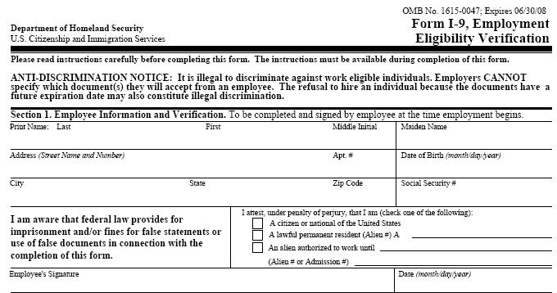
Job seeker completes personal information
Job seeker reads, signs and dates the form.
Job seeker checks an appropriate box for work eligibility and fills in other information if applicable.
Notes:
Job seeker must sign and date Section 1
Do not ask for any documentation for Section 1
Make sure all information is provided
Corrections to Section 1 can only be made by the job seeker, initialed and dated.

Slide 8
Section 1 – Employee Information and Verification
The “Preparer and/or Translator Certification” section is to be completed if the job seeker cannot complete Section 1 by her/himself or if she/he needs the form translated.
The preparer or translator must read the form to the job seeker, assist him or her in completing Section 1, and have the job seeker sign or mark the form in the appropriate place.
The preparer or translator must then complete the Preparer/Translator Certification block.

Slide 9
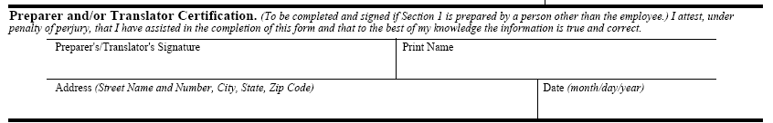
Section 1 – Employee Information and Verification

Slide 10
Section 2 – Employer Review and Verification
Job seeker must present an original document or documents that establish identity and employment eligibility. Job seekers can choose which document(s) they want to present from the lists of acceptable documents
  List A establishes both identity and employment eligibility
  List B establishes only identity.
  List C establishes only employment eligibility.

Slide 11
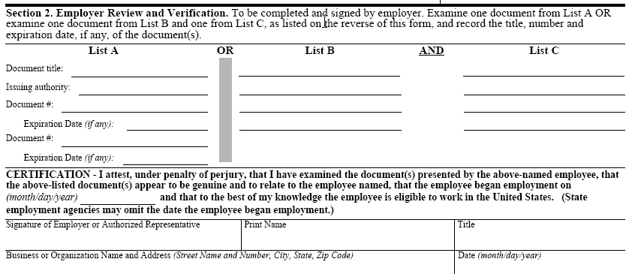
Section 2 – Employer Review and Verification

Slide 12
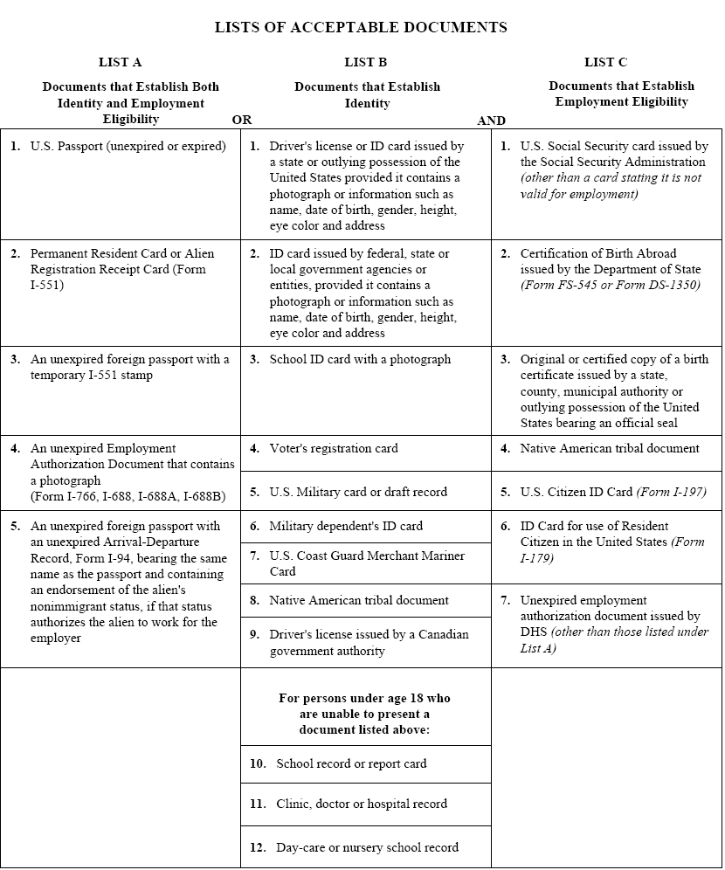

Slide 13
Section 2 (cont’d)
You may not specify which document(s) a job seeker must present.
Do not use whiteout. If a mistake occurs during completion of the I-9 form, cross out the error, initial and date it, and insert the correct information.
Corrections to Section 2 must be made by a one-stop center staff person.

Slide 14
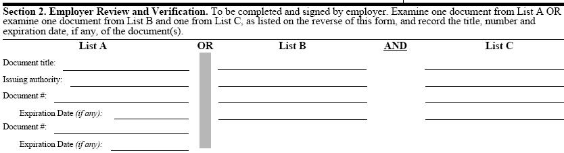
Do not request or require particular documents. The job seeker can choose from the lists which documents they would like to use.
Make sure that the documents are originals, appear to be genuine and relate to the job seeker.
Fill in the document title, issuing authority, number and expiration date (if any) in the space provided.
Record one document from List A OR one each from List B and C, not documents from all three.
Provide job seeker a list of acceptable documents.
Original documents must be provided, except for certified copies of birth certificates.
Make sure document, issuing authority and document number are recorded on correct lines.
Do not over-document List A or List B & C
Expiration dates of documents must be written in month/day/year format

Slide 15
Section 2 – Certification Section
This section needs to be completed and signed by a one-stop center staff person.
Be sure to complete business name and address, and name and title of person completing the form.
One-stop staff should not fill out the date the job seeker started work.

Slide 16
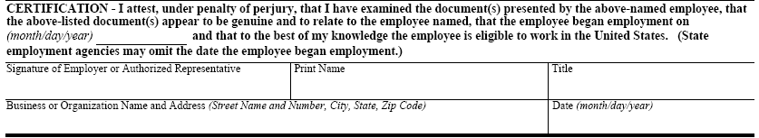
Section 2 – Certification Section
One-stop staff should not fill out the date of hire

Slide 17
Electronic Signature and Storage
Law effective April 28, 2005
Electronic Storage may include scanning
Electronic Signature may include:
–Signature pads
- Personal ID #
–Biometrics
-Click to accept box

Slide 18
Documentation
The law does not require you to photocopy documents. However, if you wish to make photocopies, you should do so for all job seekers, and you should retain each photocopy with the Form I-9.
Photocopies must not be used for any other purpose.
Photocopying documents does not relieve you of your obligation to fully complete Section 2 of the Form I-9 nor is it an acceptable substitute for proper completion of the Form I-9 in general.

Slide 19
Documentation
The one-stop center cannot accept receipts in lieu of original documents.

Slide 20
List A – Documents that establish BOTH Identity and Employment Eligibility
United States Passport (unexpired or expired)
Permanent Resident Card or Alien Registration Receipt Card (Form I-551)
Unexpired Foreign Passport (with a temporary I-511 Stamp)
Unexpired Employment Authorization Document that contains a photograph (Form I-766, I-688, I-688A, I-688B)
Unexpired Foreign Passport with an Unexpired Arrival–Departure Record (Form I-94) bearing the same name as the passport and containing an endorsement of the alien's nonimmigrant status, if that status authorizes the alien to work for the employer)

Slide 21
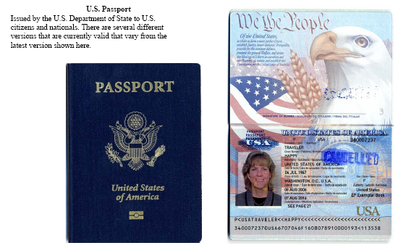
U.S. Passport

Slide 22
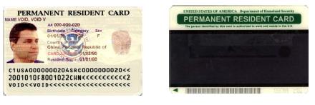
Permanent Resident Card (I-551)
The latest version of the Permanent Resident Card, Form I-551, began being issued in November 2004. The card shows the seal of the Department of Homeland Security and contains a detailed hologram on the front of the card. Each card is personalized with an etching showing the bearer’s photo, name, signature, date of birth, alien registration number, card expiration date, and card number.

Slide 23
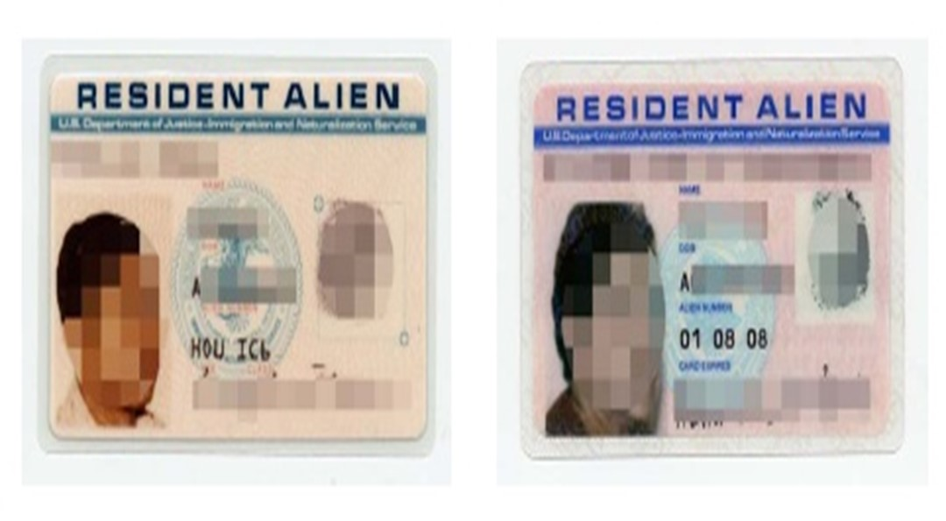
Resident Alien Card (I-551)
These cards are no longer issued, but are valid indefinitely, or until their expiration date. Recipients of this card are lawful permanent residents. This card is commonly referred to as a “green card” and is the replacement for Form I-151.

Slide 24
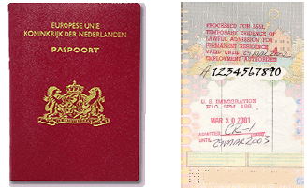
Unexpired Foreign Passport with I-551 Stamp

Slide 25
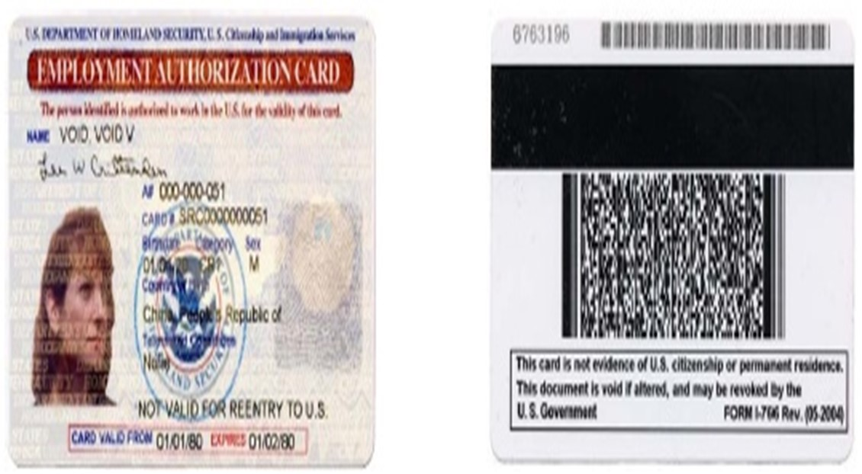
Employment Authorization Card
I-766 issued by USCIS to aliens granted temporary employment authorization in the United States. The expiration date is noted on the face of the card.

Slide 26
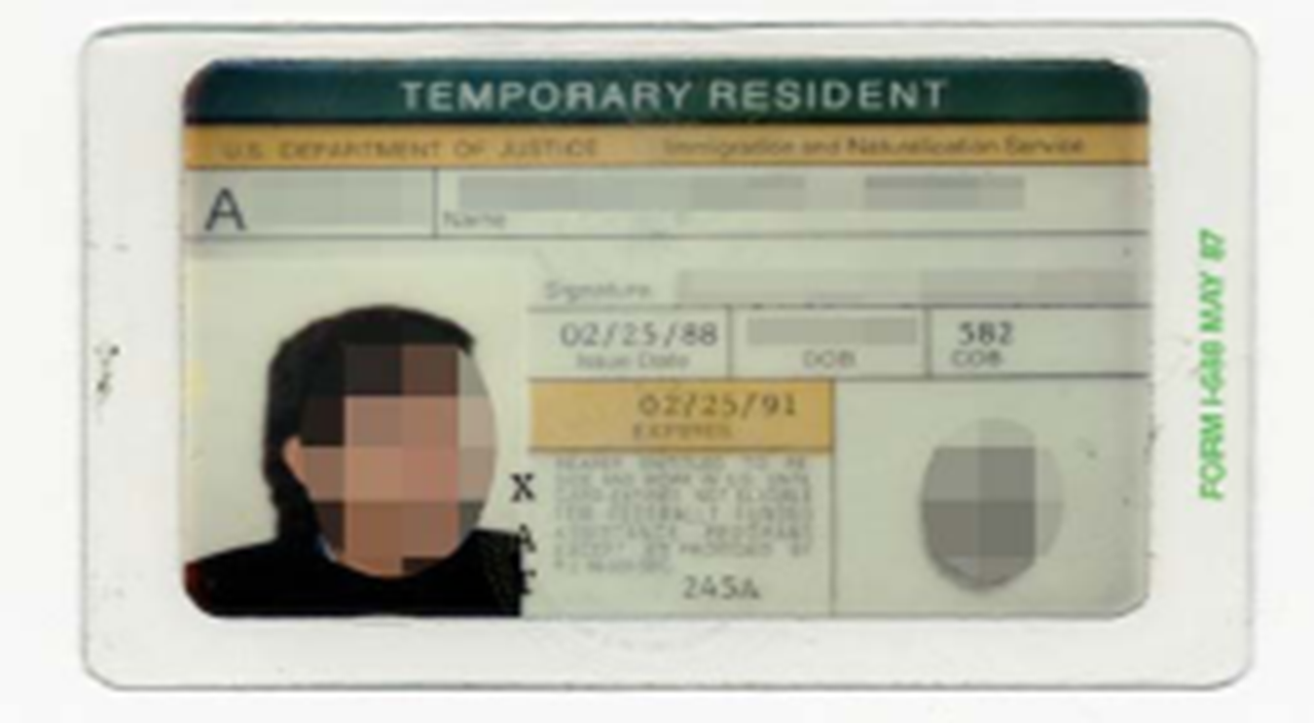
Temporary Resident Card I-688
Issued by USCIS to aliens granted temporary resident status under the Legalization or Special Agricultural Worker program. It is valid until the expiration date stated on the face of the card or on the sticker(s) placed on the back of the card.

Slide 27
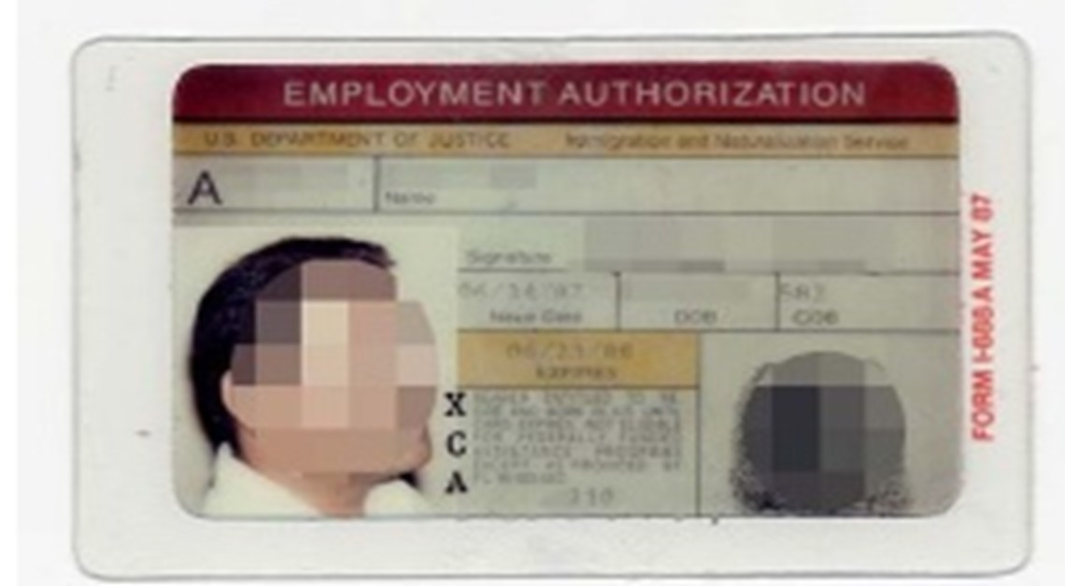
Employment Authorization Card I-668A
Issued by USCIS to applicants for temporary resident status after their interview for Legalization or Special Agricultural Worker status. It is valid until the expiration date stated on the face of the card or on the sticker(s) placed on the back of the card.

Slide 28
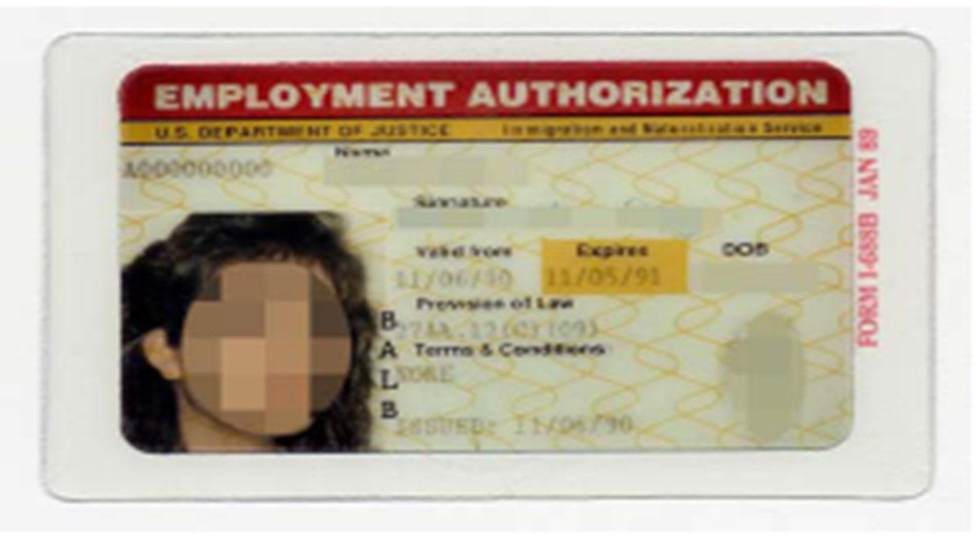
Employment Authorization Card I-668B
Issued by USCIS to aliens granted temporary employment authorization in the United States. The card has gold, interlocking lines across the front. The expiration date is noted on the face of the card.

Slide 29
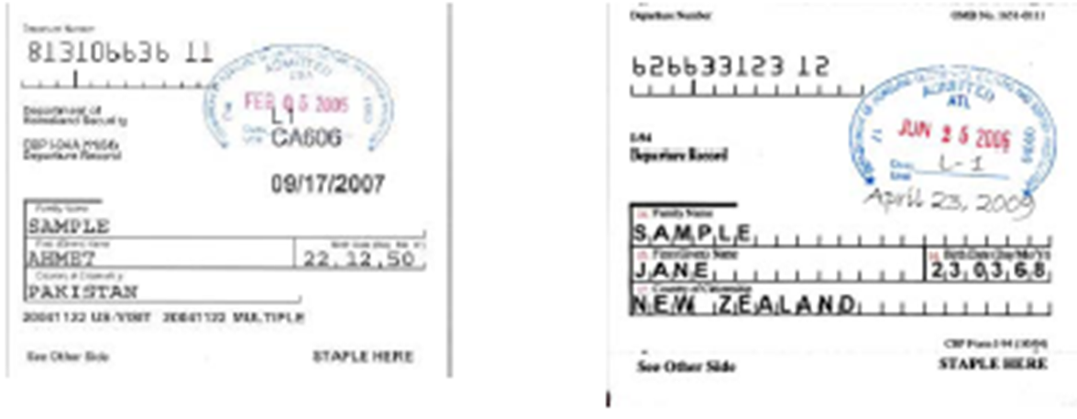
I-94/I-94A Arrival/Departure Record
Arrival-departure record issued by DHS to nonimmigrant aliens and other alien categories. This document indicates the bearer’s immigration status, the date that the status was granted, and when the status expires.

Slide 30
List B – Documents that ONLY establish Identity
Driver’s License or ID Card
  Issued by a state or outlying possession of the United States provided it contains a photograph or information such as name, date of birth, gender, height, eye color, and address.
State Identification Card
  Issued by federal, state, or local government agencies or entitles, provided it contains a photograph or information such as name, date of birth, gender, height, eye color, and address.
School ID with a photograph
Voter’s registration card
U.S. Military card or draft record

Slide 31
List B – Documents that ONLY establish Identity (cont’d)
Military dependent’s ID card
U.S. Coast Guard Merchant Mariner Card
Native American tribal document
Driver’s license issued by a Canadian government authority
For persons under age 18 who are unable to present a document listed above:
School record or report card
Clinic, doctor, or hospital record
Day-care or nursery school record

Slide 32
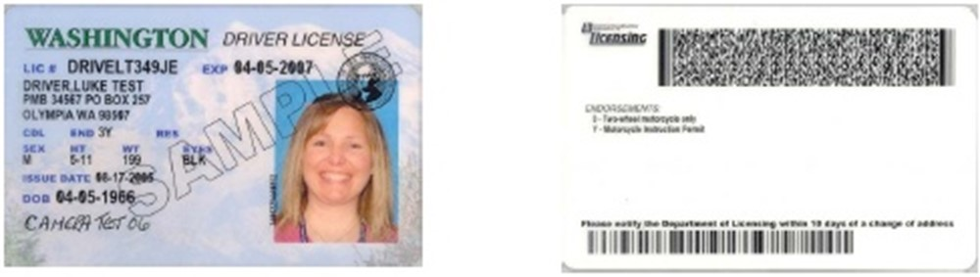
Sample Driver’s License
A driver’s license issued by any state or territory of the United States (including the District of Columbia, Puerto Rico, the U.S. Virgin Islands, Guam, the Northern Mariana Islands, and American Samoa) or by a Canadian government authority is acceptable if it contains a photograph or other identifying information such as name, date of birth, sex, height, color of eyes, and address.

Slide 33
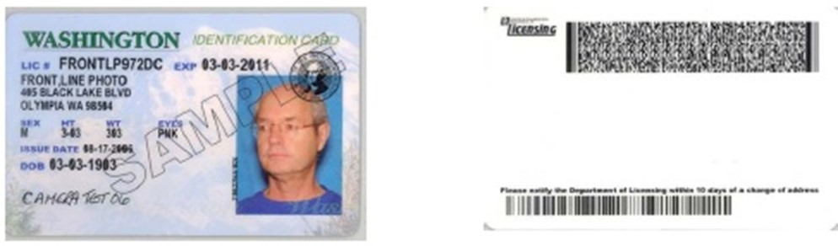
Sample State Identification Card
An identification card issued by any state (including the District of Columbia, Puerto Rico, the U.S. Virgin Islands, Guam, and the Northern Mariana Islands) or by a local government is acceptable if it contains a photograph or other identifying information such as name, date of birth, sex, height, color of eyes, and address.

Slide 34
List C – Documents that ONLY establish Employment Eligibility
U.S. Social Security Card
  Issued by the Social Security Administration (other than a card stating it is not valid for employment)
Certifications of Birth Abroad issued by the Department of State
  Form FS-545 or Form DS 1350
Original or Certified Copy of a Birth Certificate
  Issued by a state, county, municipal authority or outlying possession of the United States bearing an official seal
Native American Tribal Document
U. S. Citizen Identification Card Form I-197
ID Card for use of Resident Citizen in the United States Form
  I-179
Unexpired employment authorization document issued by DHS (other than those listed under List A)

Slide 35
Types of Social Security Cards
Three different types of Social Security cards are issued.
The most common type contains the cardholder's name and number. Such cards are issued to U.S. citizens and U.S. permanent residents.
There are also two restricted types of Social Security cards:
One reads "NOT VALID FOR EMPLOYMENT." Such cards cannot be used as proof of work authorization and are not acceptable as a List C document on the I-9 form.
The other reads "VALID FOR WORK ONLY WITH DHS AUTHORIZATION." These cards are issued to people who have temporary work authorization in the U.S. They can satisfy the I-9 requirement, if they are accompanied by a work authorization card for Direct Hire Authority

Slide 36
Social Security Cards
A Laminated Social Security card is invalid. Metal or plastic reproductions are also not acceptable.
A photocopy or facsimile of a social security card is not allowed.

Slide 37
Social Security Cards
All social security cards issued since October 1983 have been printed with raised (intaglio) printing and the signature line consists of micro line printing of the words "SOCIAL SECURITY ADMINISTRATION" in a repeating pattern.
Micro Line Security is a series of words printed in a very small font. When viewing this covert security feature, to the "naked" eye the words appear as a ruled line. However, when viewed under a magnifying glass, the words become visible.

Slide 38
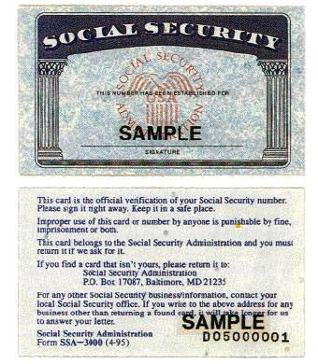

Slide 39
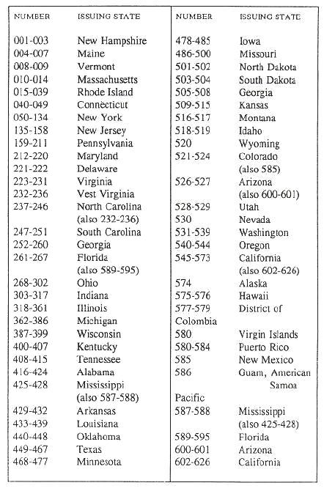
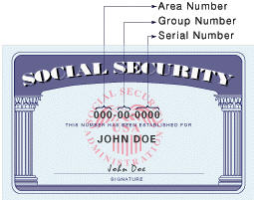
Notes:
The first three digits are called the area number, the next two digits are called the group number, and the last four digits are the serial numbers. The area numbers are assigned on the basis of the zip-code on your SSN application. The group numbers are just for bookkeeping purposes only, they don’t have any specific meaning. In each group number, the serial numbers are allocated consecutively from 0001 to 9999.

Slide 40
Invalid SSNs
Invalid social security numbers include:
Numbers with set of zeroes (as in 000-xx-xxxx, xxx-00-xxxx, xxx-xx-0000),
Numbers starting with 666, numbers from 987-65-4320 through 987-65-4329 - which are marked for advertising, and
Numbers with the starting three digits above 772, which are not yet allocated.

Slide 41

Birth Certificate

Slide 42
Birth Certificate
Birth Certificate must contain:
The full name of the child (including given name).
The date of birth.
The place of birth.
The date the certificate was filed in the registrar's (official custodian's) office, which must be within one year of the birth.
The signature of the registrar.
The authorized seal (may be raised, embossed, impressed, or multicolored) of the registrar's office.
Must be issued by state, county, municipal authority or outlying possession of the US.
A certified copy may be used but still must bear the seal.

Slide 43
Certifications of Birth Abroad issued by the Department of State
Form FS-545 or Form DS 1350
Given as records of birth to US citizens born outside US.
Form FS-545 is issued by Consular office outside US and is usually issued at time foreign birth is reported.
Form DS-1350 is issued by State Dept in Washington DC and usually issued at some later date when a foreign-born US citizen wants documentation of his/her birth abroad.
Certificates must contain raised seal.
Form FS-240 – Report of Birth Abroad of a Citizen of the United States of America – NOT ACCEPTABLE document for verification.

Slide 44
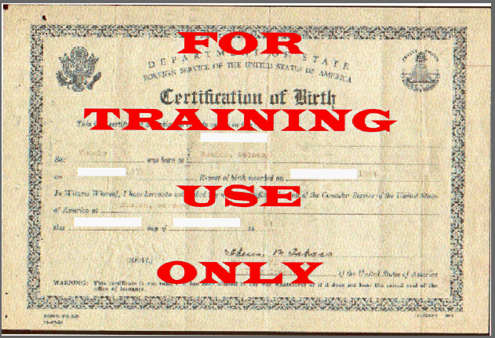
Form FS-545

Slide 45
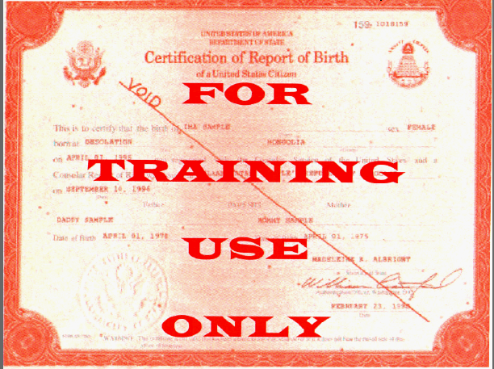
Form DS-1350

Slide 46
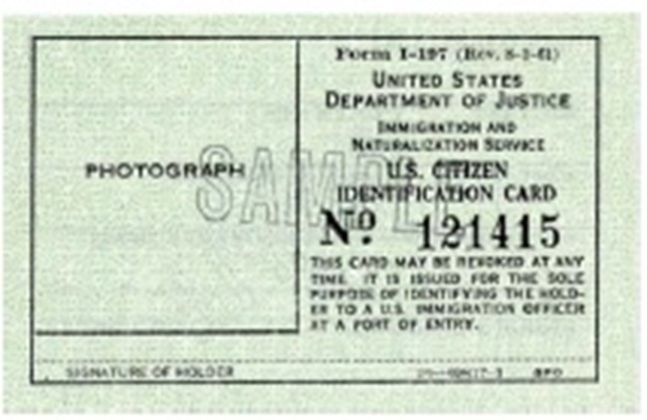
U.S. Citizen Identification Card I-197
Issued by INS to naturalized U.S. citizens. Although this card has not been issued since 1983, it is valid indefinitely.

Slide 47
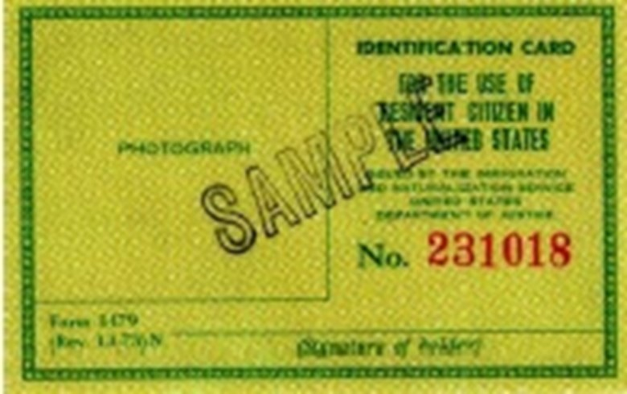
Identification Card for Use of Resident Citizen in the United States I-179
Issued by INS to U.S. citizens who are residents of the United States. Although this card is no longer issued, it is valid indefinitely.

Slide 48
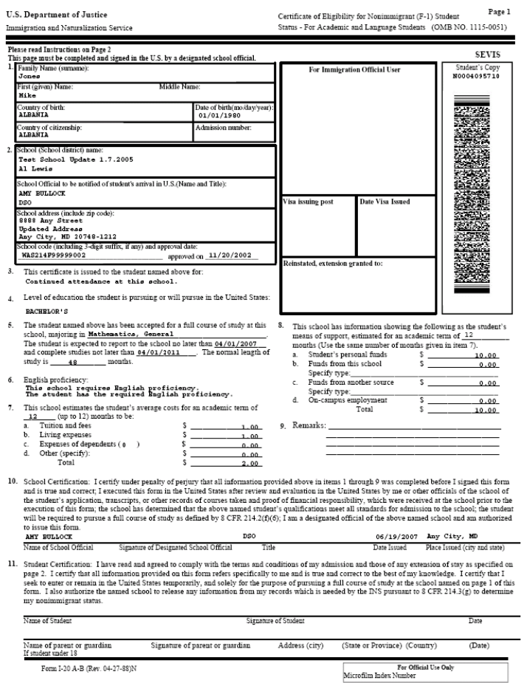
I-20 ID Card Accompanied by a Form I-94
Form I-94 for F-1 nonimmigrant students must be accompanied by an I-20 Student ID endorsed with employment authorization by the Designated School Official for off-campus employment or curricular practical training. USCIS will issue Form I-766 (Employment Authorization Document) to all students (F-1 and M-1) authorized for a post-completion practical training period. (See page 37 for Form I-94/I-94A)
Notes:
Form front

Slide 49
Notes:
Back of form

Slide 50
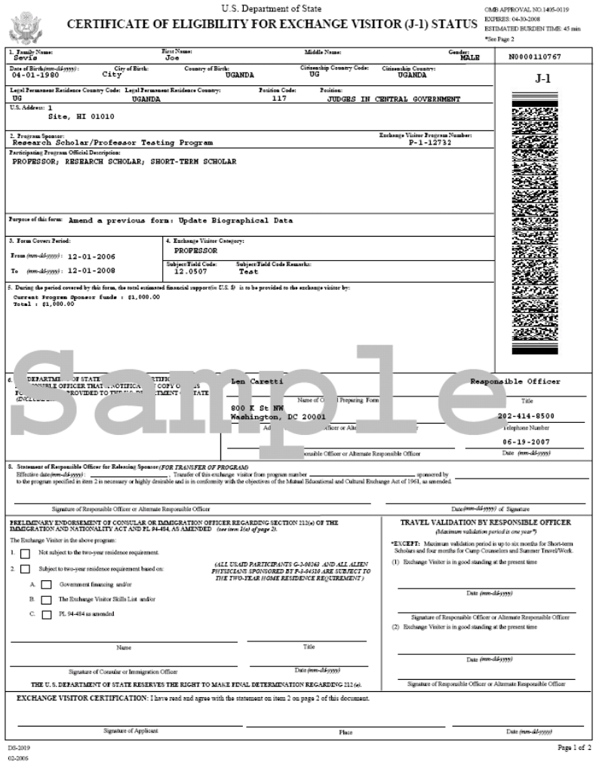
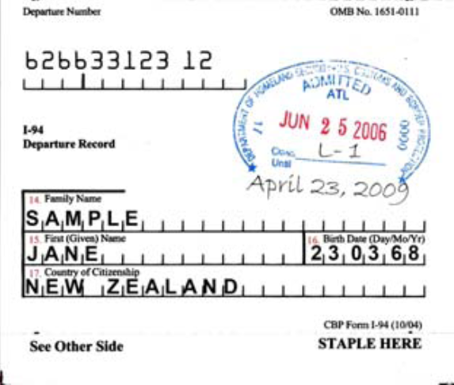
DS-2019 Accompanied by a Form I-94
Nonimmigrant exchange visitors (J-1) must have an I-94 accompanied by an unexpired DS-2019, specifying the sponsor and issued by the U.S. Department of State. J-1 students working outside the program indicated on the DS-2019 also need a letter from their responsible school officer.

Slide 51
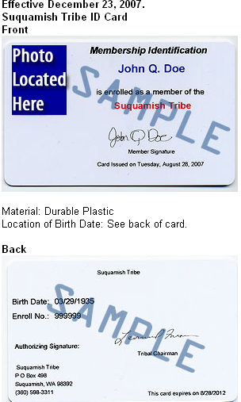
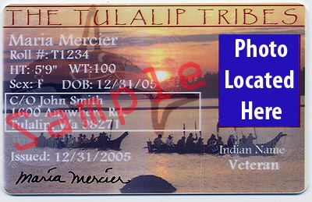
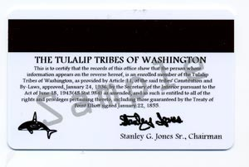
Native American Tribal Card

Slide 52
State Employment Agency Certification 516 INS
The certification shall be transmitted by the state employment agency directly to the employer, personally by an agency official, or by mail.
It must be received by the employer within 21 business days of the date that the referred individual is hired.
In no case shall the certification be transmitted to the employer from the state employment agency by the individual referred.

Slide 53
State Employment Agency Certification
The job order or other appropriate referral form issued by the state employment agency to the employer, on behalf of the individual who is referred and hired, shall serve as evidence, with respect to that individual, of the employer's compliance with the provisions of section 274A(a)(1)(B) of the Act and the regulations issued thereunder.

Slide 54
State Employment Agency Certification
A state employment agency is not required to do an I-9 if the individual is hired for a period of employment not to exceed 3 days in duration.
If the one-stop does it for one employer, then it must be done for all employers who request I-9s on hires less than 3 days duration.
Should a state employment agency choose not to do I-9s for hires under 3 days duration, the agency shall notify employers that, as a matter of policy, it does not perform verifications for individuals hired for that length of time, and that the employers must complete the identity and employment eligibility requirements.
Such notification may be incorporated into the job order or other referral form utilized by the state employment agency as appropriate.

Slide 55
State Employment Agency Certification
The employer must:
Review the identifying information contained in the certification to ensure that it pertains to the individual hired, and
Observe the signing of the certification by the individual at the time of its receipt by the employer.
Update the state employment agency certification in lieu of Form I-9, upon expiration of the employment authorization date, if appropriate, or
No longer employ an individual upon expiration of his or her employment authorization date noted on the certification

Slide 56
State Employment Agency Certification
The employer must:
Retain the certification in the same manner prescribed for Form I-9 which is three years after the date of the hire or one year after the date the individual's employment is terminated, whichever is later; and
Make it available for inspection to officers of the Service or the Department of Labor.

Slide 57
Standards for State Employment Agency Certifications
Be issued on official agency letterhead;
Be signed by an appropriately designated official of the agency;
Bear a date of issuance;
Contain the employer's name and address;
State the name and date of birth of the individual referred;
Identify the position or type of employment for which the individual is referred;
Bear a job order number relating to the position or type of employment for which the individual is referred;

Slide 58
Standards for State Employment Agency Certifications
Identify the document or documents presented by the individual to the state employment agency for the purposes of identity and employment eligibility verification;
State the identifying number or numbers of the document or documents described in paragraph (d)(8) of this section;
Certify that the agency has complied with the requirements of section 274A(b) of the Act concerning verification of the identity and employment eligibility of the individual referred, and has determined that, to the best of the agency's knowledge, the individual is authorized to work in the United States;

Slide 59
Standards for State Employment Agency Certifications
Clearly state any restrictions, conditions, expiration dates or other limitations which relate to the individual's employment eligibility in the United States, or contain an affirmative statement that the employment authorization of the referred individual is not restricted;
State that the employer is not required to verify the individual's identity or employment eligibility, but must retain the certification in lieu of Form I-9;
Contain a space or a line for the signature of the referred individual, requiring the individual under penalty of perjury to sign his or her name before the employer at the time of receipt of the certification by the employer; and
State that counterfeiting, falsification, unauthorized issuance or alteration of the certification constitutes a violation of federal law pursuant to title 18, U.S.C. 1546.

Slide 60
Standards for State Employment Agency Certifications - Retention
Must be retained by a state employment agency for a period of three years from the date that the individual was last referred by the agency and hired by an employer.
A state employment agency may retain a Form I-9 either in its original form, or on microfilm or microfiche.
By the employer, in the original form, and in the same manner and location as the employer has designated for retention of Forms I-9, and for the period of time.

Slide 61
Standards for State Employment Agency Certifications – New Referral
If the one-stop determines that a previously completed Form I-9 pertains to the individual and that the individual remains authorized to be employed in the United States, no additional verification need be conducted, and no new Form I-9 need be completed prior to issuance of a new certification provided that the individual is referred by the agency within 3 years of the execution of the initial Form I-9.

Slide 62
Standards for State Employment Agency Certifications – New Referral
If the one-stop determines that the Form I-9 pertains to the individual but that the individual does not appear to be authorized to be employed in the United States based on restrictions, expiration dates or other conditions annotated on the Form I-9, the agency shall not issue a certification unless the individual can provide the documentation to update the I-9; otherwise, the individual may no longer be referred for employment by the one-stop center.

Slide 63
I-9 Information
Employer Handbook
http://www.uscis.gov/files/form/m-274.pdf
I-9 Form
http://www.uscis.gov/files/form/i-9.pdf
516 INS
http://www.floridajobs.org/PDG/MSFW/516INS_rv2011.pdf

