Slide 1

Introduction to HUDOIG
Low Cost/No cost ways to fight fraud
Special Agent Jamila Davis Region 4 | June 2021

Slide 2
SECTION I
HUDOIG - Mission and Purpose

Slide 3
HUDOIG Mission
As the Office of Inspector General (OIG) for the U.S. Department of Housing and Urban Development (HUD), we remain an independent and objective organization, conducting and supervising audits, evaluations, and investigations relating to the Department’s programs and operations. We promote economy, efficiency, and effectiveness in these programs and operations as we also prevent and detect fraud, abuse, and mismanagement. We are committed to keeping the HUD Secretary, Congress, and our stakeholders fully and currently informed about problems and deficiencies and the necessity for and progress of corrective action.

Slide 4
HUDOIG Values
Collaboration: The commitment to work jointly with HUD, Congress, and our stakeholders for the benefit of all citizens.
Accountability: The obligation and willingness to accept responsibility and account for our actions.
Integrity: The firm adherence to high moral and professional standards, honesty, and fairness in all that we do. Acting with integrity is a core job responsibility for every employee.
Stewardship: The careful and responsible management of that which has been entrusted to our care.
Diversity: The promotion of high standards of equal employment opportunity for employees and job applicants at all levels so that our workforce is reflective of our Country’s citizens

Slide 5
HUDOIG Vision
To promote fiscal responsibility and financial accountability in HUD programs and operations,
improve the execution of and accountability for grant funds,
strengthen the soundness of public and Indian housing programs,
protect the integrity of housing insurance and guarantee programs,
assist HUD in determining whether it is successful in achieving its goals,
look ahead for emerging trends or weaknesses that create risk and program inefficiencies,
produce innovative work products that are timely and of high quality,
benchmark best practices as a means to guide HUD, and
have a significant impact on improving the way HUD does business.

Slide 6

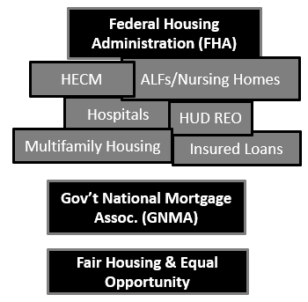
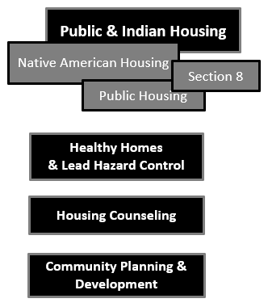
Office of Audit
Office of Investigations
Office of Evaluations
Office of Legal Counsel
Office of Management & Technology
Our Five Main Offices

Slide 7
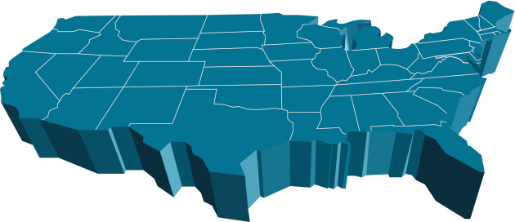






Our Locations

Slide 8
TRIVIA QUESTION
Which government agency is most similar in mission and programs to the U.S Department of Housing and Urban Development?

Slide 9
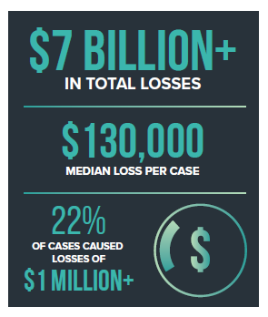
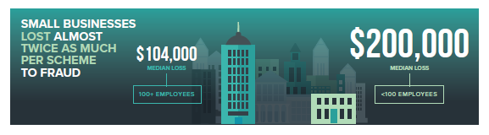
If you don’t have a budget for fraud prevention, you NEED a plan
The Association of Certified Fraud Examiners
Report to The Nations
www.acfe.com/report-to-the-nations

Slide 10
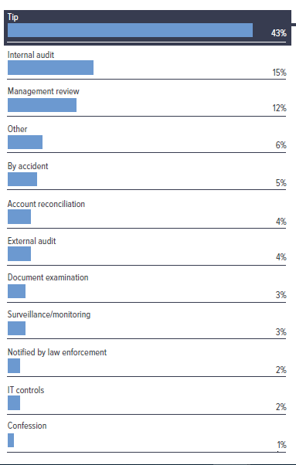
Regardless of the size of organization or the nature of the business, most fraud (43%) was detected as the result of a tip
#1 Way to Detect Fraud
The Association of Certified Fraud Examiners
Report to The Nations
www.acfe.com/report-to-the-nations

Slide 11
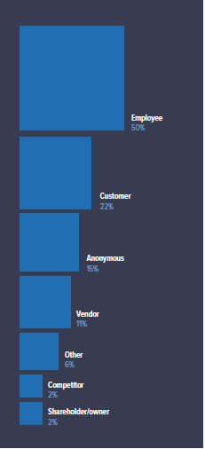
Regardless of the size of organization or the nature of the business, most tips come from:
Employees (50%), Clients/Customers (22%),
Anonymous (15%)
#1 Way to Detect Fraud
The Association of Certified Fraud Examiners
Report to The Nations
www.acfe.com/report-to-the-nations

Slide 12
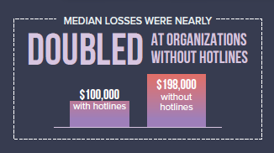
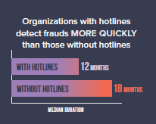
#1 Way to Detect Fraud
Organizations without fraud hotlines lose MORE money to fraud
Organizations without fraud hotlines take longer to discover fraud
The Association of Certified Fraud Examiners
Report to The Nations
www.acfe.com/report-to-the-nations

Slide 13
Suggestion #1: Establish a Fraud Hotline
Establish An Email Account
    Example: Reportfraud@anywherefl.org
    Cost Effective
    Easiest to monitor
    More anonymous, people are more comfortable
Advertise Your Fraud Hotline
  A fraud hotline advertises to clients, vendors and employees that you are serious about detecting & preventing fraud
  Put the hotline on your website, client applications, lobby, conference rooms, email signature lines, newsletters (encourage your community to communicate with you)
Really Think About Who Will Be Responsible for the Hotline
  Make sure that information from the hotline is actually addressed and that the information is handled by the appropriate individual

Slide 14


The Case Of
Bow to the Queen

Slide 15

Who Commits Fraud?
Typical Age:
- 48% are 36-45 years
- Perpetrators Age 56-60 cause the most damage
-Typical Gender:
- 58% Male
- 42% Female
Typical Education:
- 61% have a bachelor’s degree or more
Typical Criminal Background:
- 89% have NEVER been charged or arrested
-Employment Track Record:
- 85% have NEVER been disciplined at work
-Years on the Job:
Typically 6+ or more
Managers and owners do the most damage

Slide 16
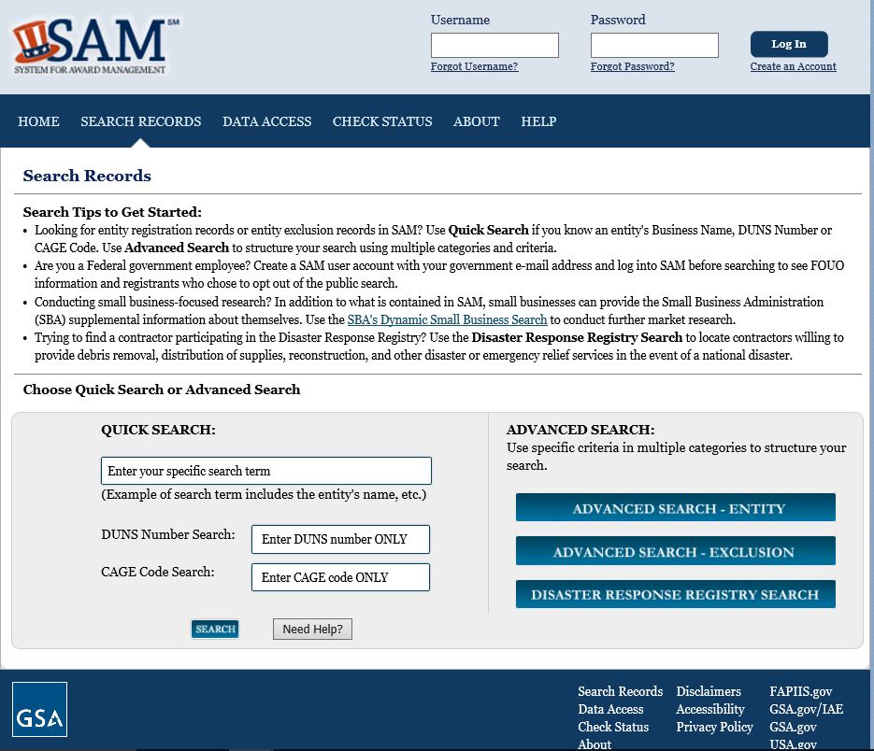
Suggestion #2: Excluded Parties List
www.sam.gov

Slide 17
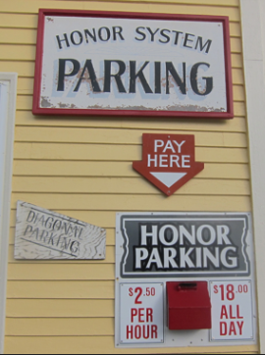

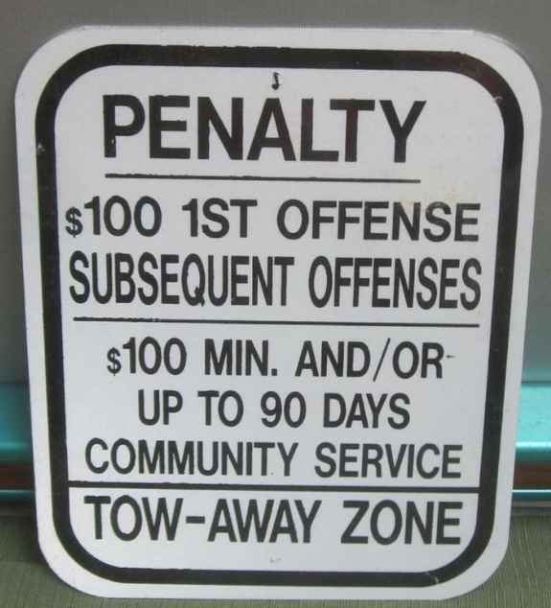

Slide 18


Suggestion #3: Strengthen Your Forms
By signing this application below I certify that the information within this document is true and complete and to the best of my knowledge. I understand that this application may result in my receipt of state and/or federal funds. Further, the submission of false or misleading information to influence a decision regarding the receipt of such funds may be punishable under 18 USC 1001.
X_________________________________________________________
By submitting this application, I certify that the information I have entered is true and complete and to the best of my knowledge. I understand that this application may result in my receipt of state and/or federal funds. Further, the submission of false or misleading information to influence a decision regarding the receipt of such funds may be punishable under 18 USC 1001.
You Must Agree to Continue
Disagree and Exit Application

Slide 19
Suggestion #3: Strengthen Your Forms
Don’t accept incomplete paperwork
Never “write-in” information based on a verbal conversation
Require the personal update of the information (email or written statement)
Make sure people get a copy of what they sign or make it available on-line for their reference
Require a signature to verify that Code of Conduct/Anti-Fraud Policy was given
Landlord/Contractor orientation attendance should be noted

Slide 20
Suggestion #4: Surprise Audits
Advertise to employees and contractors that surprise audits are conducted
  The knowledge that surprise audits occur deters fraud
A surprise audit should truly be a surprise
  Keep it random but consistent
A “surprise audit” can/should extend beyond paperwork
  Call or send a survey to the client to verify the information in the file
  Visit a home to verify an address or occupancy

Slide 21
Suggestion #5: Memorandums of Understanding
Small agencies are often unable to truly segregate duties therefore management reviews are extremely important
  The person that handles client intake should not be the same person that audits the client file
  The book keeper should not also receive and reconcile the bank statements
An agency similar to your own, is best equipped to provide an independent review of your policies, procedures, case management
Consider an MOU with another agency for quality control reviews to mutually review files for each other

Slide 22

The Case of:
“Too Good To Be Bad”

Slide 23
Suggestion #6: Develop an Anti-Fraud Policy
Develop a written policy for employees, clients and vendors
A good fraud policy will:
  Define fraud
  List examples of offenses that are prohibited
    You may not receive gifts or tips from clients/vendors
    You may not offer gifts or tips to employees
    You must report a relationship to a vendor/employee within XX days
    A familial relationship to a subcontractor must be reported & approved
    You may not seek reimbursement for exaggerated expenses or expenses you have not incurred or for expenses reimbursed by another government agency
Require employees and contractors to report suspected fraud
State your commitment to investigate
State your commitment to report instances of fraud, waste and abuse to law
enforcement
Tips on developing a fraud policy can be obtained from the HUDOIG website: http://www.hudoig.gov/sites/default/files/Developing%20a%20Fraud%20Policy_1.pdf

Slide 24
Suggestion #7: Develop a Code of Conduct
Serves as a framework for ethical decision making within an organization
Written collection of the rules, principles, values, and employee expectations
Communication tool that informs internal and external stakeholders about what is valued by a particular organization, its employees and management
Don’t just have it…reference it….often
Provide/review the Code of Conduct with employees at least annually
Agencies with a Code of Conduct visible to the public are more likely to receive information about fraud within or against the organization

Slide 25
Suggestion #8: Surveys
Surveys
  Landlord-tenant and subcontractor-contractor relationships can be hard to pierce when a contract is in place
  Conduct surveys upon move out/contract end
  Contact subcontractors after the completion of the project to verify wages, treatment, professionalism
  Don’t make your surveying a secret

Slide 26
Suggestion #9: Job Rotation/Mandatory Vacation
A significant portion of employee fraud/misconduct is discovered when an employee is on vacation or unexpectedly ill
Require employees to take vacation and to delegate their duties to another individual while they are away
  Don’t save everything for the employee to handle upon their return
Rotate job duties/case loads
  Result: Cross-trained employees
  Result: Missing client information and/or non-compliance with policies/procedures likely to be discovered by employee taking over the job

Slide 27
Suggestion #10: Employee Rewards
Reward/acknowledge employees for their efforts.
Include fraud detection and prevention efforts in employee evaluations.
Rewards don’t have to be financial
  Time Off Award
  Recognition
  Reiterate to employees that attention to fraud awareness contributes to annual ratings, promotion consideration, selection of team leaders etc.
  Challenge employees to not only identify the problem but to also recommend solutions

Slide 28
Suggestion #11: Employee Support Programs
Employees discover loop-holes while performing their routine duties.
  Employees should be encouraged to report their discoveries.
  This information should not be viewed as just “more work” or discounted (“That can’t happen because….”).
  Don’t take offense.
  Make sure employees know how to report fraud
  Ensure information reported by employees is held in confidence
    Employees will not report fraud suspected of co-workers or superiors if they are not certain that the information will be handled appropriately
Allow team leaders/supervisors to allot time for surprise audits and file reviews
  If management does not recognize that time is needed to perform fraud prevention/deterrence efforts – then the perception is that these efforts are not really important to management.

Slide 29
Suggestion #12: Clearly Define Primary Residence
Make the definition of “primary residence” clear
Do you receive all your mail at this address?
Do you receive mail at any other address?
Do you live at any other residence for part of the year?
Did you file taxes last year?
  Any state other than FL?
Do you have homeowner’s insurance?
When was the last time you held homeowner’s insurance?
Do you have any ownership interest in a business?
Do you have any ownership interest in a property other than your primary residence?

Slide 30
Proactive Approach/Run “Discrepancy” Reports
Subscribe to an Information Database
  Lexis-Nexis
  Accurint
Run reports for vendors/landlords/employees/clients with the same address;
Run report of sequential SSNs, EINs
Check incorporation records (sunbiz.org)
  Newly/Recently formed corporations
Take note of returned mail;
Better Business Bureau/Consumer Complaint websites
Ask for and check vendor references
Credit Card Statements

Slide 31
Don’t Hide Dirty Laundry…Clean it!
The occurrence of fraud alone is not a sign of a poorly run or mismanaged agency
The reaction to the occurrence of fraud is what defines the management of an agency
The existence of a fraud policy and proper handling of fraud is itself a deterrent to clients, vendors and employees
Addressing fraud assists with ridding the industry of “bad apples”
Addressing fraud to determine what procedures were violated allows management to truly close gaps to ensure the same fraud will not reoccur.

Slide 32

The Case Of
The Employee of the Year

Slide 33
CONTACT INFORMATION
HUDOIG HOTLINE: 1-800-347-3735 (Toll-Free) and/or HOTLINE@hudoig.gov
SPECIAL AGENT JAMILA DAVIS: 813-228-2160 and/or jdavis@hudoig.gov
AGENCY WEBISTE: www.hudoig.gov

